Slide 1
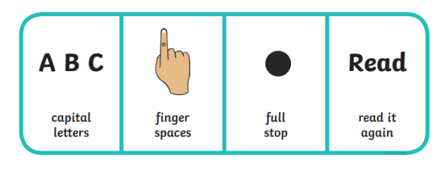
Building More Sentences

Slide 2
What Does a Sentence Need?
Below is a full sentence. Can you tell your partner why?
The lady is shopping for food.
It is a good sentence because:
It starts with a capital letter;
It has finger spaces between each word;
It ends with a full stop;
It makes sense when you read it.

Slide 3
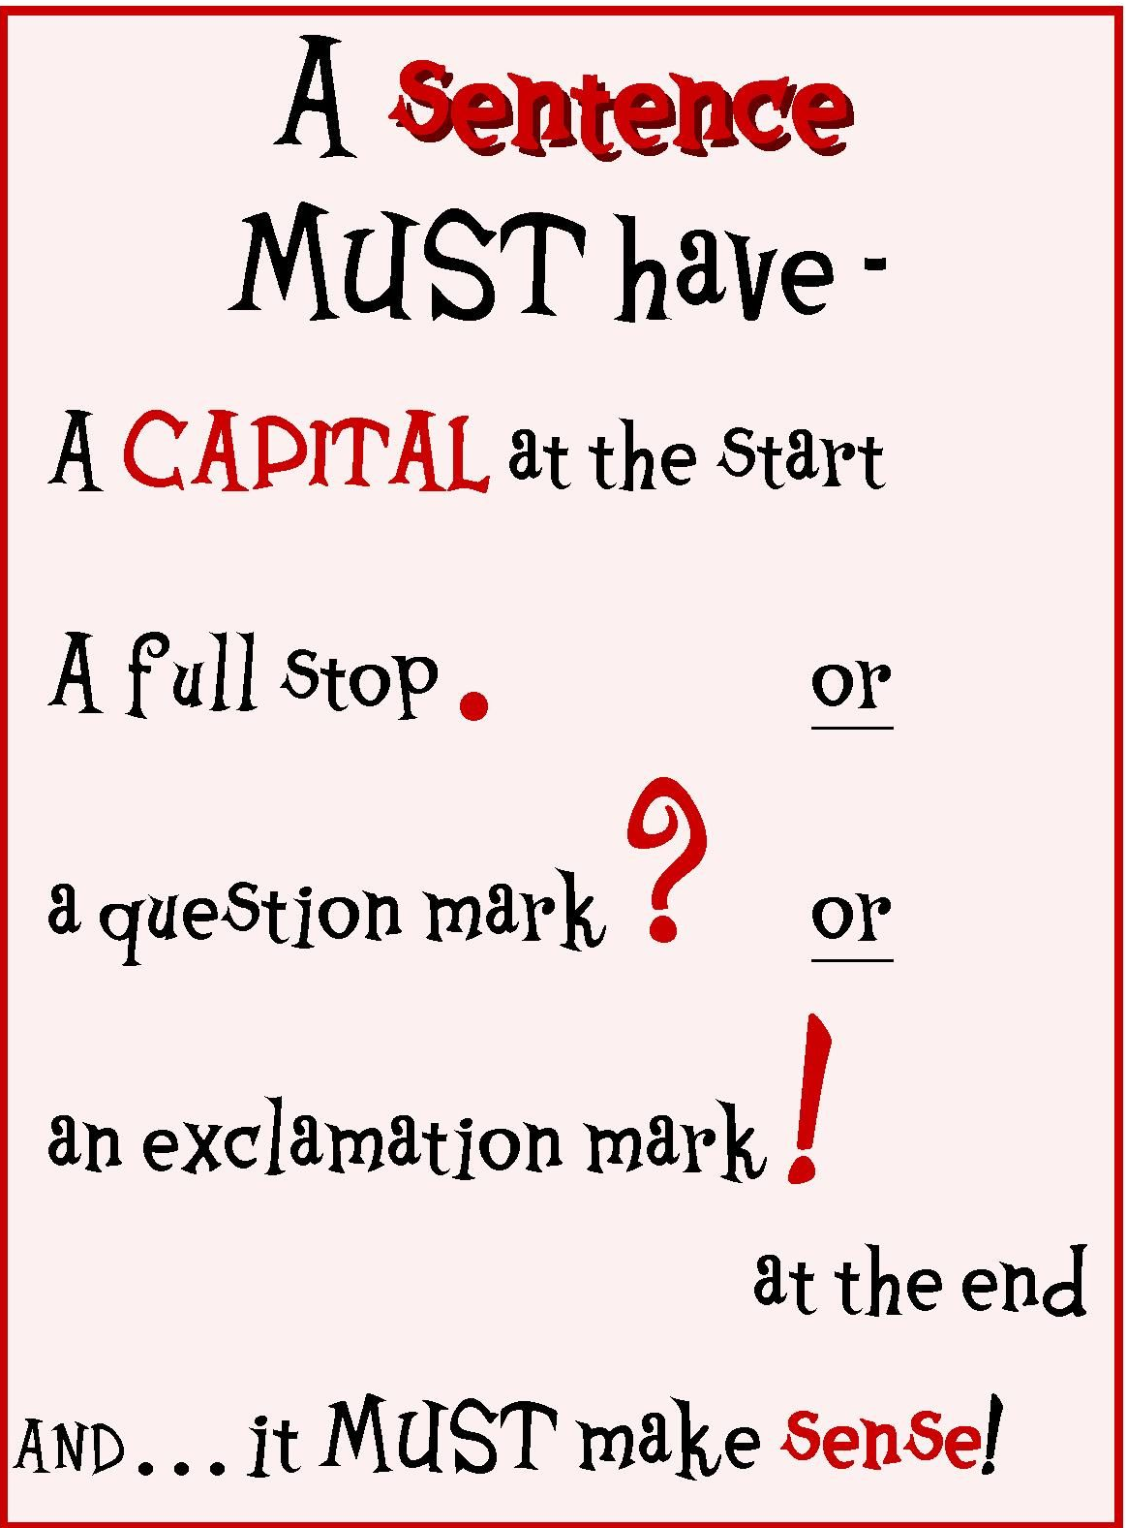

Slide 4
Telling

Slide 7
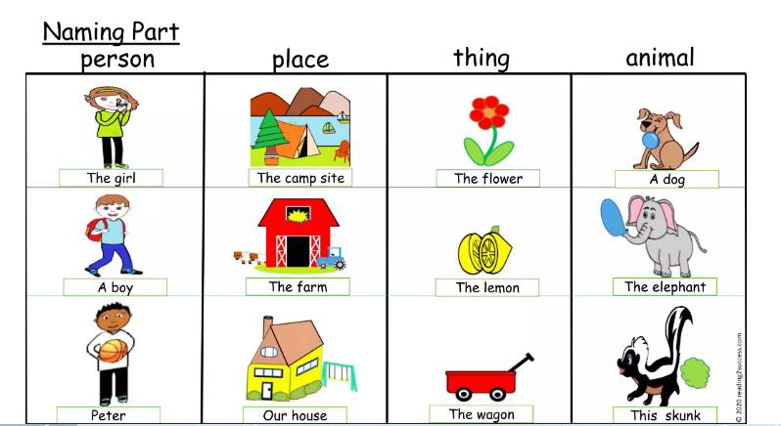

Slide 9
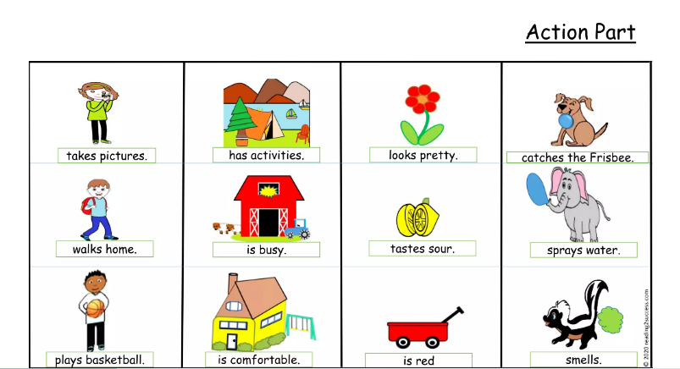
Telling

Slide 10
Telling

Slide 11
Telling

