Slide 2
Hello, I am Bertie Baker.
I love making delicious cakes and biscuits to sell in my bakery. Today, I am having a sale. This means that my cakes and biscuits will have lower prices.
Can you help me to lower my prices by counting back?

Slide 3
This Cake Costs 5p
Click on Bertie to help him lower his prices.
answer
5p count back 2p equals 3p
This price needs to go down by 2p.
5p
3p
0
1
2
3
4
5
6
7
8
9
10

Slide 4
This Cake Costs 10p
Click on Bertie to help him lower his prices.
answer
10p count back 4p equals 6p
This price needs to go down by 4p.
10p
6p
0
1
2
3
4
5
6
7
8
9
10

Slide 5
This Cake Costs 8p
Click on Bertie to help him lower his prices.
answer
8p count back 5p equals 3p
This price needs to go down by 5p.
8p
3p
0
1
2
3
4
5
6
7
8
9
10

Slide 6
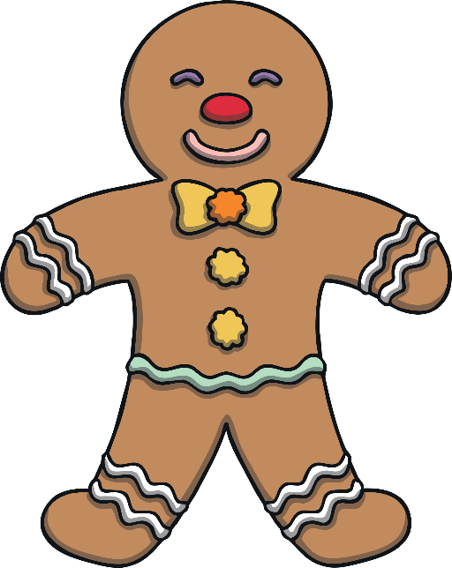
This Biscuit Costs 12p
Click on Bertie to help him lower his prices.
answer
12p count back 2p equals 10p
This price needs to be 2p less.
12p
10p
0
1
2
3
4
5
6
7
8
9
10
11
12
13
14
15
16
17
18
19
20

Slide 7
This Biscuit Costs 16p
Click on Bertie to help him lower his prices.
answer
16p count back 3p equals 13p
This price needs to be 3p less.
16p
13p
0
1
2
3
4
5
6
7
8
9
10
11
12
13
14
15
16
17
18
19
20

Slide 8
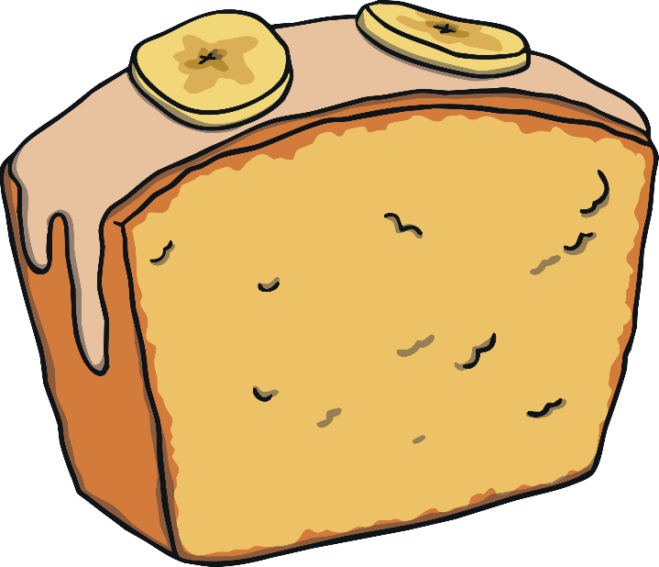
This Cake Costs 14p
Click on Bertie to help him lower his prices.
answer
14p count back 5p equals 9p
This price needs to go down by 5p.
14p
9p
0
1
2
3
4
5
6
7
8
9
10
11
12
13
14
15
16
17
18
19
20

