Slide 1
English

Slide 2
Lessons Objectives
By the end of the lesson, learners will be able to :
read the new words.
read the new words.
read the new words.
understand what conjunctions mean
01
identify the meaning for the new words.
identify the meaning for the new words.
identify the meaning for the new words.
02
use the new vocabulary in their writing.
03
use the new vocabulary in their writing.
04

Slide 3
Revision Power Point

Slide 4
cunning
Cunning: Sly
He is a cunning old fox.

Slide 5
brave
brave: courage
Super heroes are brave.

Slide 6
wicked
wicked: evil
Cindrella’s step sisters were wicked girls.

Slide 7
clever
clever: smart
He is clever in Science, and Math.

Slide 8
awful
awful: dreadful
She is an awful girl for kicking the blocks.

Slide 9
terrible
terrible: bad
.
I heard a terrible
noise outside my window.

Slide 10
elated
elated: excited
I am elated because today is my Birthday.

Slide 11
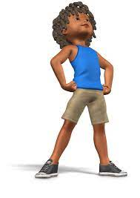
proud
proud: pleased
He is proud of his marks in Science, and Math.

Slide 12
fur
Thick, soft hair that grows on mammals
Rabbits have soft white fur.

Slide 13
jaws
Two bones in which teeth are attached to .
Jaws are the strongest bones.

Slide 14
offspring
A person’s children or an animal’s young.
The mom takes very good care of her offsprings.

Slide 15
fierce
Angry, and aggressive
He looked so fierce I was afraid of him

Slide 16
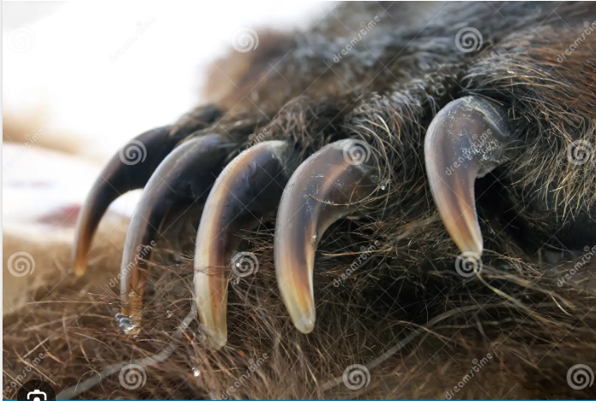
claws
The sharp curved nails at the end of each of the toes of some animals and birds

Slide 17
Can you write the words in your copybooks?

Slide 18
Lessons Objectives
Objectives check:
read the new words.
.
01
identify the meaning of the new words.
02
03
use the new vocabulary in their writing.
04

