Slide 2
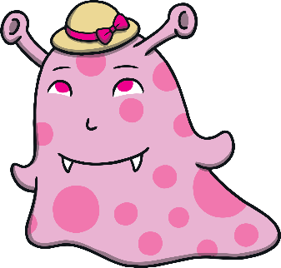
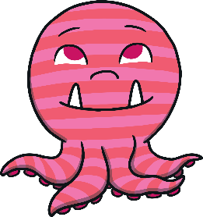
Which box should the blue monster be sorted into?
Has a Hat
Does Not Have a Hat
Well done, I do not have a hat.
Try again.
next

Slide 3
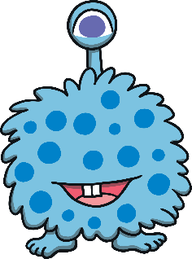
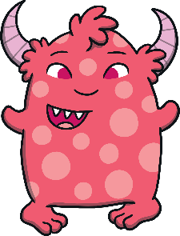
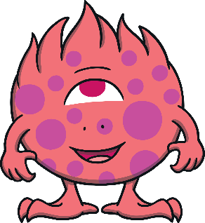
Which box should the pink monster be sorted into?
One Eye
Two Eyes
Well done, I have two eyes.
Try again.
next

Slide 4
Which box should the blue monster be sorted into?
Spotty
Stripy
Well done, I am spotty.
Try again.
next

Slide 5
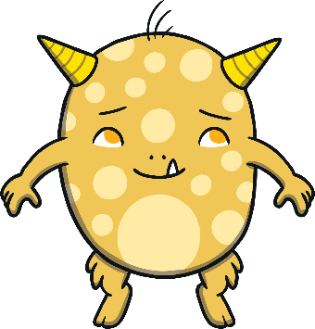
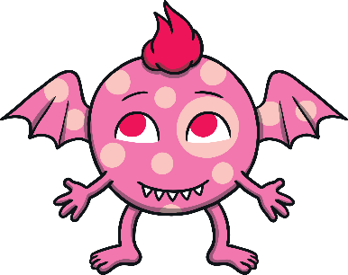
Which monster will complete the sorting diagram?
Pink
Not Pink
?
Well done!
Try again.
Try again.
next

Slide 6
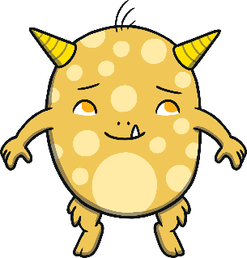
Which monster will complete the sorting diagram?
Hair
No Hair
?
Well done!
Try again.
next

Slide 7
Feet
No Feet
Look at the monsters.
answer
What do you notice about the monsters in the first box? What is the same about them?
What do you notice about the monsters in the second box? What is the same about them?
How have the monsters been sorted?
next

Slide 8
Three Teeth
Two Teeth
Look at the monsters.
answer
What do you notice about the monsters in the first box? What is the same about them?
What do you notice about the monsters in the second box? What is the same about them?
How have the monsters been sorted?
next

Slide 9
How Could You Sort These Monsters? Think of ways you could sort them into two groups.

Slide 10
Well done for sorting all of the monsters!

