Slide 2
Meet Rectangle
My name is Rectangle. I am a super shape!
My special superpower is that I have 4 straight sides and 4 corners.
Click on me to see my 4 straight sides and 4 corners.
Next

Slide 3
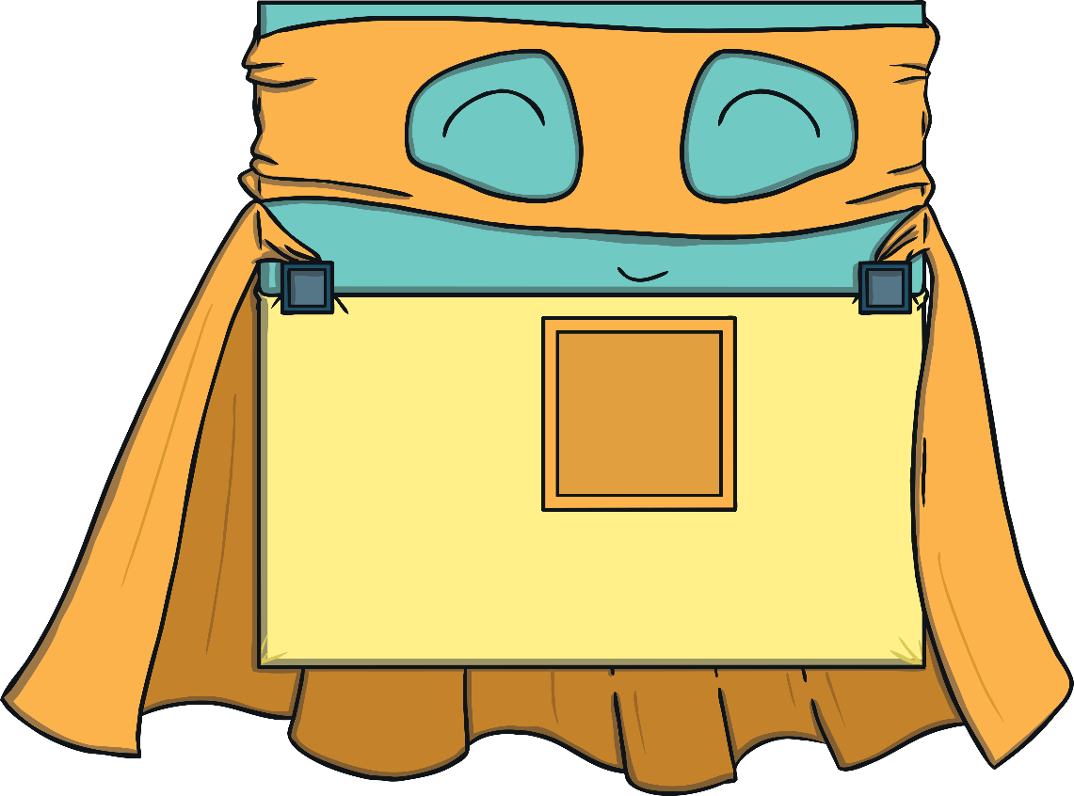
Meet Square
My name is Square. I am a super shape!
I also have 4 straight sides and 4 corners, but my straight sides are all the same length.
Click on me to see my 4 straight sides and 4 corners.
Next

Slide 4
Together, we form part of the League of Shapes! We fight crimes and help to protect shapes with 4 sides from the Shape Catcher! Do you think you can help us?
Next

Slide 5
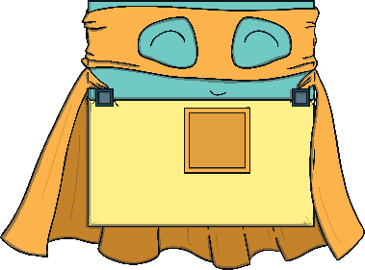
Our first mission is to find all the shapes with 4 sides. Can you find them all?
Well done! You helped to find all the shapes with 4 sides. Do all of the shapes with 4 sides look the same?
Next

Slide 6
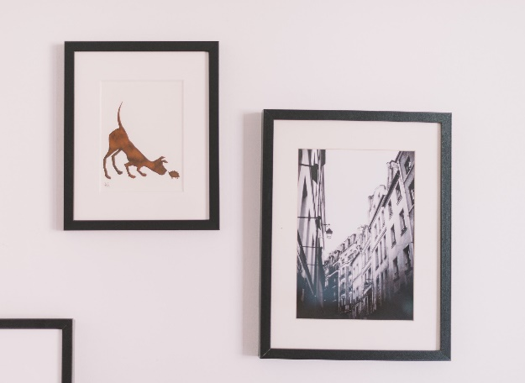
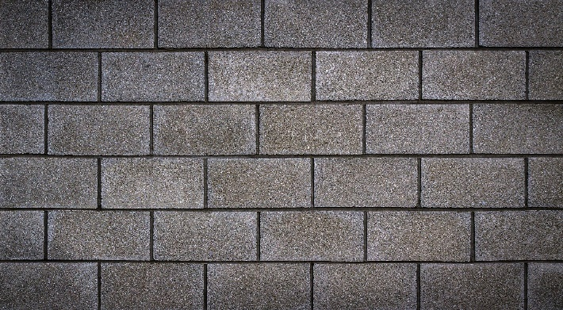
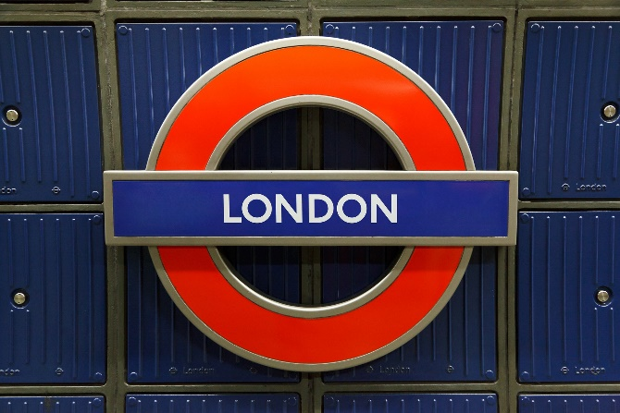
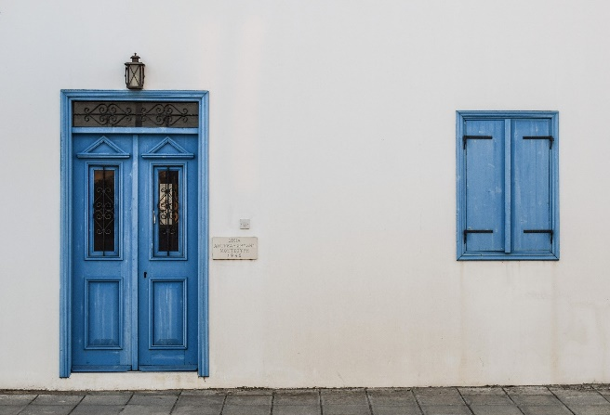
Rectangle has heard that the Shape Catcher is trying to steal all of the rectangle shapes from the town. Do you think you could find all the rectangles so that Rectangle can protect them?
Click on all the rectangle shapes and I will protect them!
Next

Slide 7
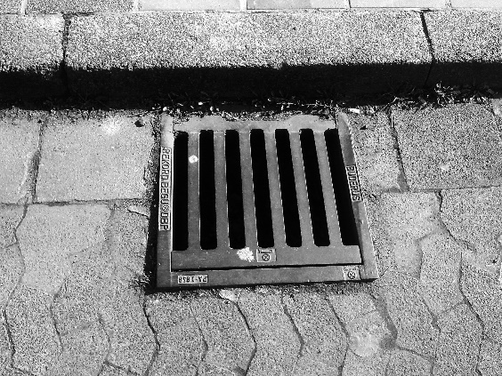
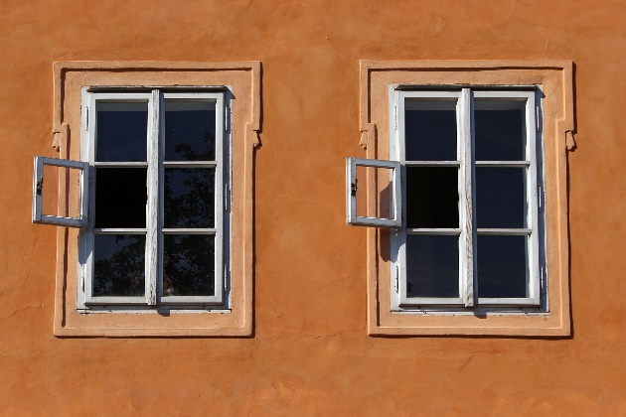
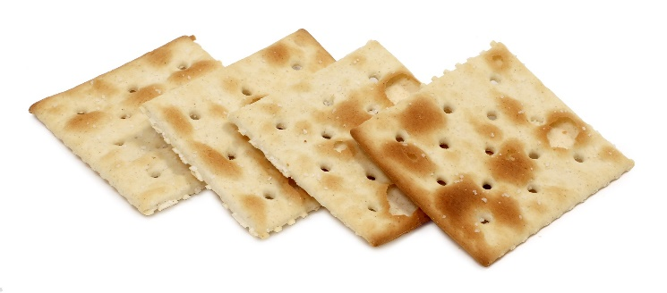
Well done! You protected all the rectangle shapes but now the Shape Catcher is planning on stealing the squares.
Can you click on the squares?
Do you remember what is special about my sides?
Next

Slide 8
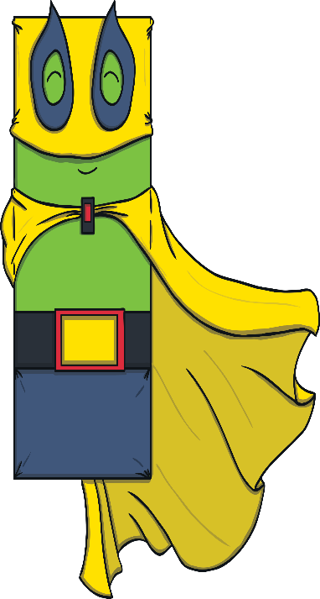
Oh no! The Shape Catcher has caught Rectangle! He is stretching him and squashing him.
Oh poor Rectangle! Don’t worry though, Rectangle is not hurt. He was always a rectangle, even when he looked a little different. As long as he still has 4 sides and 4 corners, he’s still a rectangle.
Am I still a rectangle?
Am I still a rectangle?
Am I still a rectangle?
Am I still a rectangle?
Next

Slide 9
Now the Shape Catcher has caught Square! Poor Square is being spun around and around.
Don’t worry, Square will be fine. Even when Square is turned around, she is still a square. She still has 4 sides, that are the same size and 4 corners. Square might be a bit dizzy though!
Next

Slide 10
At last Rectangle and Square have escaped the Shape Catcher’s clutches. Now they need to save all the shapes with 4 sides.
Can you click on all the shapes with 4 sides for us?

Slide 11
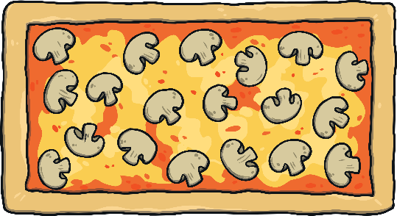
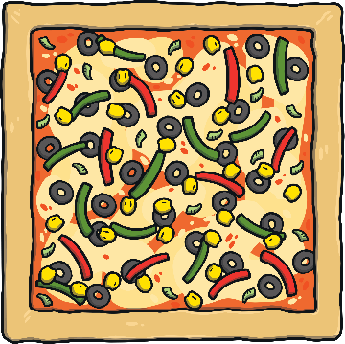
Another successful day, fighting crime and protecting the all the 4-sided shapes of the world. Well done Square and Rectangle! I think our 4-sided superheroes deserve a treat. Which pizza do you think belongs to which superhero?
Thank you for helping the League of Shapes. We look forward to fighting crime with you another day!

