Slide 1
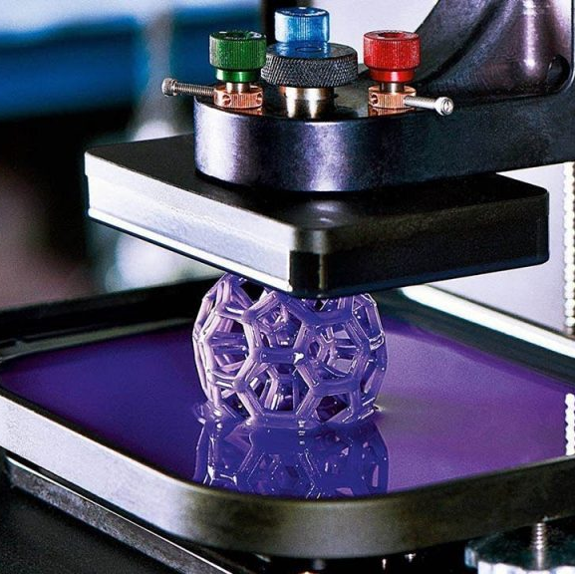
Unit 1 Lesson 3 What do I think about 3D printing??
This Photo by Unknown author is licensed under CC BY-NC.

Slide 2
Read the infographic. what it is about?
What fraction of people don’t think that all homes in the future will be 3D printed ?
What fraction of people wouldn't consider living in a 3D printed home?

Slide 3
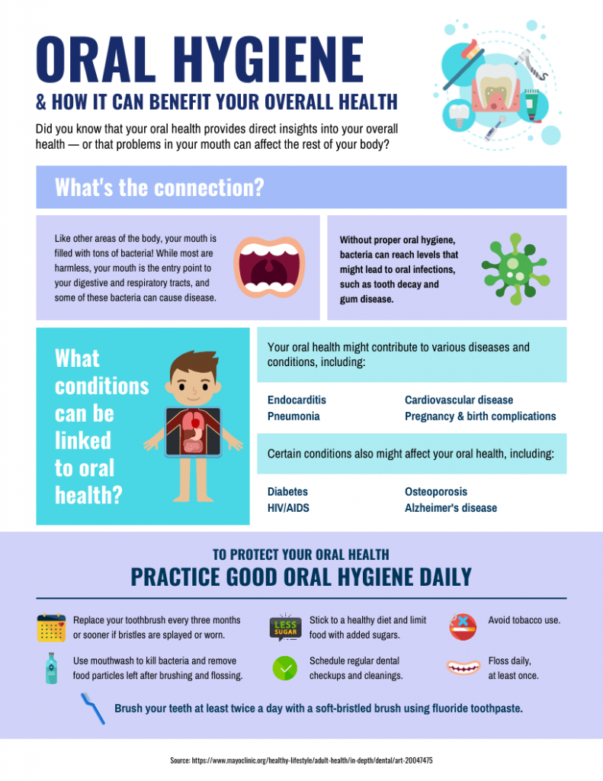
Infographic
A text with pictures, numbers and symbols to help us understand information about a topic.

Slide 4
•1-Discruptive title and subheads .
•2-Eye -Catching graphics .
•3-Bold appropriate color scheme
•4-Specially formatted facts.

Slide 6
Key words that help you to identify someone's opinion
I don’t want to…..
I ‘m not sure…..
I don’t love to …..
I I’m interested in ….
Because I love…..
This Photo by Unknown author is licensed under CC BY.

Slide 7
Answer Himari's question (Group Discussion)

