Slide 2
Learning Intention
To understand the language of before and after.
Success Criteria
I can identify the numbers before and after to 100.
I can identify the numbers before and after when skip counting.
I can identify before and after in a pattern or sequence.

Slide 3
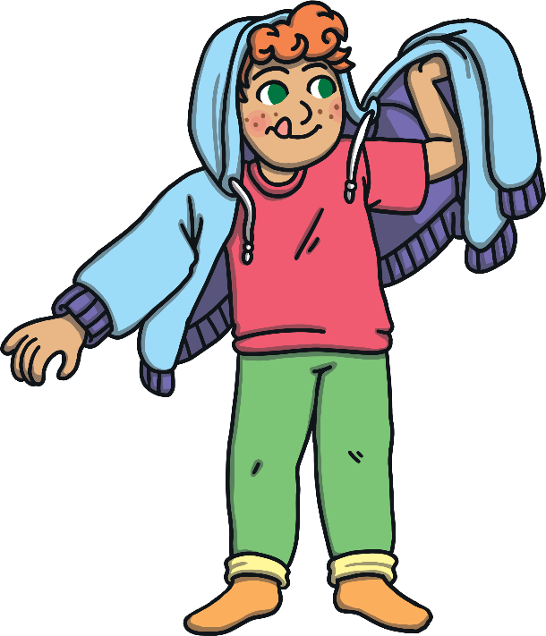
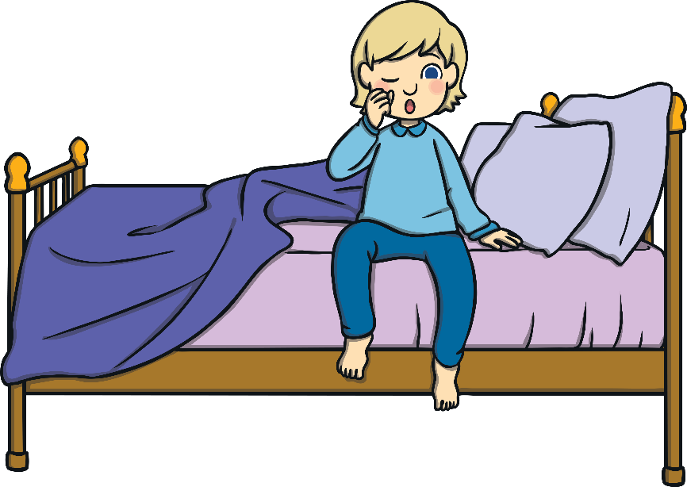
Before and After
What do the words ‘before’ and ‘after’ mean?
We could say before I brushed my teeth in the morning, I got out of bed.
After I brushed my teeth, I got dressed.

Slide 4
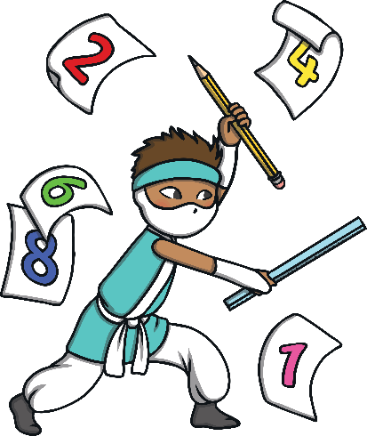
Before and After Numbers to 20
We can also use the language ‘before’ and ‘after’ when using numbers.
What number comes before 12?
0 1 2 3 4 5 6 7 8 9 10 11 12 13 14 15 16 17 18 19 20
Answer

Slide 5
Before and After Numbers to 20
What number comes after 12?
0 1 2 3 4 5 6 7 8 9 10 11 12 13 14 15 16 17 18 19 20
Answer

Slide 6
Before and After Numbers to 20
Lets Practise!
On your whiteboard write down the numbers before.
15
- 14
13
- 12
6
- 5
16
- 15
20
- 19
12
- 11
11
- 10
5
- 4
Answer

Slide 7
Before and After Numbers to 100
Lets Practise!
On your whiteboard or workbook write down the numbers after.
19
- 20
5
- 6
10
- 11
16
- 17
15
- 16
14
- 15
9
- 10
12
- 13
Answer

Slide 8
Before and After Number Patterns
We can also use ‘before’ and ‘after’ when we are using number patterns or sequences.
Lets skip count in 2s from 2 to 20.
0 1 2 3 4 5 6 7 8 9 10 11 12 13 14 15 16 17 18 19 20

Slide 9
Before and After Patterns
We can also use ‘before’ and ‘after’ when looking at picture patterns
What shape would come after or next in the sequence?

Slide 10
Before and After Patterns
What shape comes before the hexagon?
What shape comes before the heart?

