Slide 1
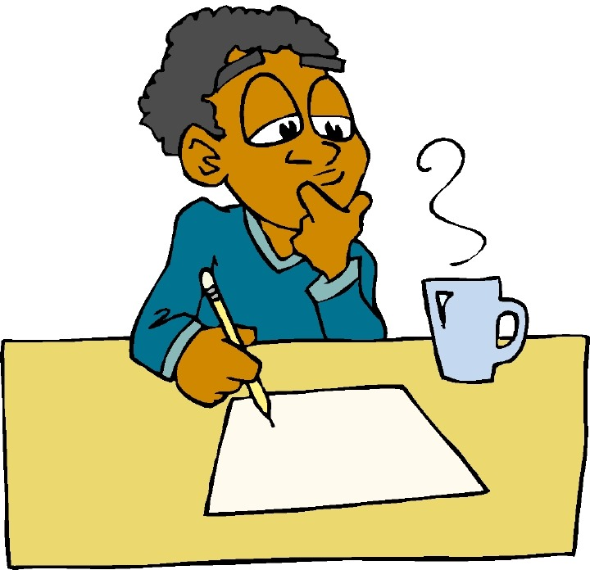
English

Slide 2
Lessons Objectives
By the end of the lesson, learners will be able to :
describe the setting of the story
read the new words.
read the new words.
understand what conjunctions mean
01
describe the time of the story
02
describe the place of the story
03
use the new vocabulary in their writing.
04

Slide 3
Sports Day Journal
This is a journal of what you did on sports day.
In this journal, you can record activities you have done, and how
you felt about being part of a team.
You can record things you have seen, heard and felt while doing
each activity
Draw your observations and write about them.

Slide 4
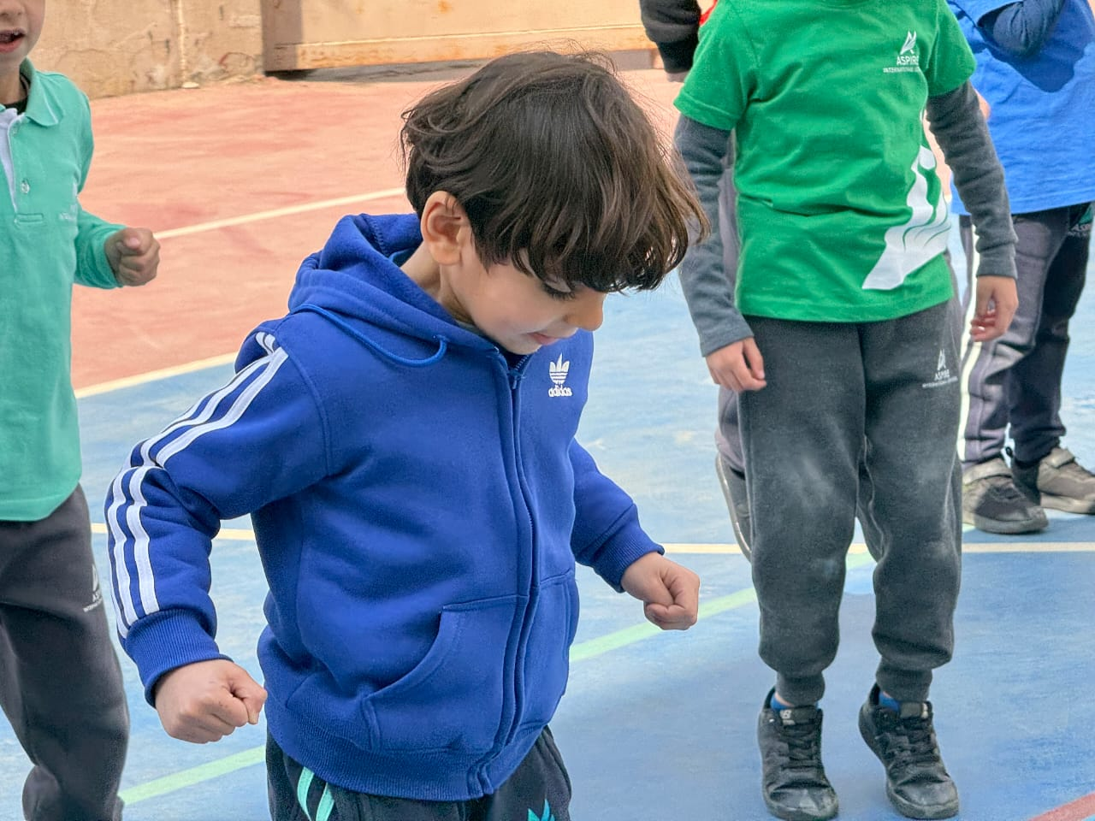
Activities Done in the sports day.
1. Zumba Dance
Starting the sports day with a fun zomba dance
Dancing to the beat of the music

Slide 5
Hoola Hoop Race With Our Parents
Mum and I are getting ready for the race.
Dad is trying his best to win the race

Slide 6
My mum and I working together in a team
I’m having an amazing day with my mum.

Slide 7
A huge hug from my kind dad

Slide 8
Jumping the Hurdles
I’m getting ready to run
I’m running back to my teammates

Slide 9
I’m almost to the finish line
I’m running as fast as I could

Slide 10
I jumped thehurdles it was fun
I will jump the hurdles

Slide 11
Hockey Game
Trying to keep the ball in its place is hard

Slide 12
Having fun rolling the ball with the stick

Slide 13
Its a challange rolling the ball.

Slide 14
Team work is great
Team work is great and we are having fun helping each other.

Slide 15
The Best Day Ever
Use the following connectives:
then, because, and
Feelings
Sad
happy
angry
tierd
Who was with you?
What did you do?
When was your best time ever?
Where did you enjoy the most games?
How did you feel?

Slide 16
Lessons Objectives
By the end of the lesson, learners will be able to :
describe the setting of the story
read the new words.
read the new words.
understand what conjunctions mean
01
describe the time of the story
02
describe the place of the story
03
use the new vocabulary in their writing.
04

