Slide 2
Aim
To understand what Eid Al-Fitr is and how we celebrate it.
Success Criteria
I can identify the meaning of Eid Al-Fitr.
I can explain how we know when Eid Al-Fitr is here.
I can explain the meaning of Zakat Al-Fitr and who we should give to.
I can list some of the things we do on Eid Al-Fitr.

Slide 3
What Is Eid Al-Fitr?
Eid Al-Fitr means ‘the feast of breaking the fast’. Eid Al-Fitr is a celebration that happens when Ramadan ends.

Slide 4
Do You Remember?
What is the name of the month that comes after Ramadan?
?
Shawwal

Slide 5
Eid Al-Fitr
The first day of the month of Shawwal is the first day of Eid Al-Fitr.
In Eid Al-Fitr we celebrate completing our fast and we thank Allah for the strength and blessings He has given us throughout Ramadan.

Slide 6
How Do We Know When Eid Al-Fitr Is Here?
We know that Eid Al-Fitr is here when we see a new crescent moon in the sky.
Each month of the Islamic calendar begins with a new moon. When we see the new moon of the month of Shawwal we know it is the first day of Eid!

Slide 7
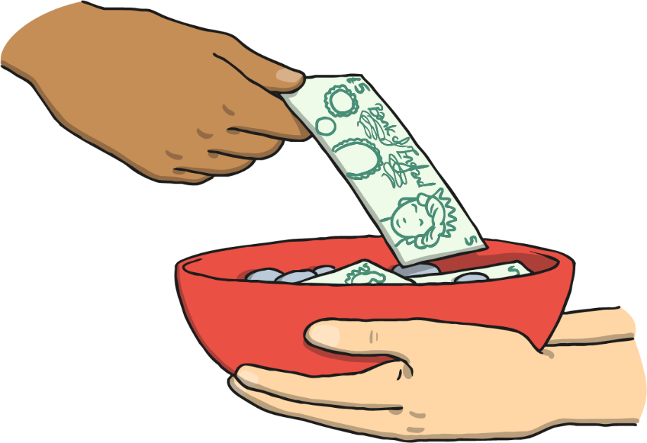
What Is Zakat Al-Fitr?
Eid Al-Fitr is a very special time when family and friends get together to have fun and celebrate. It is also a time to give charity.
Zakat Al-Fitr is an obligatory charity that we give at the end of Ramadan and before Eid Al-Fitr prayer at the latest.

Slide 8
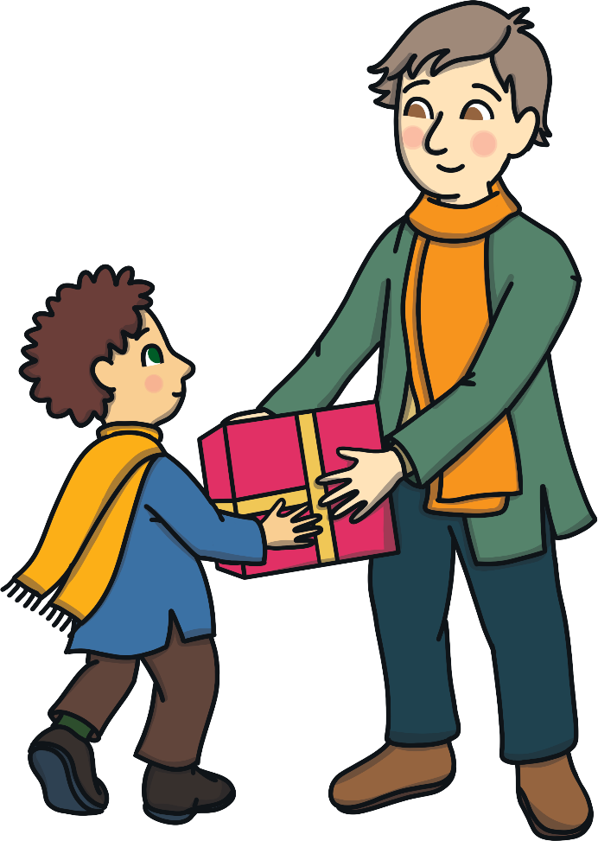
Who Should We Give Zakat Al-Fitr to?
Zakat Al-Fitr can be given as food or money to people who are less fortunate so that they can enjoy and celebrate Eid Al-Fitr.

Slide 9
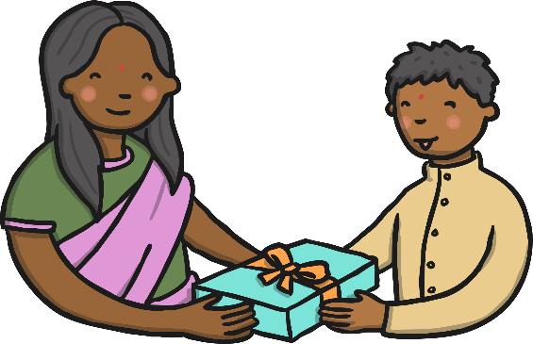
What Do We Do on Eid Al-Fitr?
1
We take a shower.
v
2
We get dressed in our new clothes.
3
We come together for the Eid prayer.
4
We visit family and friends.
5
We exchange gifts and Eid greetings cards.

Slide 10
Eid Al-Fitr around the World
Muslims all over the world celebrate Eid in different ways.
How do you celebrate Eid in your country?
Research another country and collect some pictures that show how Muslims celebrate Eid Al-Fitr there!

Slide 11
Reflection
1
What is the meaning of Eid Al-Fitr?
v
2
How do we know when Eid Al-Fitr is here?
3
What is Zakat Al-Fitr? Who do we give it to? Why?
4
What do we do in Eid Al-Fitr?
5
What other countries’ Eid celebrations would you like to learn about?

Slide 12
Aim
To understand what Eid Al-Fitr is and how we celebrate it.
Success Criteria
I can identify the meaning of Eid Al-Fitr.
I can explain how we know when Eid Al-Fitr is here.
I can explain the meaning of Zakat Al-Fitr and who we should give to.
I can list some of the things we do on Eid Al-Fitr.

