Slide 2
Subtraction
Subtraction means to take away from or make smaller.
-
=
Click here for the answer!

Slide 3
Subtraction Words
Some phrases that mean subtraction are:
Find the difference
Take away
-
Subtract
Minus
The answer to a subtraction problem is called the difference.

Slide 4
How to Subtract
5 - 2 =
First, draw five dots.
Next, cross out two dots.
Finally, count how many dots are left.
1
2
3
There are three dots left so, 5 - 2 = 3

Slide 5
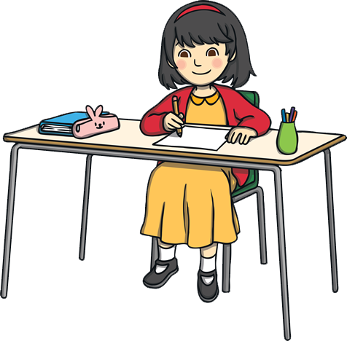
Quick Check
Click here for answers!
Try these problems:
4 - 2
2
=
6 - 5
1
=
7 - 3
4
=
8 - 4
4
=

Slide 6
How to Check Subtraction
To check your answer:
Take the difference (your answer) and add it to the minuend (the amount being subtracted or taken away).
Does the sum equal the original amount?
If yes, then your answer was correct.
3 + 2 = 5

Slide 7
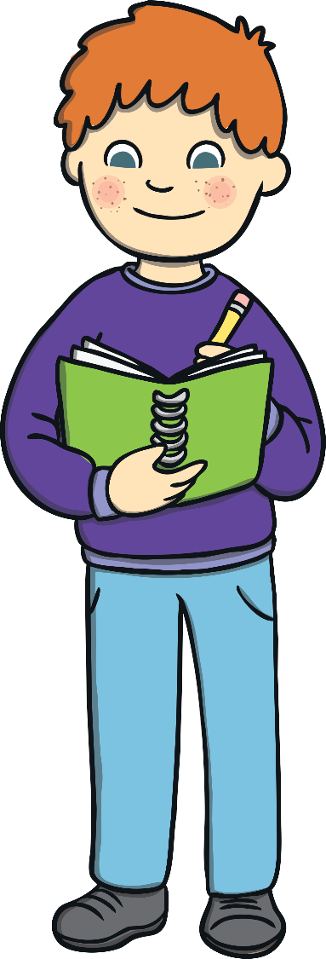
Quick Check
Click here for answers!
Check the answers to these subtraction problems.
Are they correct?
8 - 5
3
=
6 - 3
5
=
5 - 4
1
=
7 - 5
3
=

Slide 8
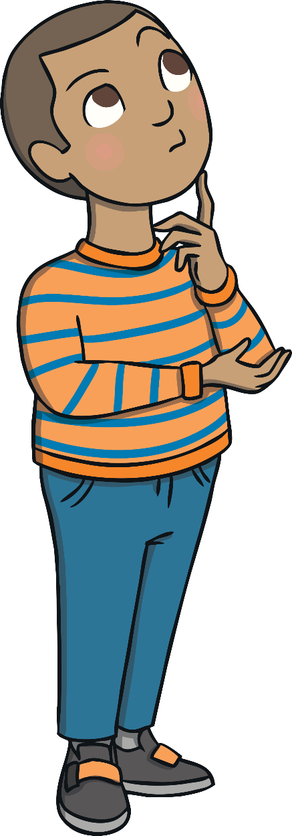
Fact Memorization
It is very helpful to memorize subtraction facts.
This way you can work faster.
Make sure to practice subtraction and addition facts every day.

Slide 9
Review
?
What does subtraction mean?
?
What is the answer to a subtraction problem called?
-
?
How do you subtract?
?
How do you check the answer to a subtraction problem?

Slide 10
Practice Problems
Click here for answers!
1
2
9 - 3
=
6
7 - 1
=
6
3
5 - 4
=
1
10 - 5
=
5
4 - 2
=
2
6 - 5
=
1

