Slide 1
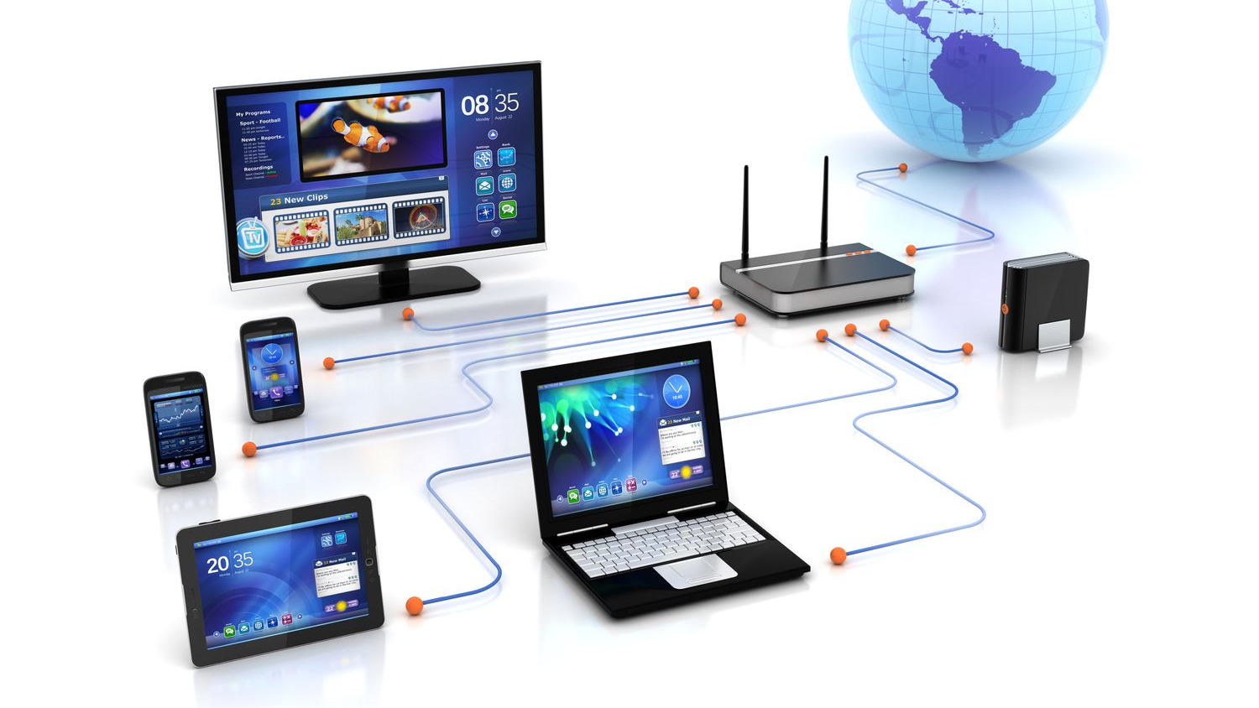
Networks

Slide 2
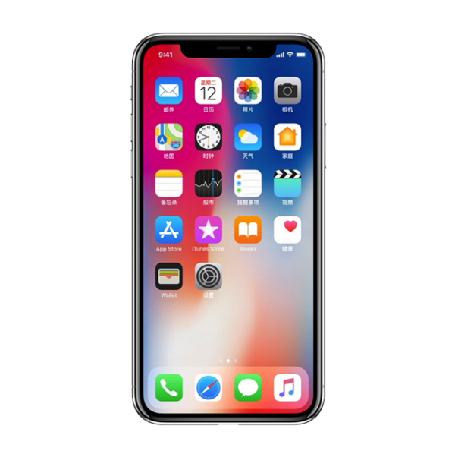
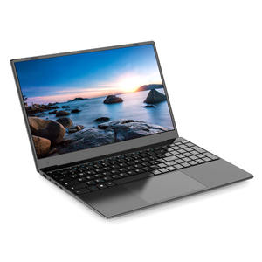
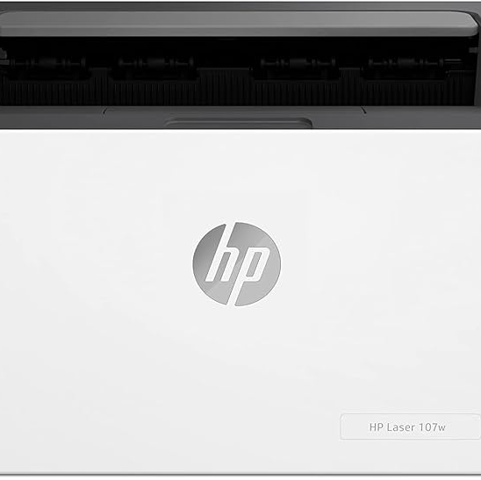
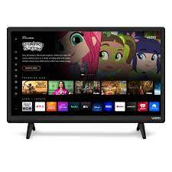
Devices that use to connect to a network wirelessly:
laptops, mobile phones, printers, televisions, headphones, speakers and tablets

Slide 3
0:01 / 4:40
•
Intro
Bluetooth vs WiFi - What's the difference?

Slide 4
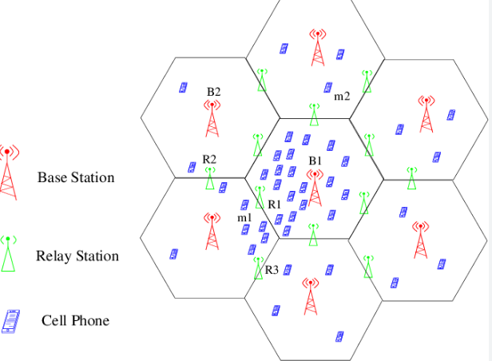
What is a cellular network?
Have you seen any 'cells' or mobile phone towers?
Where are these towers located?

Slide 5
What is the difference in transmission speed between 3G, 4G and 5G:
Research, also research each generation of mobile network.

