Slide 1
English

Slide 2
Lessons Objectives
By the end of the lesson, learners will be able to :
understand what conjunctions mean
understand what conjunctions mean
01
identify different types of conjunctions.
identify different types of conjunctions.
02
use the conjunctions properly.
03
04

Slide 3
Fiction vs Non-Fiction What’s the Difference?
Fiction Books
contain made up stories.
Non-Fiction Books contain true facts and information.

Slide 4
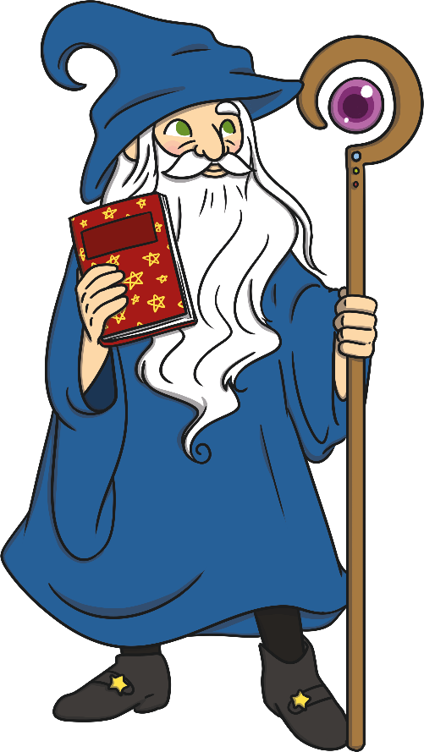
Features of a Fiction Book
“Fiction” books are filled with made up stories, created from the imagination of the author. They are not real and sometimes they even include talking animals! Fiction books will usually include these features:
Not real
Tells a story
Characters and setting
Illustrations
Problem and solution
Should be read in order

Slide 5
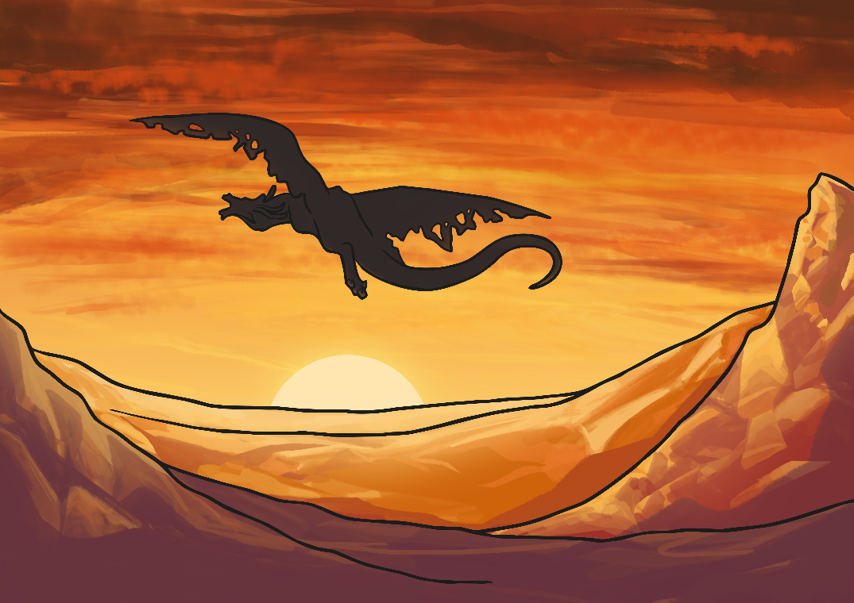
Tells a Story
Can you think of any stories you have read recently?
Using the pictures below as clues, think of a book which uses the characters in the story.

Slide 6
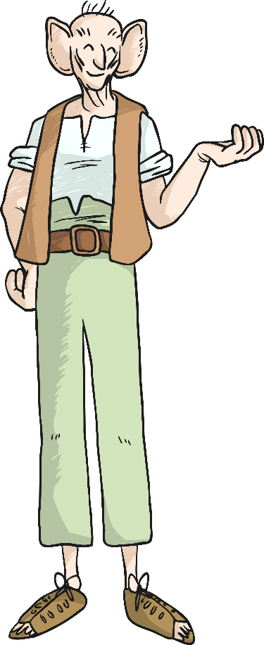
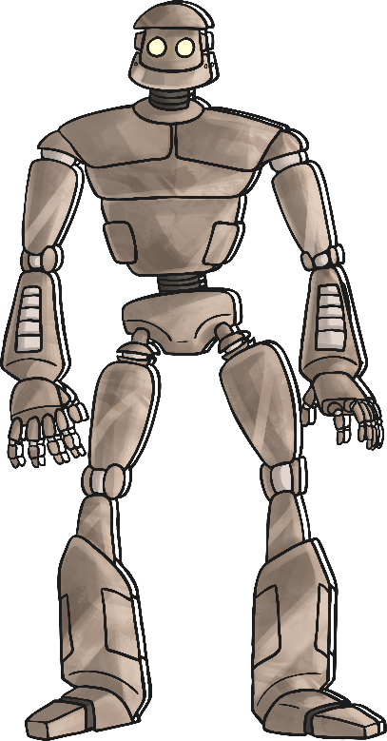
Characters
What characters have you read about recently?
Using the key words below, can you name any famous book characters?
Evil
Scary
Brave
Powerful
Ugly
Beautiful
Giant
Magical

Slide 7
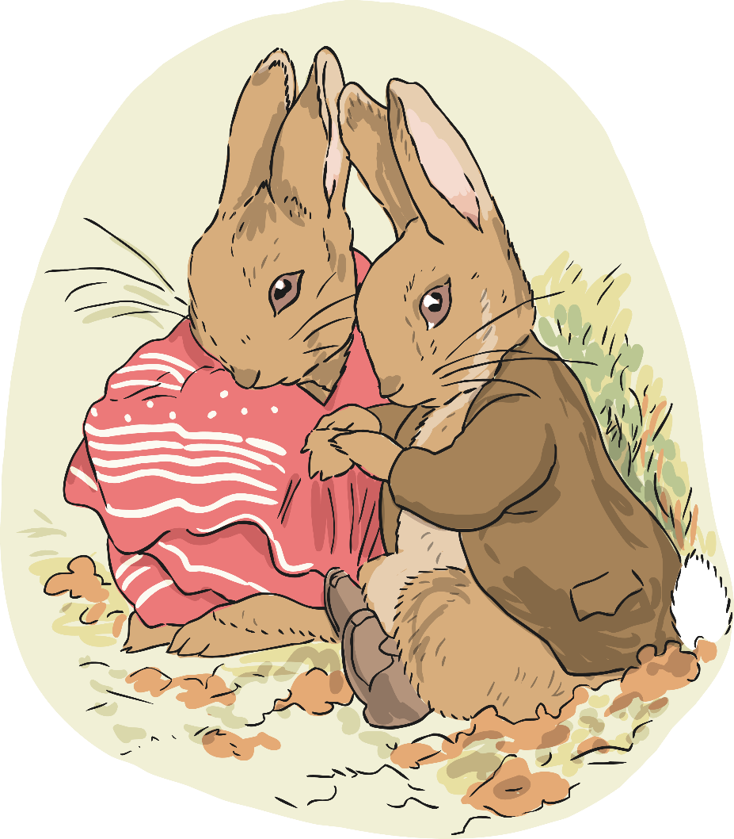
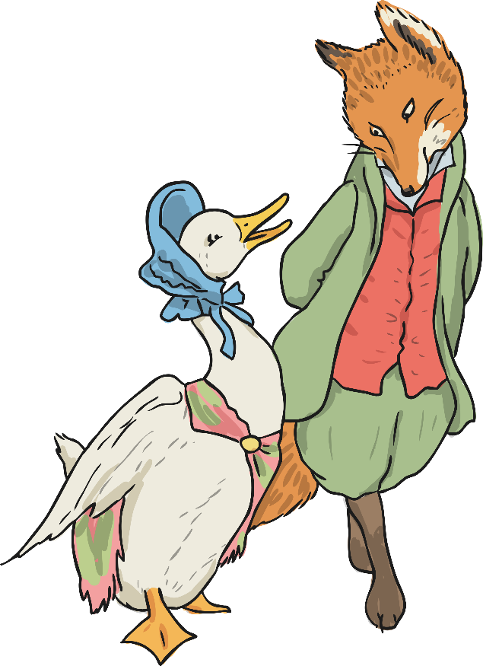
Illustrations
Fiction books often include illustrations.
Why do you think books include illustrations?

Slide 8
Written in Chapters
Each chapters tells a part of the story.
Chapters sometimes end on a cliffhanger to keep the reader interested and to build tension.
Chapters often have a common theme such as:
Time
setting
characters involved.

Slide 9
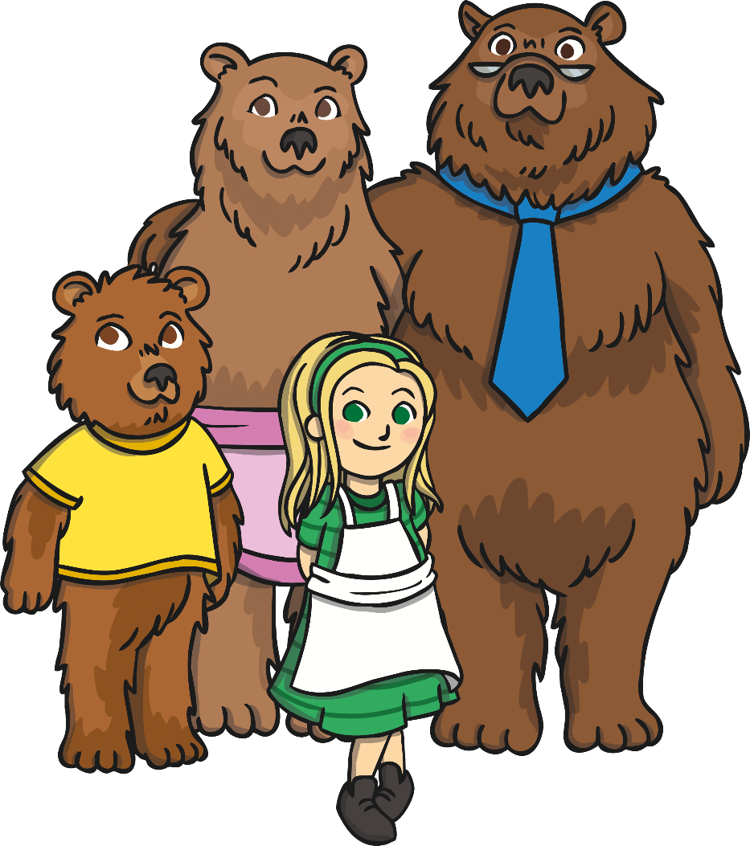
Examples of Fiction
There are many different kinds of fiction books and texts. These are just some of the different examples:
Fairy Tales and Nursery Rhymes
Picture Story Books
Chapter Books
Novels

Slide 11
Can You Think of Any Other Types of Fiction Texts?
Remember, it doesn’t have to be a book! Twist and turn to the person next to you to discuss.
?
?
?
?

Slide 12
Lessons Objectives
Objectives check:
understand what fiction means
01
identify the main features of fiction books.
02
read fiction books.
03
04

