Slide 2
Meet Number Ten
Hello, I am Number Ten. What do you notice about me? I’m off to the store today with my friend, Number Four. I have been saving my money.
How many pennies did you count?

Slide 3
Meet Number Four
I’m off to the store today with my friend Number Ten and I need to take some money with me. How many pennies do I have?
Hello, I am Number Four. What do you notice about me?

Slide 4
Number Ten and Number Four arrived at the store at the same time. They were excited to see each other and they both had a funny feeling. Then, there were was a loud bang and…

Slide 5
…something magical happened!
I am Number Fourteen.

Slide 6
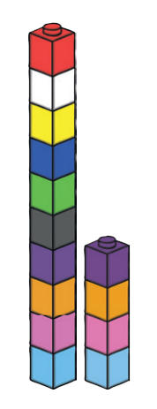
Cube Towers
This is the number 14 shown as towers of cubes.
Can you check that there are 14? How can you be sure?
14 is 1 tower of ten and 4 blocks more

Slide 7
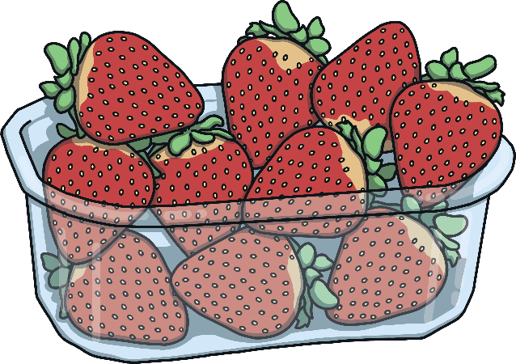
Inside the store, Number Fourteen looked at the fruit. He decided to get some strawberries.
How many strawberries are in this box?
1
2
3
4
5
6
7
8
9
10

Slide 8
He picked up some loose strawberries too.
How many strawberries do we have now?
2
1
3
4
10

Slide 9
We make 14!
I am 4.
I am one 10.
2
1
10
3
4

Slide 10
Then, Number Fourteen looked at the apples. Can you find a box with 14 apples?
Great job! Thank you for finding me a box of 14 apples.
Which box has 14 apples inside? How do you know?
Try again.

Slide 11
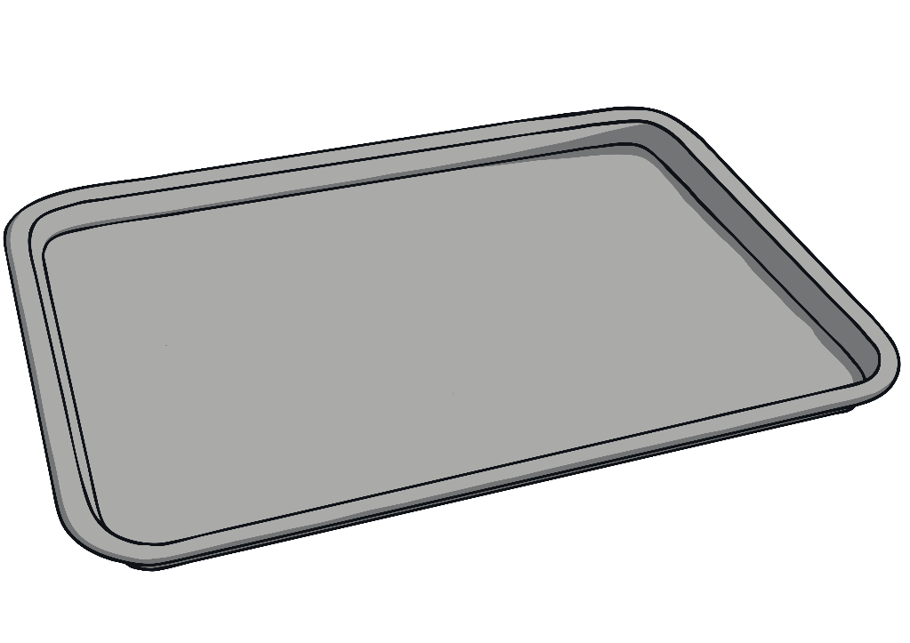
Next, Number Fourteen picked up a bag of potatoes.
Oh no! The bag has broken! Can you help me to pick up the potatoes?

Slide 12
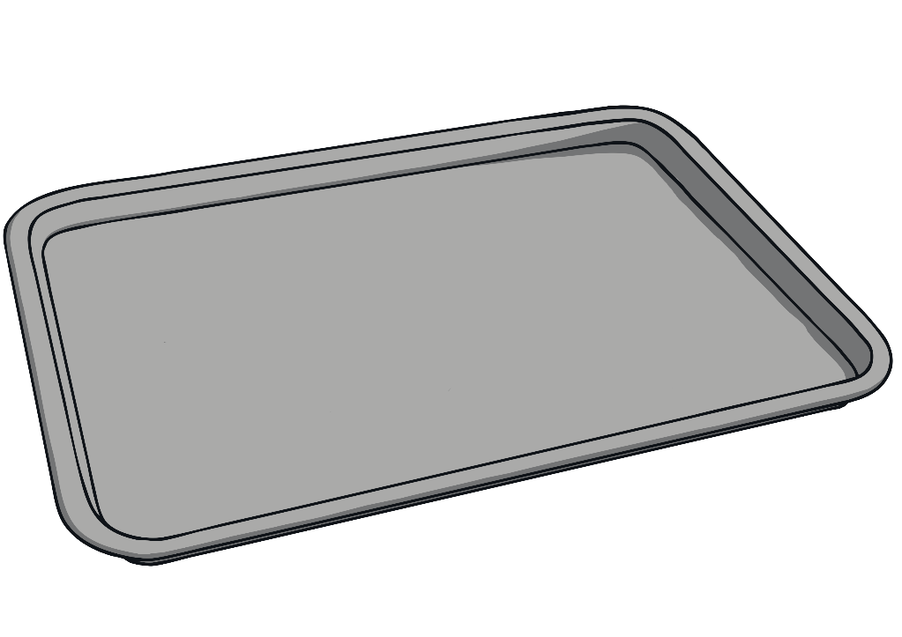
How many potatoes can you see on the tray? How many don’t fit on the tray? How many potatoes are there altogether?

Slide 13
That’s right – altogether there are 14 potatoes.
And here are 4 potatoes.
Here is one tray of 10 potatoes.

Slide 14
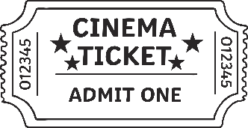
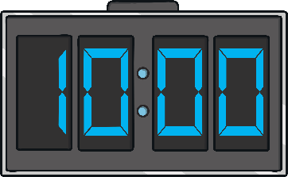
Next, Number Fourteen wanted to go and get some cheese from the counter. He had to get a ticket. What number can you see on the ticket?
14
There is a display that tells me what customer is being served. What number customer is being served now? Will I have to wait long?

Slide 15
Lots of bags of cheese are ready to collect. The shopkeeper has placed them in order on the counter.
5
10
Oh no! Some of the bags are facing the wrong way and I can’t see the numbers. Which bag is mine?

Slide 16
The shopkeeper has turned the bags around. What numbers can you see? Click on bag 14.
5
6
7
8
9
10
11
12
13
14
Hooray! That’s my order. Thank you!

Slide 17
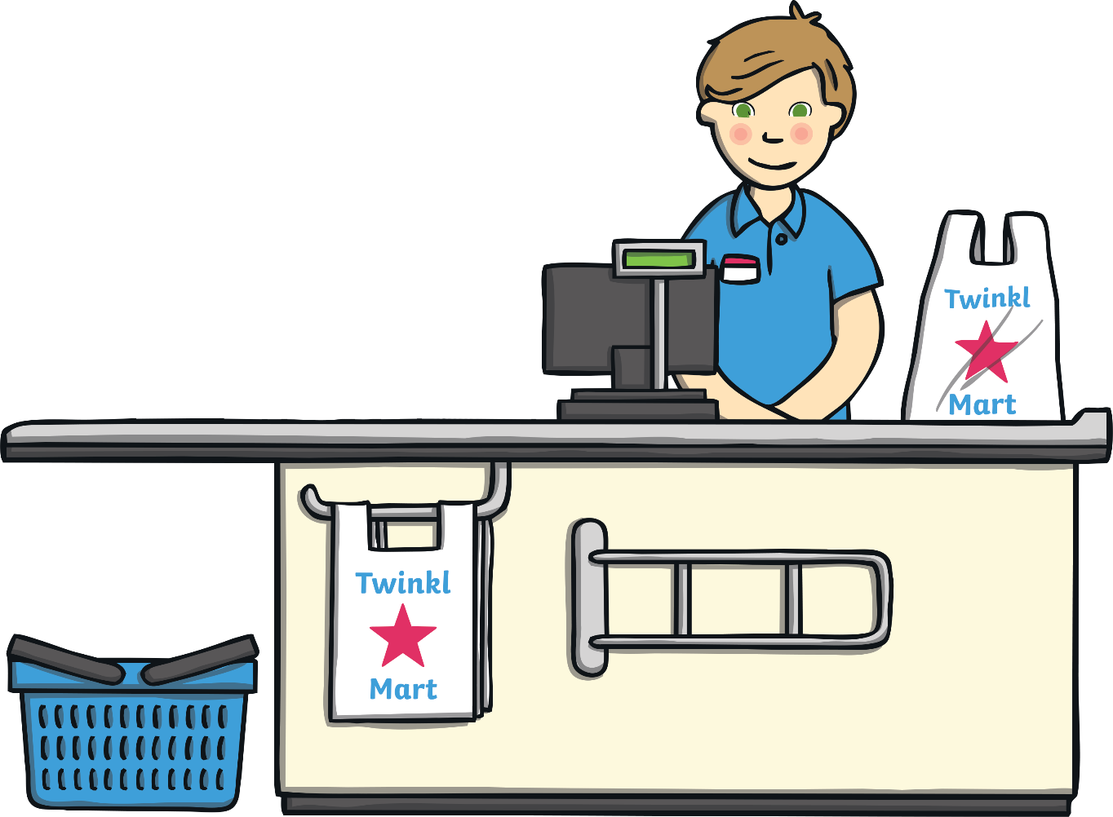
Then, Number Fourteen went to the till.
That will be 14p please.
How much does my shopping cost?
14
14

Slide 18
How much money have I got? Click me to check.

Slide 19
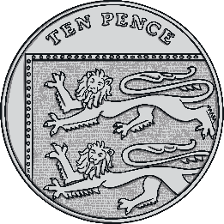
That’s right! I had 14 pennies. We can make 14p another way – click me to take a look. Talk about what you can see this time.

Slide 20
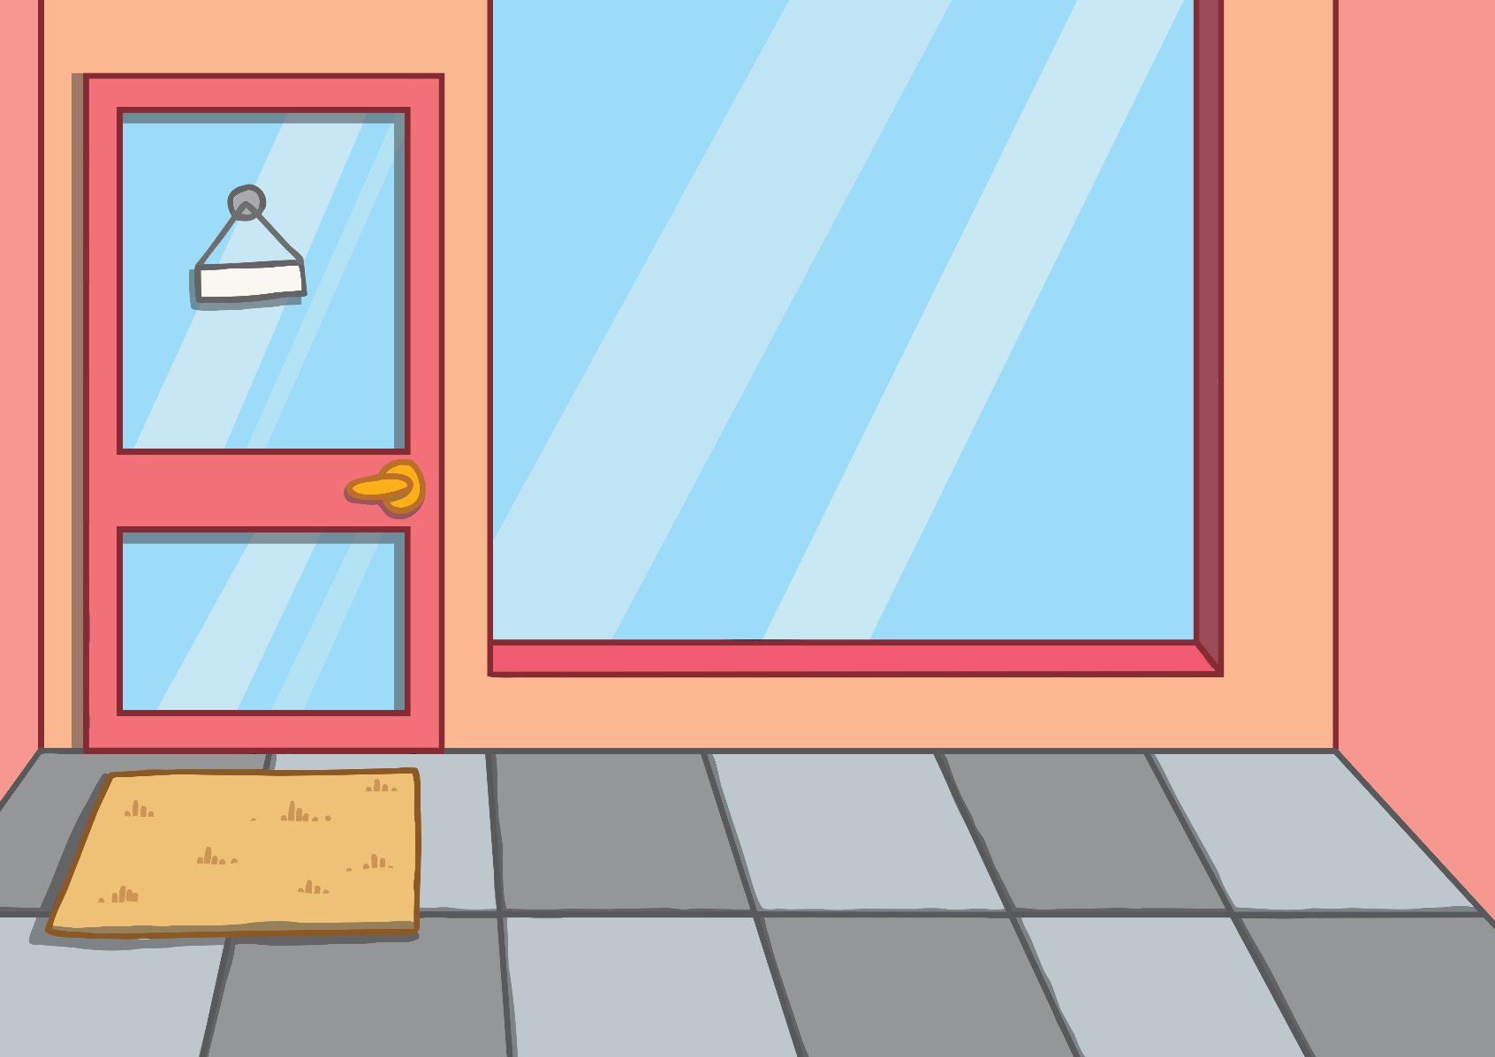
It was time for Number Fourteen to go home. He had a funny feeling as he reached the door.

Slide 21
Suddenly, there was another loud bang!
What do you think is going to happen to me now?

Slide 22
Number Ten and Number Four said goodbye to each other and made their way home.

Slide 23
Number Lines
Can you spot the number 14 on the number line? Which numbers are next to number 14?
Click the hand to reveal the answer!
0
1
2
3
4
5
6
7
8
9
10
11
12
13
14
15
16
17
18
19
20

Slide 24
Number Lines
20
How about this number line?
Can you spot the number 14?
Is it in the same place?
19
18
17
16
15
14
13
12
11
10
9
8
7
6
5
4
3
2
Click the hand to reveal the answer!
1
0

Slide 25
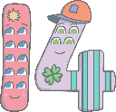
Can you find 14 on the number track? Click on Number Fourteen to move him onto the number track.
20
19
18
17
Which number comes before number 14? Which number comes after number 14? Can you spot any patterns when you look at the number track?
16
15
13
12
11
10

