Slide 2
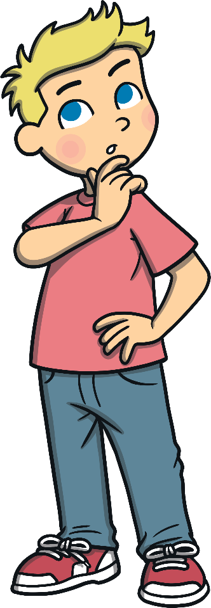
Length
Why would we need to know the length of something?
We might need to get a tablecloth for a table and when we go to the fabric shop we would need to know the measurement.
We might need to know how tall we are so that when we buy clothes, we know our size.
We might want to get some carpet for the floor and we would need to know how much carpet to get before we buy it.

Slide 3
How can we measure the length of something?
There are many ways to measure something...
We could line lollipop sticks back to back and count how many we used.
When people want to know who is taller, they often stand back to back, or side to side to get an idea.
These are nice ways to get an idea of how long something is but could you go to the fabric shop and say, my table is 20 matchsticks long and 10 matchsticks wide in order to get a tablecloth?
The sales assistant may have a hard time getting you the right amount of material. So, instead of matchsticks we use units of measurement that are specific and do not change like the metre or centimetre.

Slide 4
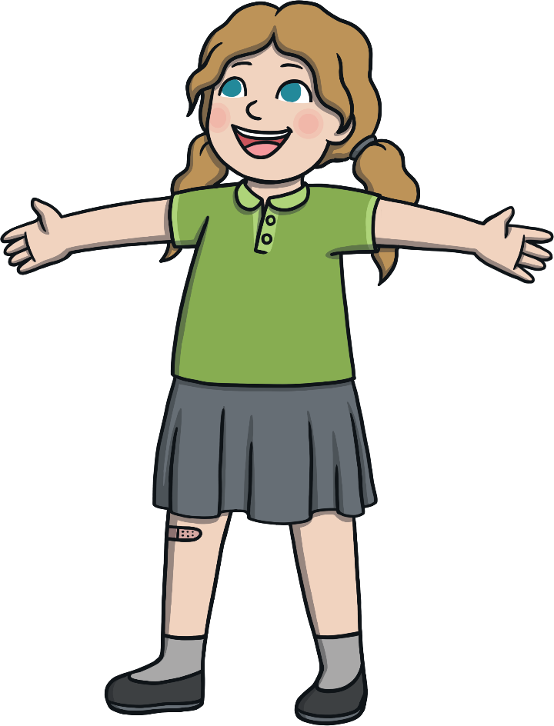
Metre
A metre is about the length of your arms outstretched.
Look around the room, is there anything that you can think of that is about the same size as a metre?

Slide 5
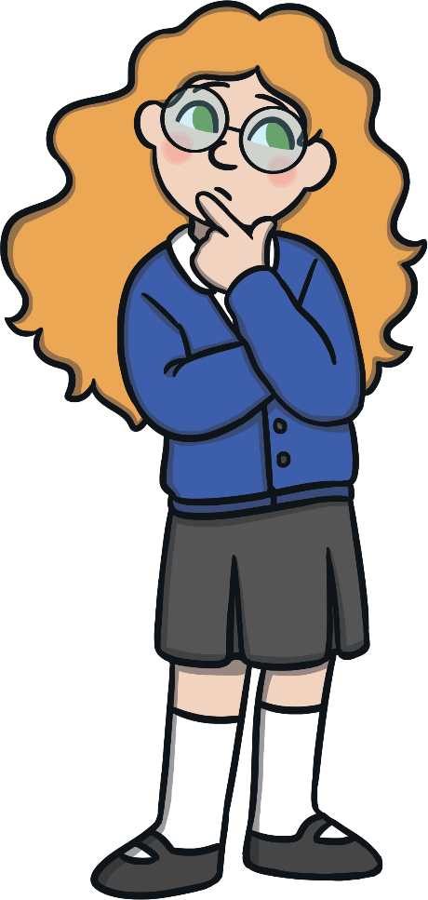
Can you think of anything that is about a metre in length?
Width of a doorway
Width of a large fridge
Depth of the shallow end of a swimming pool
Tip-to-tip of a child's outstretched arms
Metres can be used to measure the length of a house or the size of a playground, but what unit of measurement do we use if something is much smaller than a metre?

Slide 6
Centimetre
A fingernail is about one centimetre wide.
Look around the room, is there anything that you can think of that is about the same size as a centimetre?

Slide 7
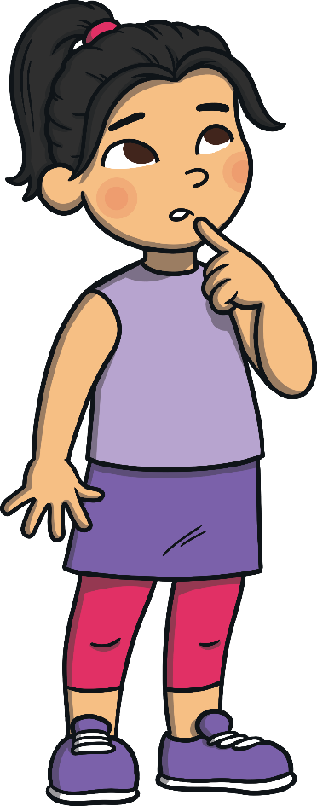
Can you think of anything that is about as wide as a centimetre?
About as long as a staple
Width of a highlighter
Diameter of a belly button
Thickness of a homework journal
Width of your index finger

Slide 8
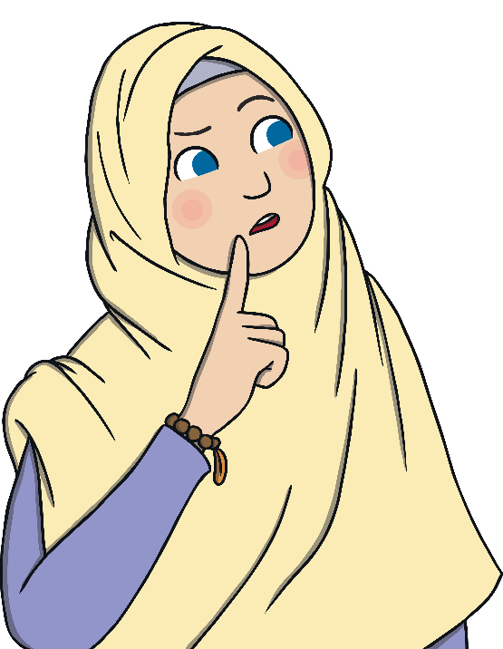
What can we use to measure in centimetres (cm)?
A Ruler
But how do we use a ruler?
When we start measuring with a ruler we always start at 0.
Can you find 0 on your ruler?

Slide 9
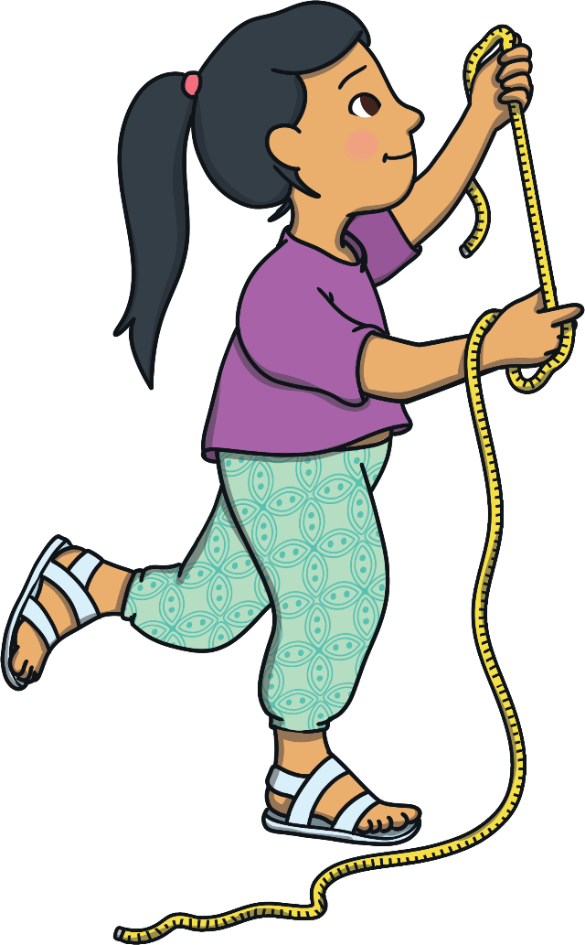
What does estimating mean?
Estimating means having a good guess at something.
Why do we estimate?
If we estimate before we measure than it can save us some time. If we think that what we are about to measure is closer to a metre, then we’ll know to use our metre stick, if it is closer to a centimetre, then we’ll know to use a ruler.

Slide 10
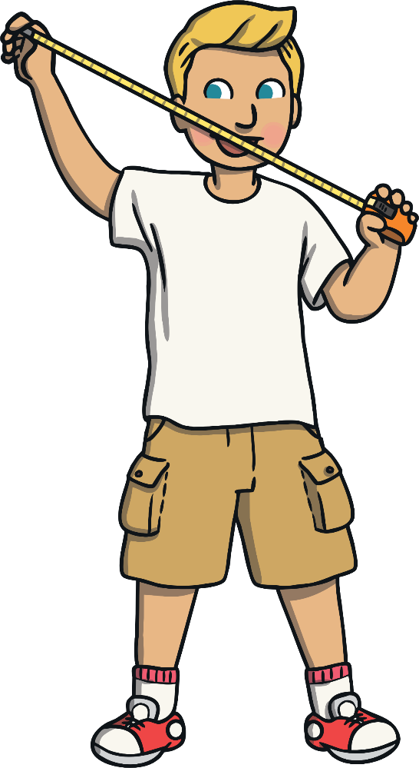
How do we estimate?
Estimating Strategies:
When estimating it is a good idea to have an estimating benchmark. Can you think of something that is about a metre?
You could visualise something that is about a metre and try and see how many of these things might fit into what you are about to measure just by looking at it.
Is there anything near what you are about to measure that you could help you estimate its size?
Can you think of any other strategies that you might use?

Slide 11
Let’s Estimate
If we were to measure the length of a pencil, would we measure using centimetres, or metre?
Remember, a centimetre is about the width of your fingernail and a metre is about tip-to-tip of your outstretched arms. Which is bigger, a centimetre or a metre?
Which of these is the best estimate for the length of a football field?
10 centimetres (cm)
100 centimetres (cm)
10 metres (m)
100 metres (m)

Slide 12
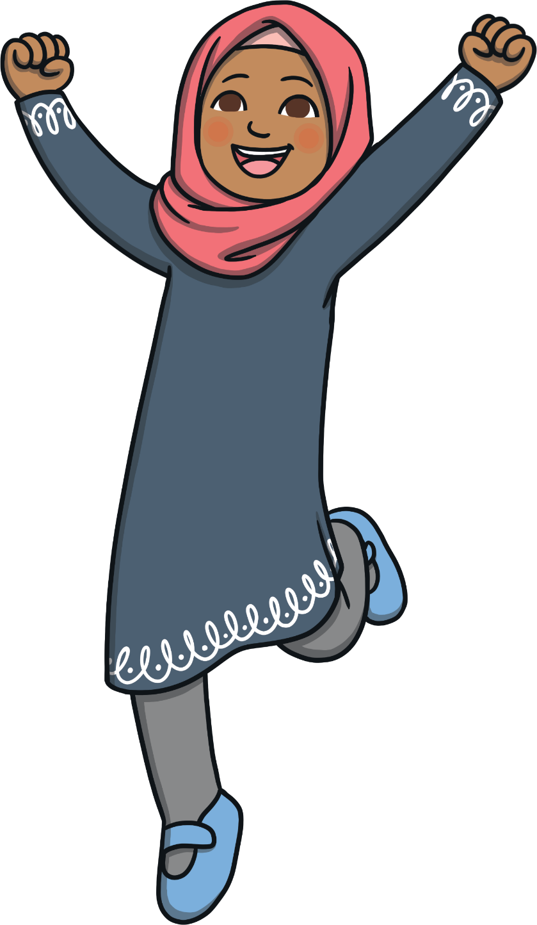
The best estimate for a football field is:
100 m

Slide 13
Let’s Estimate
If we were to measure the length of a pencil, would we measure using centimetres, or metre?
Remember, a centimetre is about the width of your fingernail and a metre is about tip-to-tip of your outstretched arms. Which is bigger, a centimetre or a metre?
Which of these is the best estimate for the length of a pencil?
50 centimetres (cm)
1 centimetre (cm)
8 centimetres (cm
90 centimetres (cm)

Slide 14
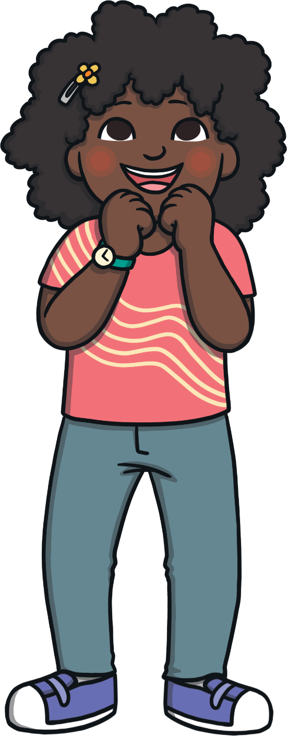
The best estimate for a pencil is:
8 cm

Slide 15
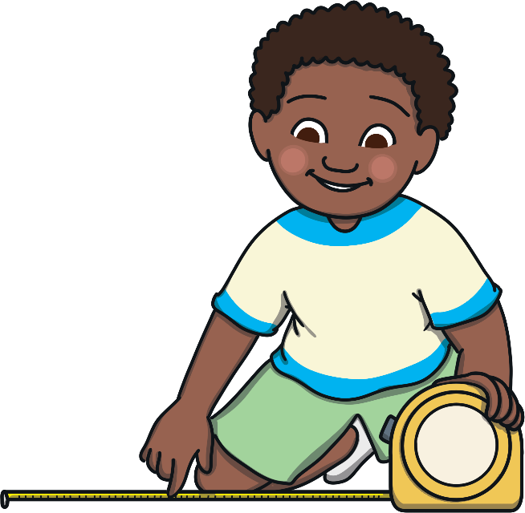
Estimating
Remember, Estimating is not about getting the answer right or wrong.
We estimate to save us time before we start to measure.
If we think about what we are about to measure before we begin our work we will usually end up with a more accurate answer and we will be more prepared in doing our work.

Slide 16
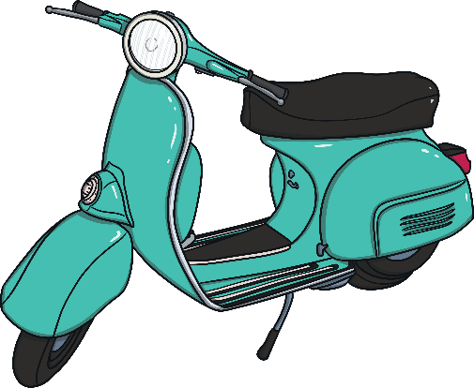
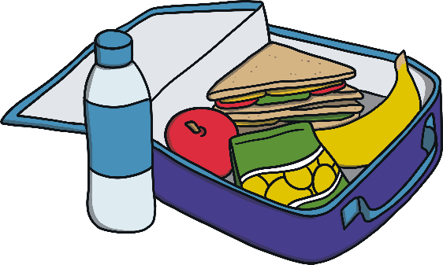
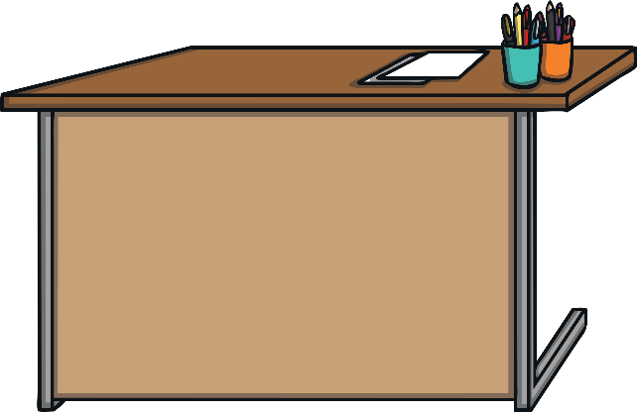
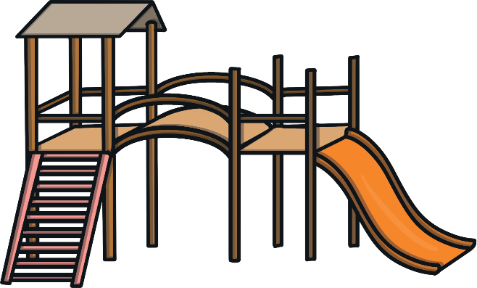
Now, let’s estimate which of these should be measured in metres (m) or in centimetres (cm) together

Slide 17
Length Scavenger Hunt
What you will need:
Your ruler, your metre string, a sheet to record your findings.
Team work:
When working with your partner: talk to each other about how you will measure and what you will use as you go.
Think about whether a ruler or a metre string would be the best thing to use.
Task:
In the classroom, can you find:
Something that is 15cm in length
Something that is the same length as your school bag
Something that is 1 metre in length
Something that is more than 20cm but less than a metre
Something that is around the same length as your finger

