Slide 1
The Three Little Pigs

Slide 2
The Three Little Pigs Video

Slide 3
Who are the Characters in the story?

Slide 4
Where is the wolf and what time of day is?

Slide 5
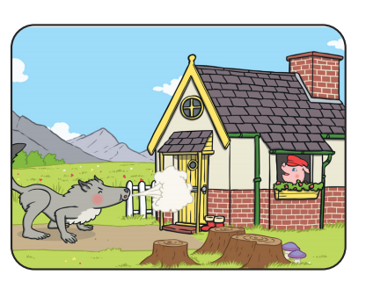
Why could the wolf not blow down the the house of the Third Little Pig?
WW
What did the first
Little Pig build his
house out of?
What did the wolf do to the next Little Pig’s house?

Slide 6
The End

Slide 7
Enter title
Click here to add content of the text
Enter title
Enter title
Click here to add content of the text
Click here to add content of the text
Enter title
Enter title
Click here to add content of the text

Slide 8
01
02
03
04
Enter title
Enter title
Enter title
Enter title
Click here to add content of the text the main idea of this page,
Click here to add content of the text the main idea of this page,
Click here to add content of the text the main idea of this page,
Click here to add content of the text the main idea of this page,

Slide 9
Enter title
Enter title
Enter title
Enter title
Click here to add content of the text the main idea of this page,
Click here to add content of the text the main idea of this page,
Click here to add content of the text the main idea of this page,
Click here to add content of the text the main idea of this page,

Slide 10
Blackboard template
Click here to add content of the text
Reporter: XX
Department: XX

