Slide 1
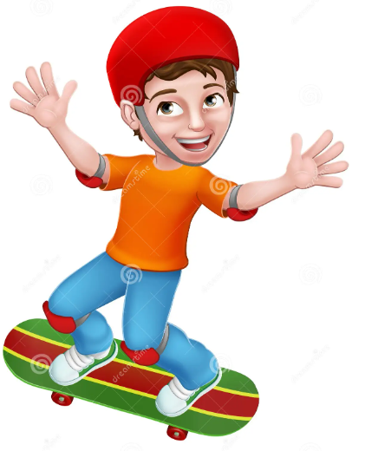

Slide 4
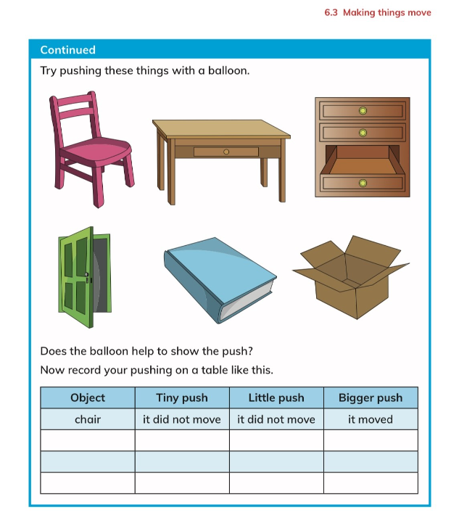
Activity
Students will use a balloon
To try to push items in the classroom.
Students to record their results on
the table.
(Take pictures).

Slide 5
Wednesday

Slide 7
https://m.youtube.com/watch?v=t09pAwLICC4&pp=ygUQRWxlY3RyaWNpcnkga2lkcw%3D%3D

Slide 9
Thursday

Slide 10
Activity

