Slide 2
Meet Number Ten
Hello, I am Number Ten. Can you tell a friend what you notice about me? My friend, Number Six, is coming to visit today. I have bought a box of cakes for us to have at teatime.
How many cakes are in the box?
Cakes

Slide 3
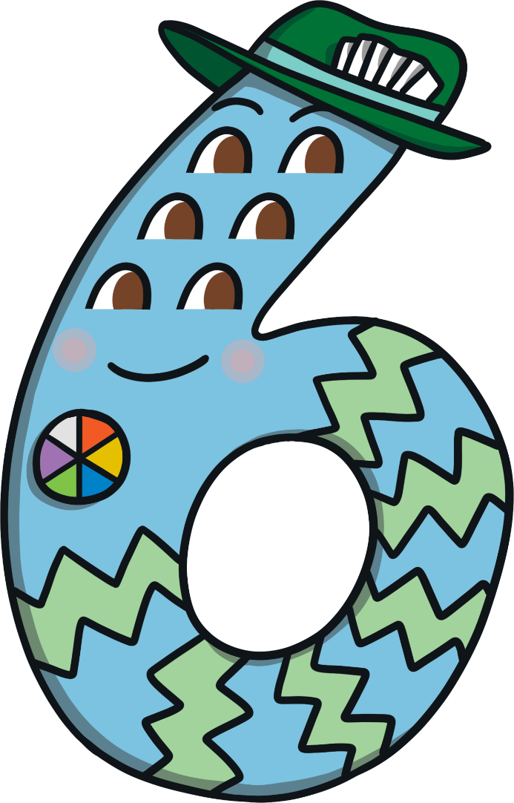
Meet Number Six
I am off to visit my friend, Number Ten. I have made some cakes to take. How many do I have?
Hello, I am Number Six. What do you notice about me?

Slide 4
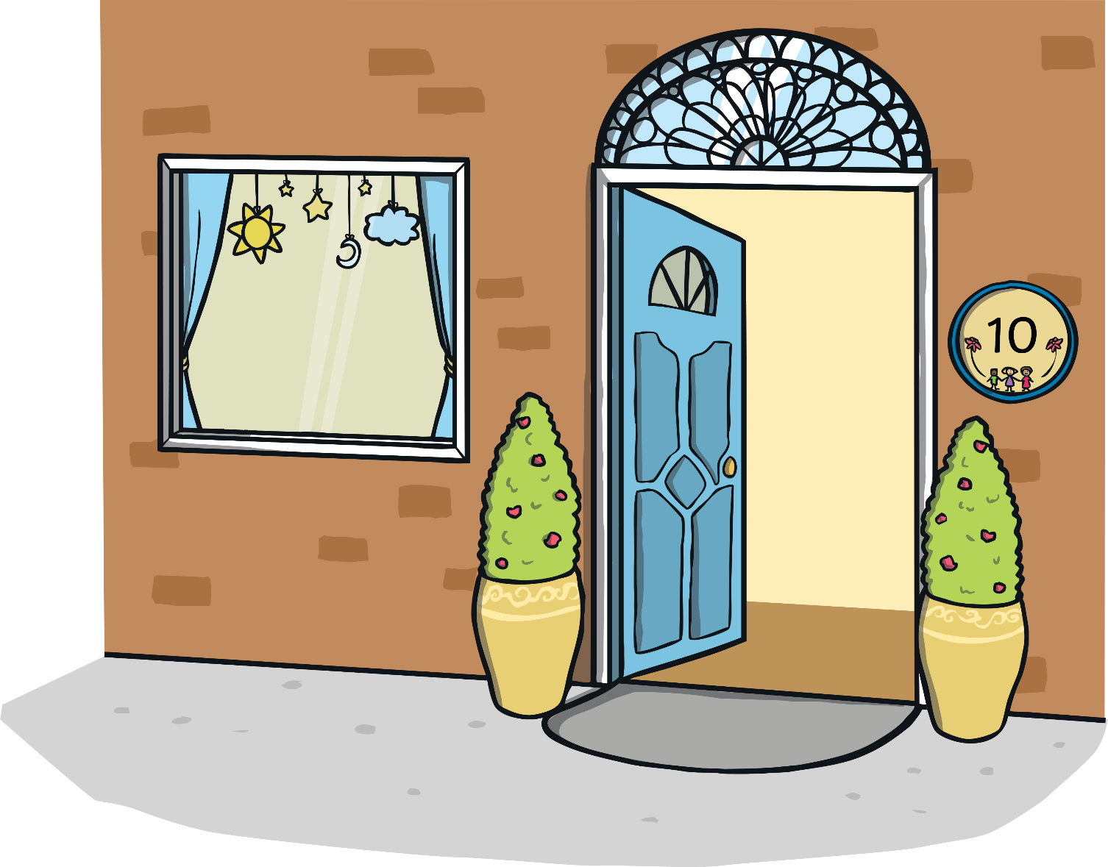
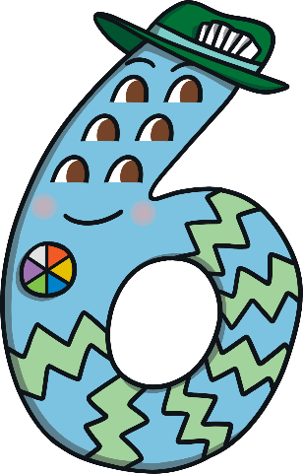
Number Ten opened the door just as Number Six arrived. They were excited to see each other and they both had a funny feeling. Then, there was a loud bang and…

Slide 5
…something magical happened!
I am Number Sixteen.

Slide 6
Cube Towers
This is the number 16 shown as towers of cubes.
16 is 1 tower of ten and 6 blocks more

Slide 7
First, Number Sixteen decided to play with some building bricks. Can you help Number Sixteen to build a tower of red bricks?
10
9
8
7
6
5
Click on the bricks to help me build a tower. How many red bricks are there in my tower?
4
3
2
1

Slide 8
Can you help Number Sixteen to build a tower of green bricks?
6
5
4
I wonder how many green bricks we have. Click the green bricks to help me build another tower.
3
2
1

Slide 9
We make 16!
I am 6.
I am one 10.

Slide 10
Next, Number Sixteen decided to draw a picture. Can you find a box of 16 crayons?
Great job! Thank you for finding me a box of 16 crayons.
Which box has 16 crayons? How do you know?
Try again.

Slide 11
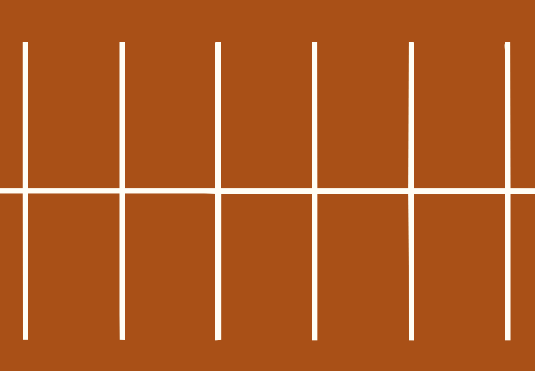
Then, Number Sixteen decided to play with some toy cars. He made a garage out of a cardboard box.
How many cars are in the garage?

Slide 12
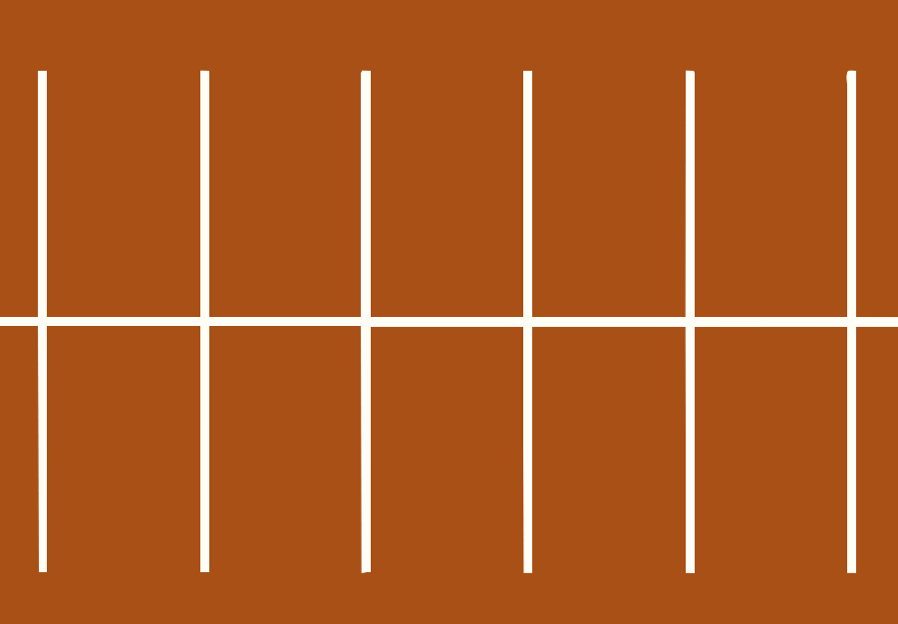
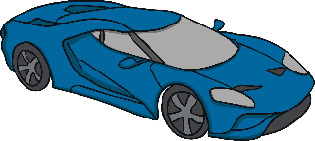
Number Sixteen found some more toy cars in his toy box.
How many cars do I have altogether?
1
2
3
4
5
6
10

Slide 13
That’s right – altogether, I have 16 cars.
I am 6.
I am one 10.
1
2
3
4
5
6
10

Slide 14
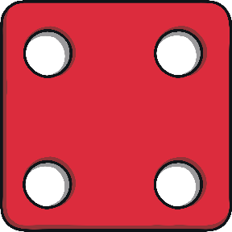
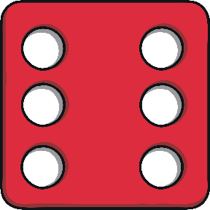
Then, Number Sixteen decided to play a dice game. After a few goes, he landed on number 10.
Click on the dice to make it roll again. Which number does it land on?
10
11
12
13
14
15
16
17
18
19
20

Slide 15
Let’s count on six more. What number do I land on?
10 and 6 more is 16.
10
11
12
13
14
15
16
17
18
19
20

Slide 16
Finally, it was teatime! Can you help Number Sixteen count the cakes?
Altogether, we have 16 cakes for teatime.
Here are 6 cakes.
Here is one box of 10 cakes.
Cakes
Thank you, this is plant pot 15. What number would come before 15?

Slide 17
After teatime, it was home time. Number Sixteen had a funny feeling as he reached the door.

Slide 18
Suddenly, there was another loud bang!
What do you think is going to happen to me now?

Slide 19
Number Ten and Number Six said goodbye.

Slide 20
Number Lines
Can you spot the number 16 on the number line? Which numbers are next to number 16?
Click the hand to reveal the answer!
0
1
2
3
4
5
6
7
8
9
10
11
12
13
14
15
16
17
18
19
20

Slide 21
Number Lines
20
How about this number line?
Can you spot the number 16?
Is it in the same place?
19
18
17
16
15
14
13
12
11
10
9
8
7
6
5
4
3
Click the hand to reveal the answer!
2
1
0

Slide 22
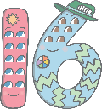
Can you find 16 on the number track? Click on Number Sixteen to move him onto the number track.
20
19
18
17
Which number comes before number 16? Which number comes after number 16? Can you spot any patterns when you look at the number track?
15
14
13
12
11
10

