Slide 2
The plural of man is…
1
Mr
A
men
B
mens
C

Slide 3
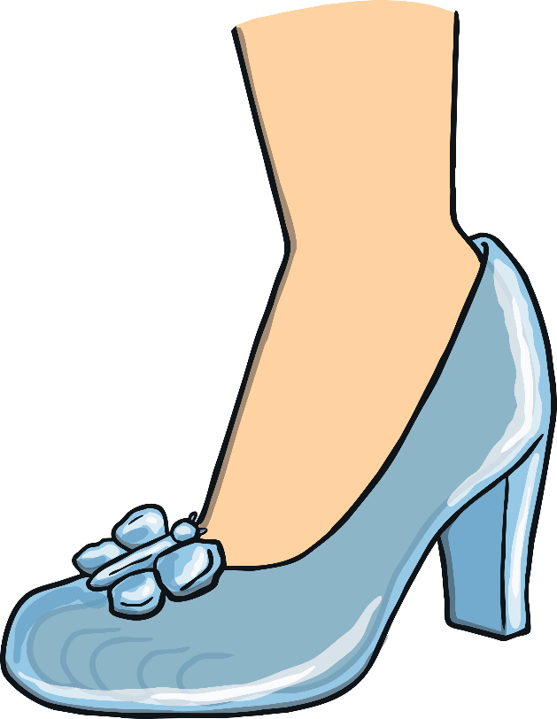
The plural of foot is…
2
feet
A
foots
B
feets
C

Slide 4
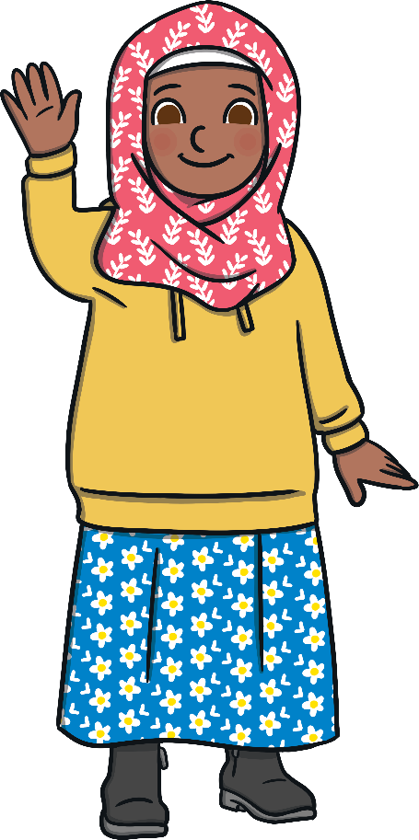
The plural of child is…
3
childs
A
kids
B
children
C

Slide 5
The plural of tooth is…
4
teeth
A
tooths
B
teeths
C

Slide 6
The plural of person is…
5
persons
A
people
B
peoples
C

Slide 7
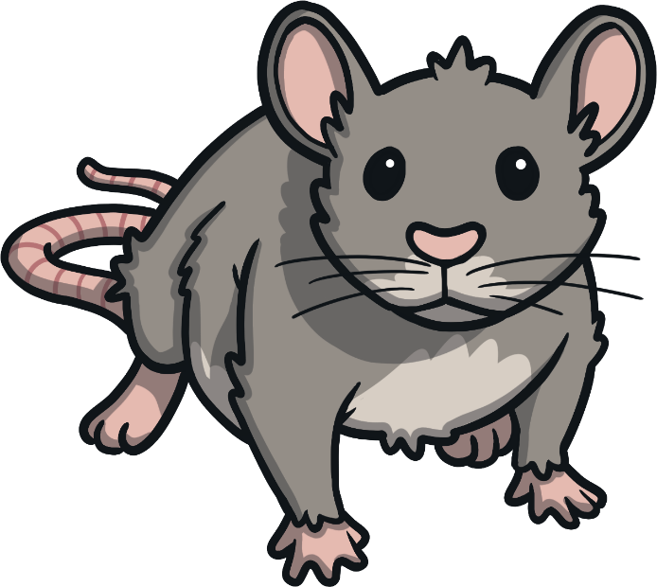
The plural of mouse is…
6
mice
A
mices
B
mouses
C

Slide 8
The plural of goose is…
7
gooses
A
geese
B
geeses
C

Slide 9
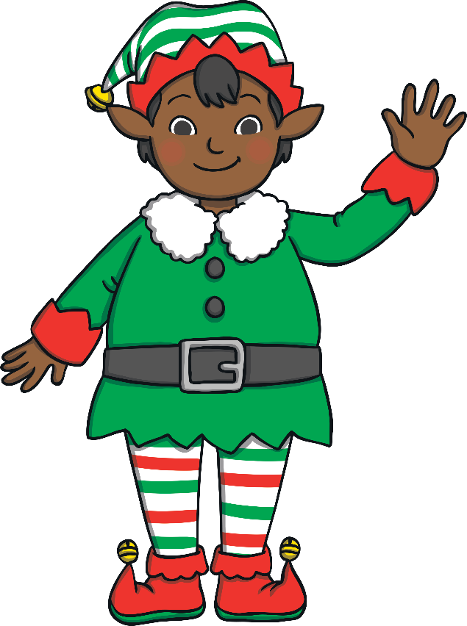
The plural of elf is…
8
elfs
A
elfes
B
elves
C

Slide 10
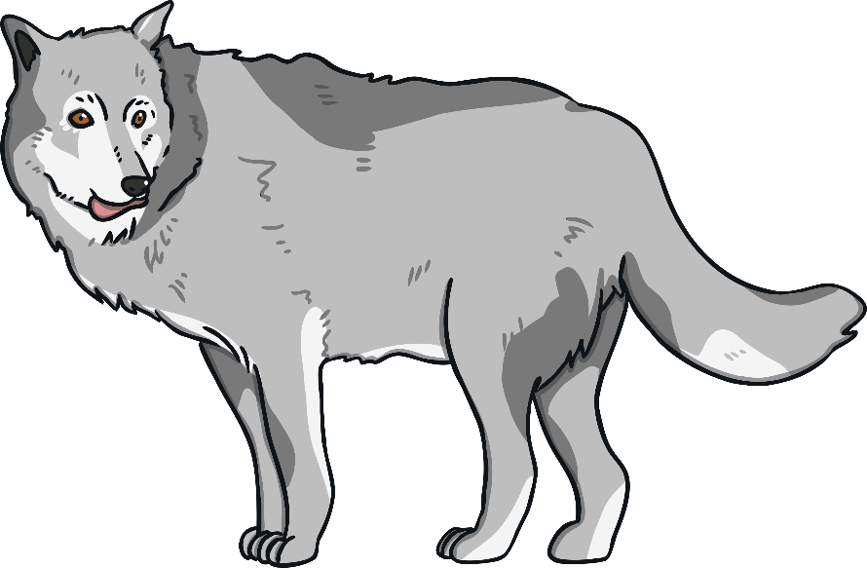
The plural of wolf is…
9
wolfs
A
wolves
B
wolfes
C

Slide 11
The plural of cactus is…
10
cactuses
A
cactusi
B
cacti
C

