Slide 1
Digging into Informational Texts

Slide 2
Analyzing Informational Texts Definition
When people analyze something, they critically examine it to generate a deep understanding.
Readers can analyze all types of written texts to discern their meanings and how the author created them.
When analyzing informational texts, readers examine the reason and way that an author presents information to a reader.

Slide 3
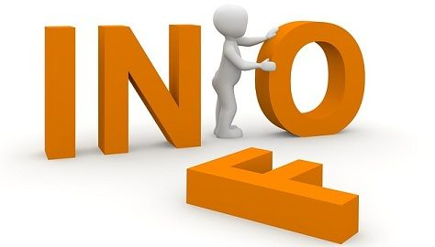
Informational Text Definition
An informational text is a non-fictional text that informs the reader about a topic.
For example,
Textbooks
Autobiographies
Biographies
Instruction manuals
Newspapers
Narrative non-fiction
Magazines

Slide 4
Analyzing Informational Texts Purpose
To understand more about the author's purpose for presenting the information (typically to inform, entertain, or persuade.)
To understand concepts on an in-depth level and make connections between ideas

Slide 5
Readers can ask questions like the following: 1.What was the author's reason for writing this text? 2.What is the main idea of this text? 3.How does the author use elements like headings, illustrations, and bolded text to make a point?
To analyze an
informational text

