Slide 1
Writing adventure stories

Slide 2
Objectives
understand what an adventure story is.
recognize the characteristics of an adventure text
identify the structure and traits of good writing
write an adventure story

Slide 3
What is meant by ‘adventure writing’?
A story in which the characters go somewhere exciting and dangerous. An adventure story can be an exciting, danger, risk, magical, spooky, supernatural, disaster/emergency, quest or mission.

Slide 4
Can you think of any books, films or TV shows that are based on an adventure?
Books
Lord of the Flies
Treasure Island
Movies/ TV. shows
Jumanji
Avengers

Slide 5
Key Features of Adventure Writing
Watch this short video called ‘Adventure Novel Genre Introduction’ and make notes.
what are the key features of adventure writing?
what type of characters are typically included in an adventure story?
can you think of any settings where adventure stories might be set?
do you recognise any of the adventure stories in the video?

Slide 6
Tasks
Think of an adventure novel or film that you know of. Which key features / characteristics of adventure writing do they show? If you don’t know any adventure novels or films, try researching them online or look at the pictures below to give you inspiration.
Novel or film name:
Which key features of the adventure genre does it show?

Slide 7
Key Features of Adventure Writing:
Setting: The character’s journey will take them from their familiar, everyday surroundings to a new, unfamiliar environment. This setting/place will create problem that increase tension to main character.

Slide 8
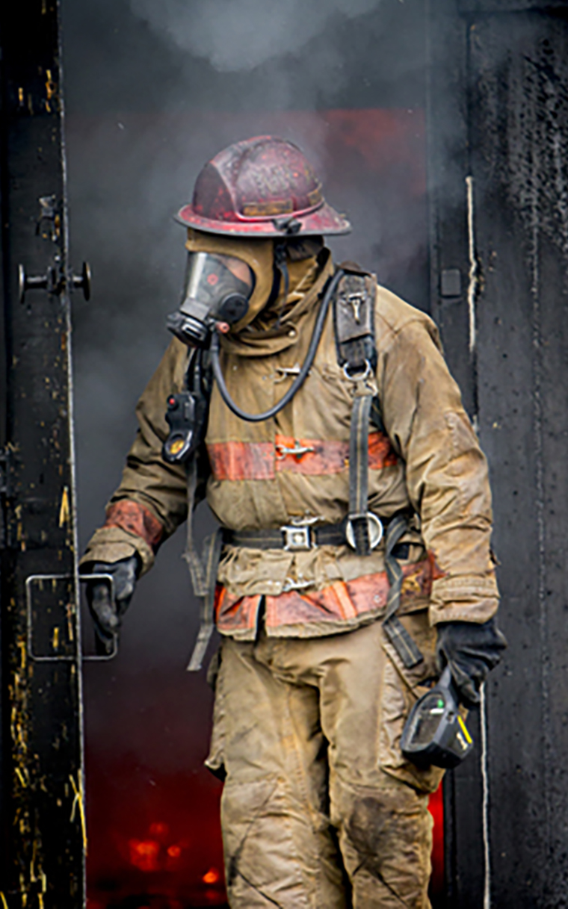
Key Features of Adventure Writing
The MC - A hero
The main character of an action-adventure story will most often start out as an ordinary person before they embark on their adventure.

Slide 9
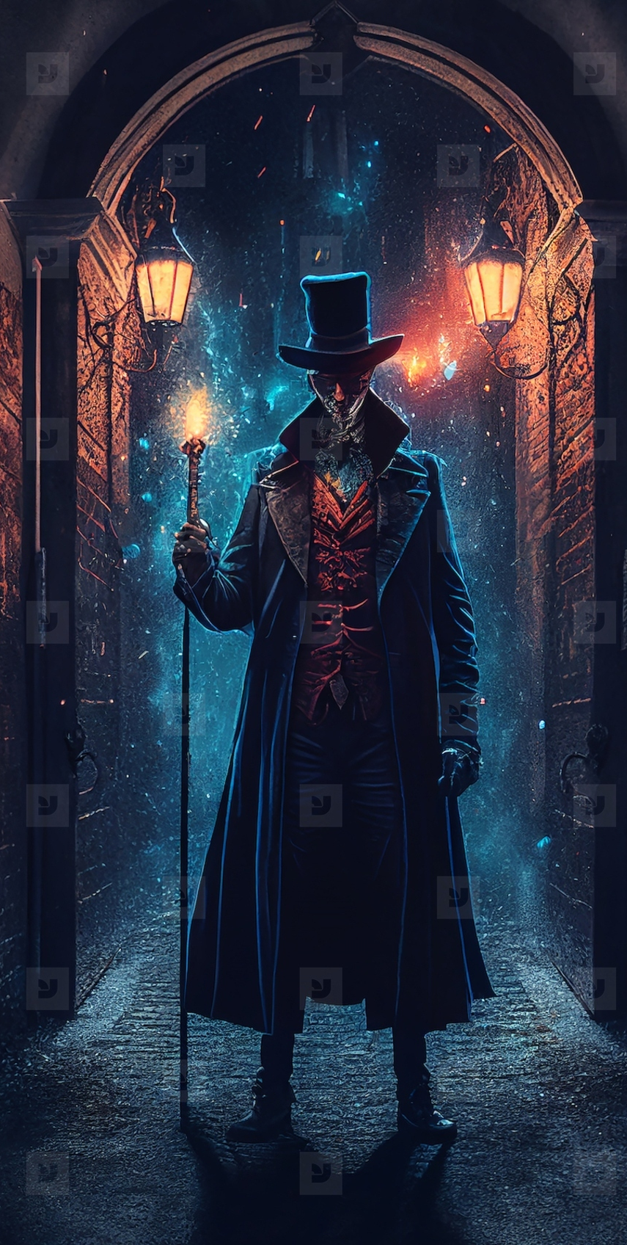
Key Features of Adventure Writing
Main theme: A quest
The protagonist will be presented with a problem they need to solve. This quest will ignite the plot with a series of events that create the storyline.
Remember: the problem that faces the main character can be another person (the antagonist or the villain)

Slide 10
Key Features of Adventure Writing
The plot - Action and Excitement:
Adventure novels typically have fast-paced, action-packed plot lines. Stories about epic journeys or epic tales - often involving a mixture of adventure and fantasy - culminate with a thrilling climax or a series of climactic events.

Slide 11
Task 2
2. Create an adventure fact-file outlining how and why your chosen book / film is a good exemplar of this genre.
Include: - plot summary - main characters - key features and characteristics of the adventure genre - reviews from readers and commentaries from experts - your personal opinion

Slide 12
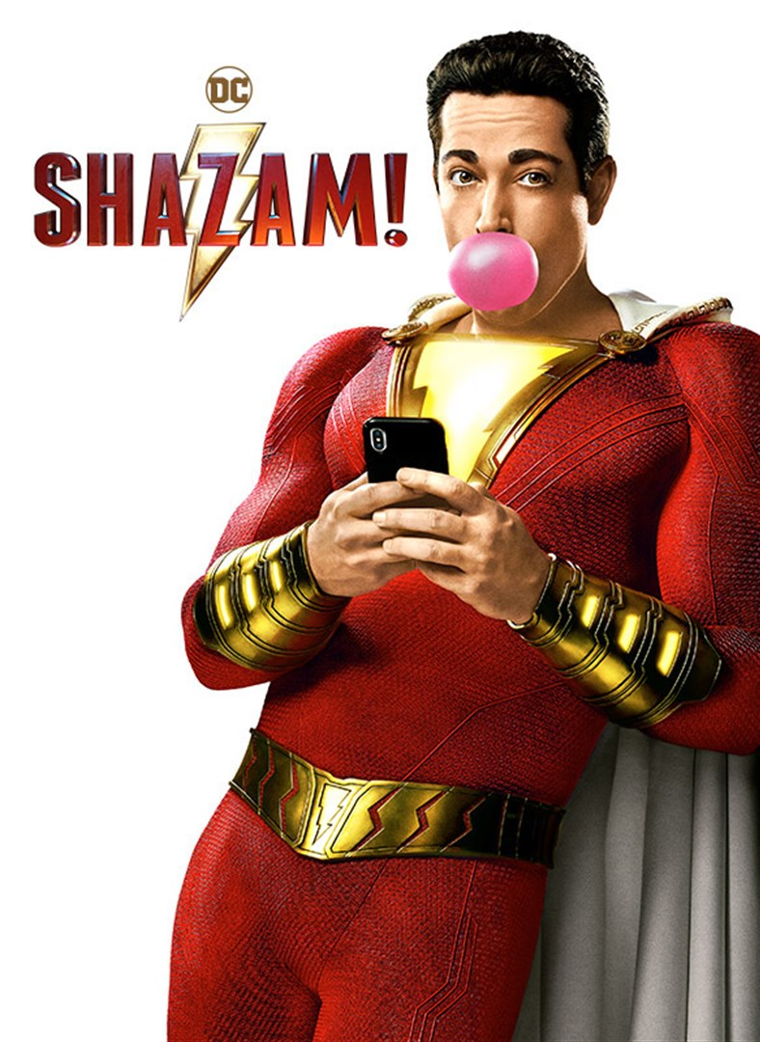
Homework
Write the beginning of an adventure story with a character who has a special gift or a special power .
You should consider:
the setting (e.g. in a city, a village, a desert, somewhere else)
what special gift or power your character has (e.g. the ability to fly, the ability to see into
the future, invisibility)
how the character uses the power.

