Slide 1
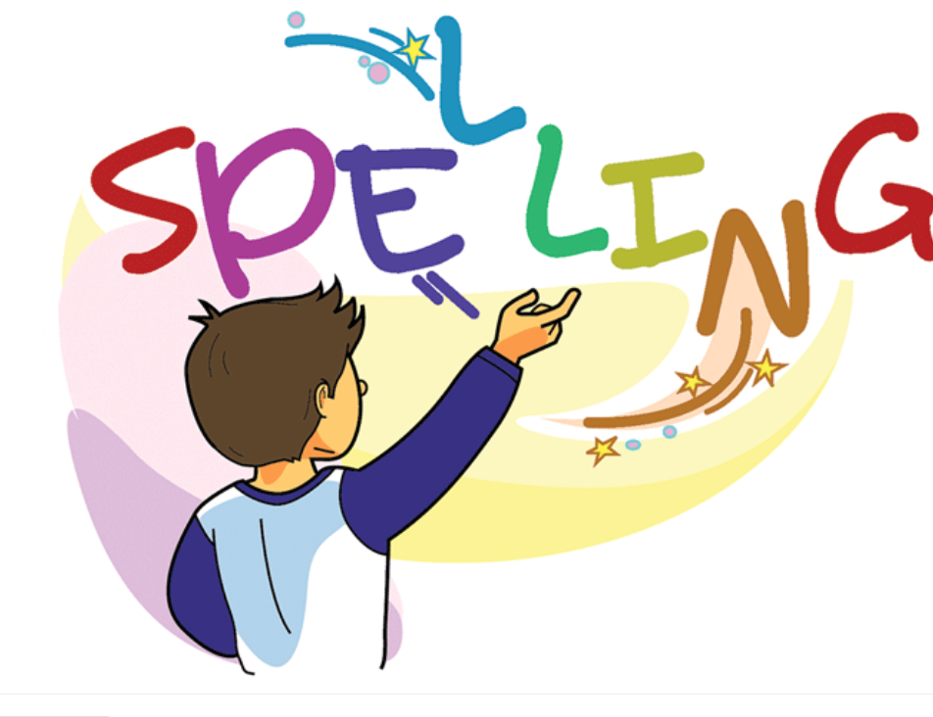

Slide 2
Sunday Weekly Tasks
1. Spelling test “ea” words with the short sound /e/
2. Comprehension Pop up Quiz “The Sun”

Slide 3
Activity Group
Match the (ur) word sounds to the pictures.
Divide students into groups have them match the (ur) words to their pictures.
PS.
Please don’t forget to take pictures to post of FireFly.
Thanks.

Slide 4
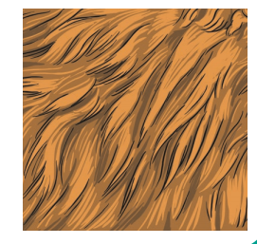
Spelling Words ur words
fur
fur:
The thick hair that
covers the bodies of some
animals.
She stroked the rabbit's soft fur.

Slide 5
turn:
turn:
To move in a circle.
To change the direction in which you are facing or moving .
Turn right at the traffic lights.

Slide 6
burger
burger:
Meat or other food made into a round, fairly flat shape, fried and usually eaten between two halves of a bread roll
Children love eating burger and fries.

Slide 7
curl
curl:
A piece of hair that grows or has been formed into a curving shape
Her hair fell in curls over her shoulders.

Slide 8
hurt
hurt:
To feel pain in a part of your body.
Adam hurt his knee when he fell off his bike.

Slide 9
surf
surf
To ride on a wave as it comes towards land, while standing or lying on a special board.
They go surfing every weekend.

Slide 10
burn
burn:
To produce flames
A fire was burning brightly in the fireplace..

Slide 11
nurse
nurse:
A person who cares for people who are ill or injured, especially in a hospital:
The hospital has at least five nurses on duty all the time.

Slide 12
purple
purple:
A dark reddish-blue colour:
Purple is my favourite colour.

Slide 13
turnip
turnip:
A round, white root that is cooked and eaten as a vegetable.
He ate plums, peppers and turnips for dinner.

Slide 14
Thank You!

