Slide 2
Meet Number Ten
Hello, I am Number Ten. What do you notice about me? I’m off to meet my friend, Number Seven. We are going on holiday to the beach! We have to take a train so I must remember to bring some money for my ticket.
How many pennies did you count?

Slide 3
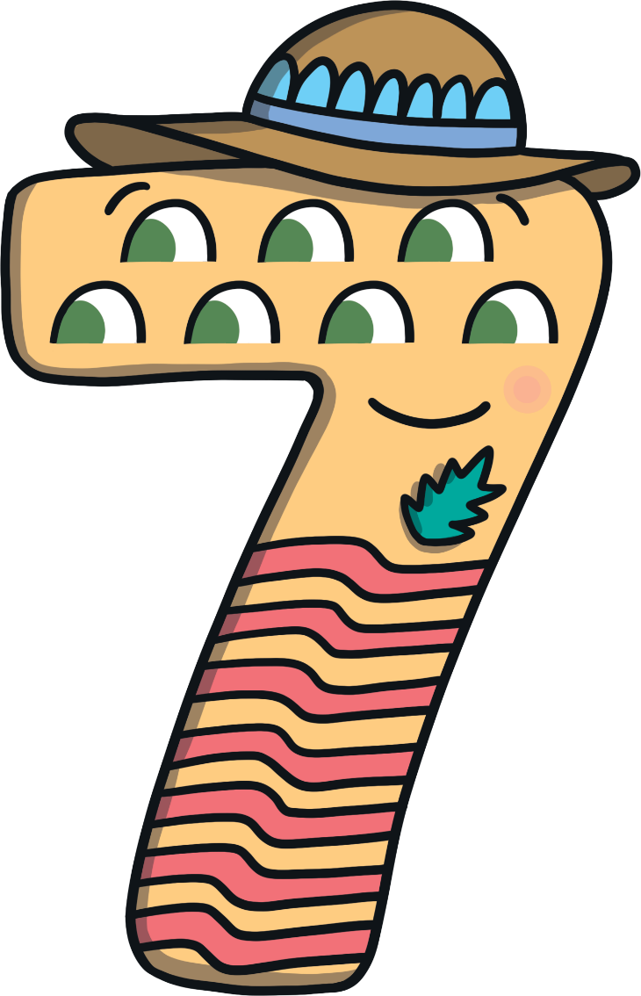
Meet Number Seven
I’m off to meet my friend, Number Ten. We are going on holiday to the beach and we need to buy tickets for the train. How many pennies do I have?
Hello, I am Number Seven. What do you notice about me?

Slide 4
Number Ten and Number Seven arrived at the train station at the same time. They were excited to see each other and they both had a funny feeling. Then, there were was a loud bang and…
TICKETS

Slide 5
…something magical happened!
I am Number Seventeen.

Slide 6
Cube Towers
This is the number 17 shown as towers of cubes.
17 is 1 tower of ten and 7 blocks more

Slide 7
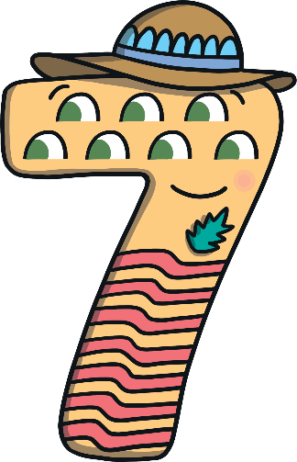
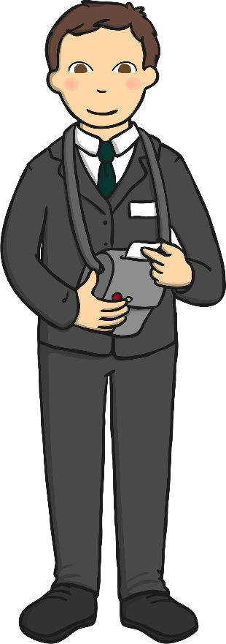
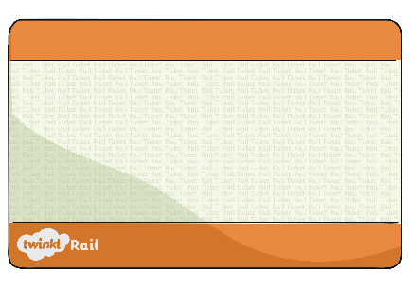
Number Seventeen looked at the sign in the train station. She had to buy a ticket from the ticket conductor. The conductor printed some tickets.
Ticket
17p
Can you help me work out which ticket is mine?
Let’s pay for the ticket!
Try again.
14
17
16

Slide 8
Number Seventeen started searching for the pennies to pay the ticket conductor.
Can you remember how many pennies Number Ten had? Choose the correct purse.

Slide 9
Can you remember how many pennies Number Seven had? Choose the correct ten-frame.

Slide 10
We make 17.
How many pennies do we have altogether? Can you tell a partner? Click me to check.
I am 7.
I am one 10.

Slide 11
When Number Seventeen arrived in Devon, she was very excited. She went straight to the beach.
Click me to look at all the pretty shells. How many can you count?

Slide 12
We make 17.
How many shells are in my bucket? How do you know?
I am 7.
I am one 10.

Slide 13
Number Seventeen started to build some sandcastles. She decorated them with flags.
I have 10 flags on my sandcastles so far. How many more flags do I need to make 17? Can you choose the correct sandcastle to make 17 flags altogether?
Try again.

Slide 14
We make 17.
That’s right, 10 add 7 is 17. I have 17 flags on my sandcastles altogether.
I am 7.
I am one 10.

Slide 15
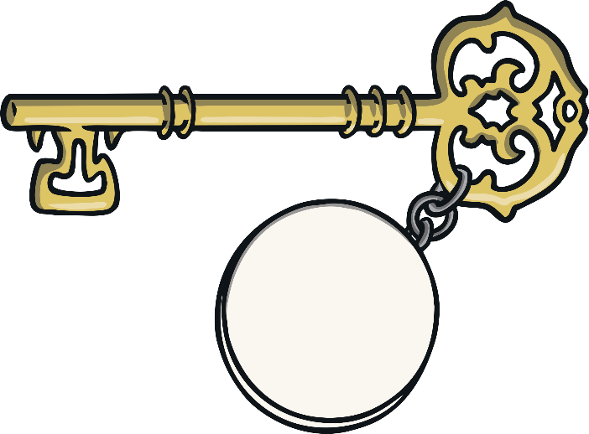
Number Seventeen went to the hotel. She was given a key with her room number on.
Which room am I staying in?
17

Slide 16
10
15
Try again.
Try again.
Try again.
Try again.
Try again.
Try again.
Try again.
Some of the hotel doors are missing their numbers. Can you help Number Seventeen find her room? Click the door you think she should enter.

Slide 17
The next morning, it was time for Number Seventeen to go home. She started to have a funny feeling.
TICKETS

Slide 18
Suddenly, there was another loud bang!
What do you think is going to happen to me now?

Slide 19
Number Ten and Number Seven said goodbye to each other and made their way home.

Slide 20
Number Lines
Can you spot the number 17 on the number line? Which numbers are next to number 17?
Click the hand to reveal the answer!
0
1
2
3
4
6
7
8
9
10
12
13
5
11
14
15
16
17
18
19
20

Slide 21
Number Lines
20
How about this number line?
Can you spot the number 17?
Is it in the same place?
19
18
17
16
15
14
13
12
11
10
9
8
7
6
5
4
3
2
Click the hand to reveal the answer!
1
0

Slide 22
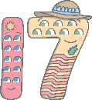
Can you find 17 on the number track? Click on Number Seventeen to move her onto the number track.
20
19
18
Which number comes before number 17? Which number comes after number 17? Can you spot any patterns when you look at the number track?
16
15
14
13
12
11
10

