Slide 1
English

Slide 2
Lessons Objectives
By the end of the lesson, learners will be able to :
understand what conjunctions mean
understand what conjunctions mean
01
identify different types of conjunctions.
identify different types of conjunctions.
02
use the conjunctions properly.
03
04

Slide 3
What are conjunctions?

Slide 4
What are conjunctions?

Slide 5
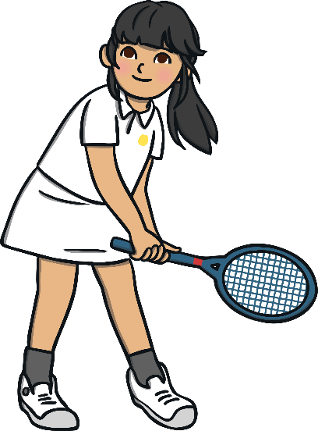
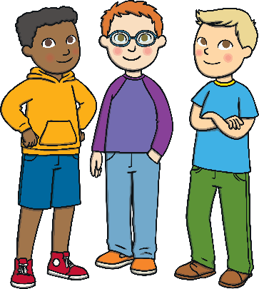
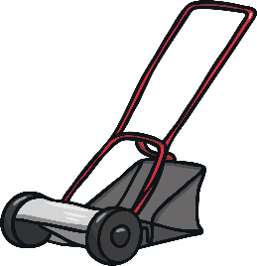
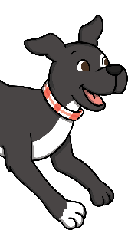
and
There are two types of conjunction: co-ordinating conjunctions and subordinating conjunctions. The conjunction ‘and’ is used in a sentence to join or link words, phrases or clauses together. It is a co-ordinating conjunction that can make a compound sentence.
Romario mowed the grass and his friends
helped him.
I like to play tennis and I love to walk my dog.
Danni will be eating doughnuts and she will be drinking a milkshake.

Slide 6
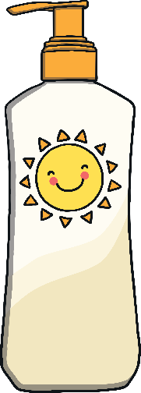
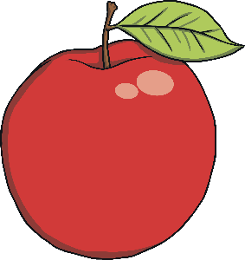
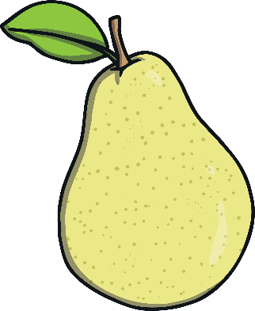
but
There are two types of conjunction: co-ordinating conjunctions and subordinating conjunctions. The conjunction ‘but’ is used in a sentence to join or link words, phrases or clauses together. It is a co-ordinating conjunction that can make a compound sentence.
James needed to wear sun cream but he had forgotten to pack it.
She likes apples but she doesn’t like pears.
The tiger was hungry but he was too tired to hunt.

Slide 7
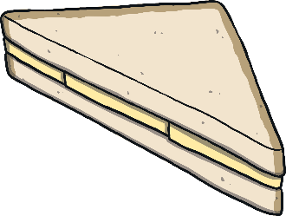
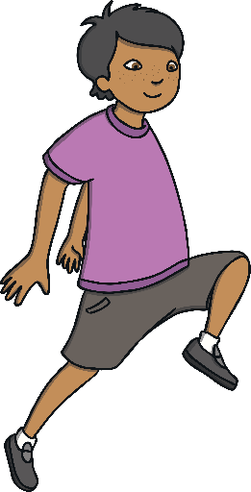
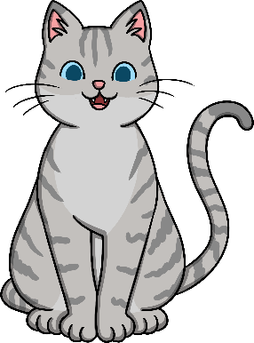
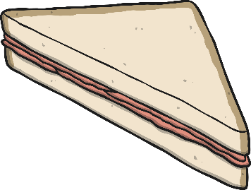
or
There are two types of conjunction: co-ordinating conjunctions and subordinating conjunctions. The conjunction ‘or’ is used in a sentence to join or link words, phrases or clauses together. It is a co-ordinating conjunction that can make a compound sentence.
Would you like a cheese or would you like a ham sandwich?
Nikita would love a pet dog or she might like a pet cat.
Noah could win the skipping race or Barnaby might win.

Slide 8
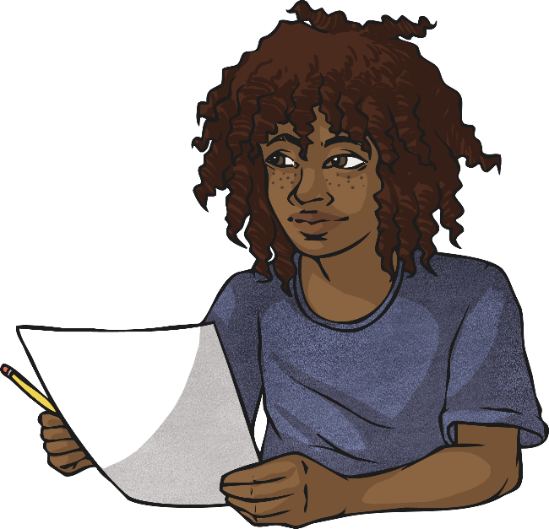
Which co-ordinating conjunction fits best?
Click the circles next to the
co-ordinating conjunctions to reveal.
Correct
Incorrect
I don’t want to do my homework tonight, Mum says I have to.
and
but
or
so

Slide 9
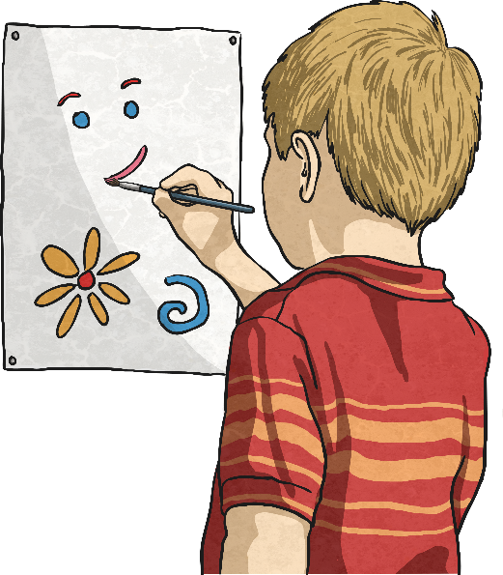
Which co-ordinating conjunction fits best?
Click the circles next to the
co-ordinating conjunctions to reveal.
Correct
Incorrect
In art class, I like to paint Jane likes to draw.
and
but
so
or

Slide 10
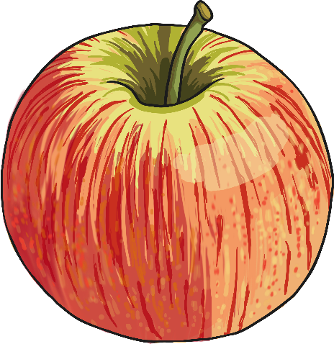
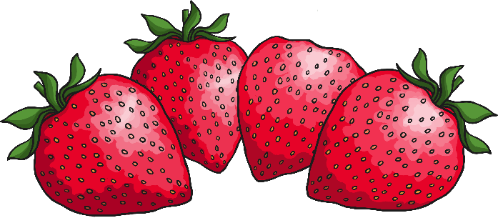
Which co-ordinating conjunction fits best?
Click the circles next to the
co-ordinating conjunctions to reveal.
Correct
Incorrect
Dad said I can eat some strawberries I can eat an apple.
and/or
but
so

Slide 11
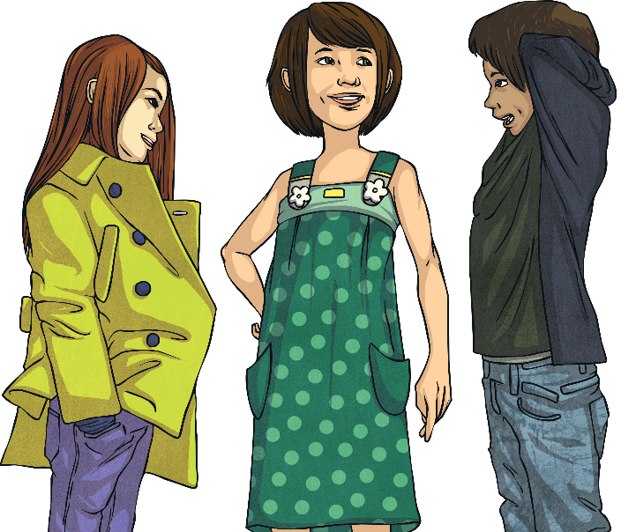
Which co-ordinating conjunction fits best?
Click the circles next to the
co-ordinating conjunctions to reveal.
Correct
Incorrect
Do you want to go now should we go later?
and
but
or
so

Slide 12
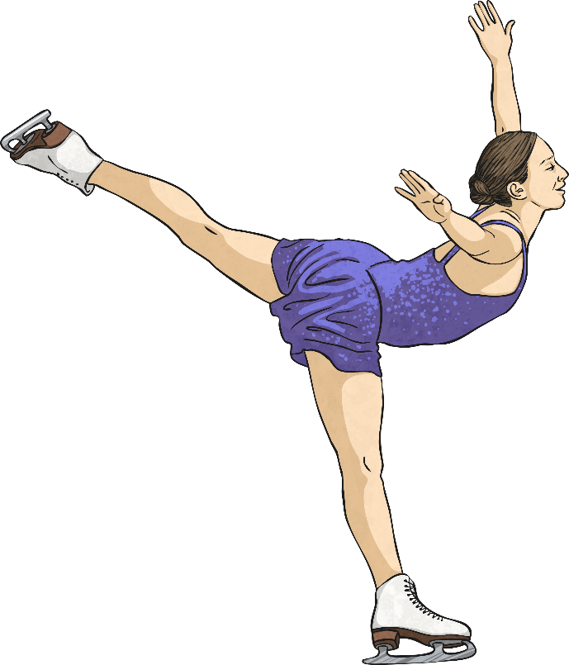
Which co-ordinating conjunction fits best?
Click the circles next to the
co-ordinating conjunctions to reveal.
Correct
Incorrect
Tom’s favourite sport is tennis Amina’s is ice skating.
and
but
or
so

Slide 13
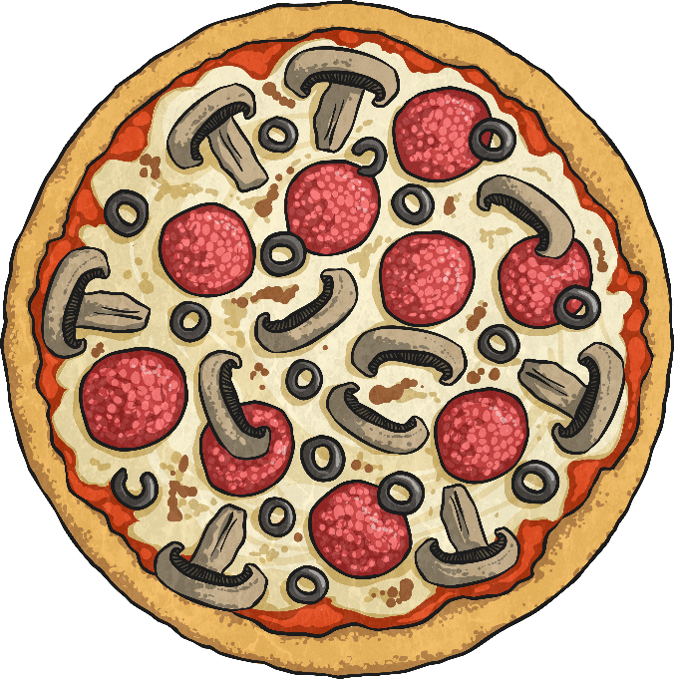
Which co-ordinating conjunction fits best?
Click the circles next to the
co-ordinating conjunctions to reveal.
Correct
Incorrect
My friend likes cheese they don’t like it on pizza.
and
but
or
so

Slide 14
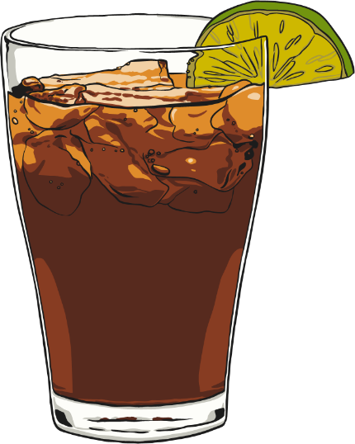
Which co-ordinating conjunction fits best?
Click the circles next to the
co-ordinating conjunctions to reveal.
Correct
Incorrect
Would you like fizzy pop would you prefer fruit juice?
and
but
or
so

Slide 15
Lessons Objectives
Objectives check:
understand what conjunctions mean
01
identify different types of conjunctions.
02
use the conjunctions properly.
03
04

