Slide 2
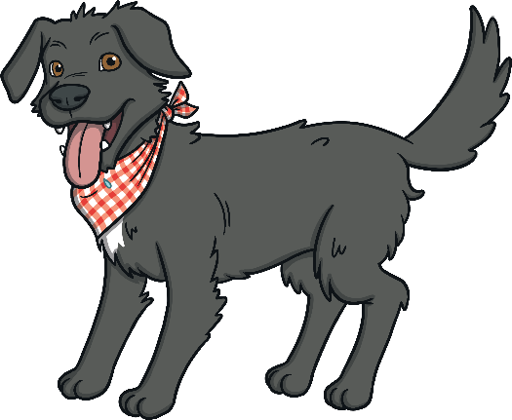
Identify the noun phrase in this sentence:
The dog barked loudly.
The dog
A
barked
B
loudly
C

Slide 3
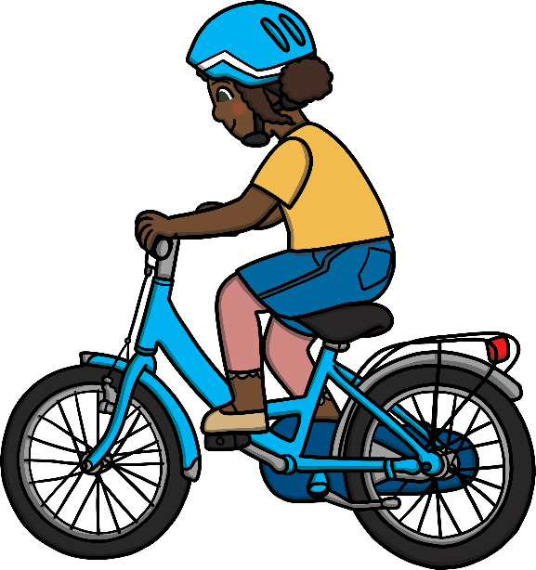
Identify the noun phrase in this sentence:
That blue bike is mine.
is mine
A
blue bike
B
That blue bike
C

Slide 4
Identify the noun phrase in this sentence:
I made a huge, pink birthday cake.
I made
A
a huge, pink birthday cake
B
birthday cake
C

Slide 5
Identify the noun phrases in this sentence:
The bakery on the corner sells lots of yummy pastries.
The bakery on the corner
A
lots of yummy pastries
B
The bakery on the corner lots of yummy pastries
C

Slide 6
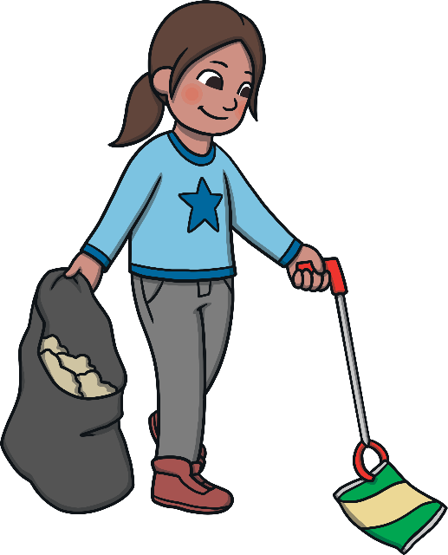
Identify the noun phrase in this sentence:
She picked up some litter.
She
A
picked up
B
some litter
C

Slide 7
Which adjective would work best in this noun phrase?
the sea
salty
A
sour
B
sweet
C

Slide 8
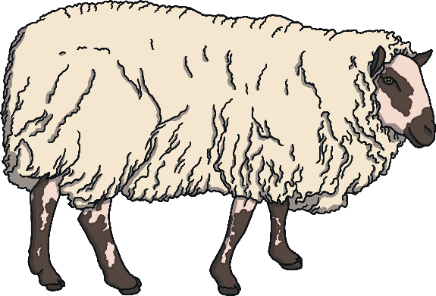
Which adjective would work best in this noun phrase?
a sheep
scaly
A
fluffy
B
slimy
C

Slide 9
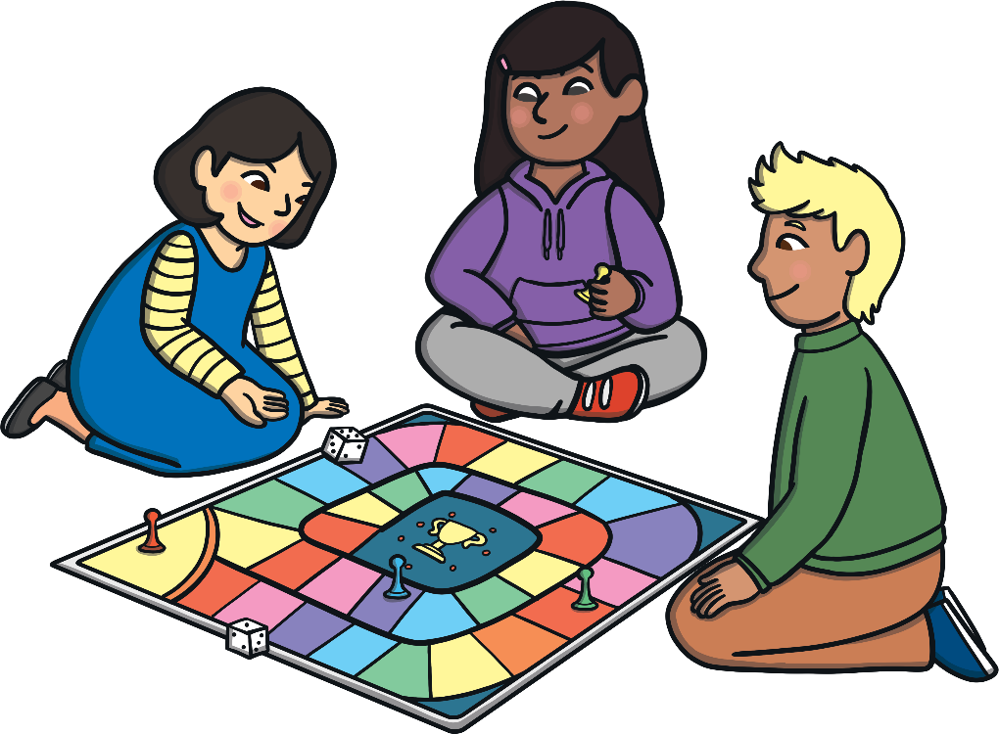
Which adjective would work best in this noun phrase?
a game
fun
A
rude
B
hungry
C

Slide 10
Which adjective would work best in this noun phrase?
this book
exciting
A
hairy
B
polite
C

Slide 11
Which adjectives would work best in this noun phrase?
that , jumper
soft, delicious
A
squeaky, short
B
warm, clean
C

Slide 12
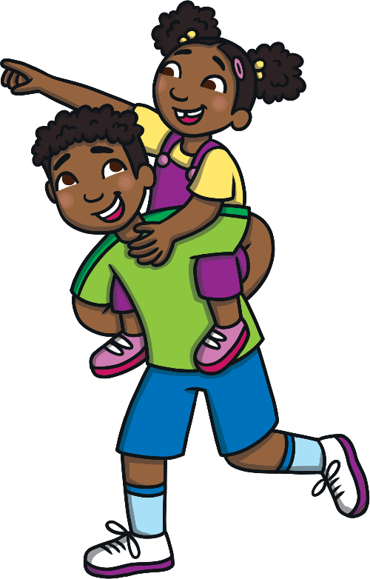
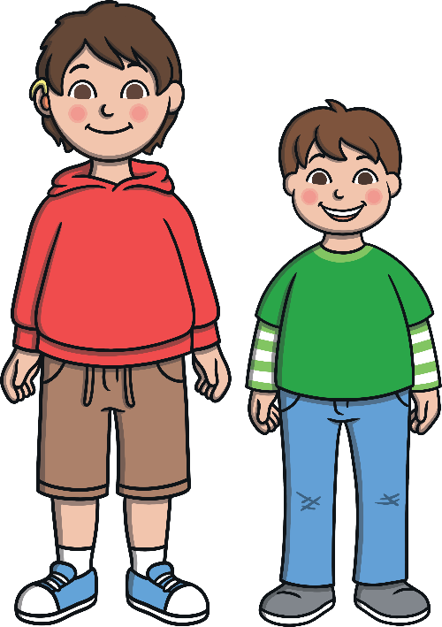
Which adjectives would work best in this noun phrase?
my , brother
kind, silly
A
annoying, fluffy
B
tall, late
C

Slide 13
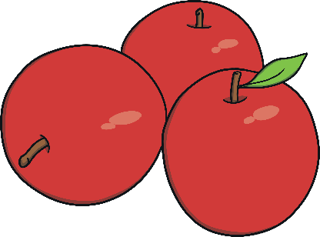
Which adjectives would work best in this noun phrase?
some , apples
orange, juicy
A
red, crunchy
B
green, greedy
C

