Slide 1
How Does a Computer Work?
the Magic in Simple Terms

Slide 2
A computer works by transforming the simple language of binary codes into the complex, multifaceted digital operations we rely on daily. From streaming your favorite show to crunching numbers for your work report, it’s a marvel of modern technology. But what exactly goes on behind the screen?

Slide 3
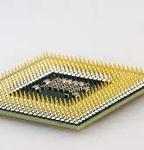
The Brain of the Computer – The Processor
Imagine a crowded city where every task, no matter how big or small, is coordinated flawlessly. This city is like the Central Processing Unit (CPU) of your computer, a masterpiece of engineering that orchestrates the entirety of how a PC works. The CPU, often referred to as the brain of the computer, is a critical part of the computer’s system architecture and is where the magic of how a computer works begins.

Slide 4
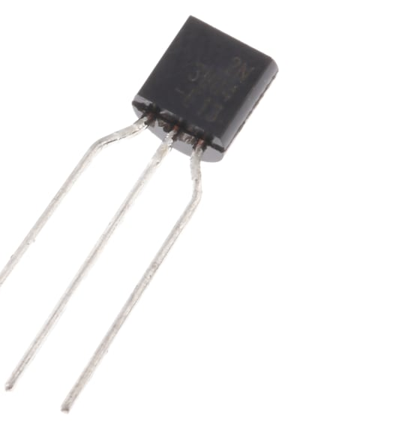
A Symphony of Transistors
So how does a computer work using a CPU? Comprising millions of tiny transistors, the CPU is a marvel of modern engineering. These transitions act as microscopic switches, rapidly flipping between the on and off states, representing the binary language of ones and zeros. This rapid flipping allows the CPU to perform its many calculations and process instructions at incredible speeds

Slide 5
Input and Output – Communication Channels
Understanding computer functioning and how PCs work is incomplete without delving into its communication channels: the input and output devices. These are the bridges between the user and the machine, facilitating a two-way conversation.

Slide 6
Decoding Outputs – How Computers Talk Back
On the flip side are output devices, which translate the computer’s digital language into a form we can perceive. The most familiar output device is the monitor, which displays text, images, and videos. Speakers and headphones convert digital audio signals into sound waves. Printers materialize digital documents into physical paper forms. Even newer technologies, like VR headsets, serve as output devices, creating immersive visual and auditory environments.

Slide 7
Boolean logic

