Slide 1
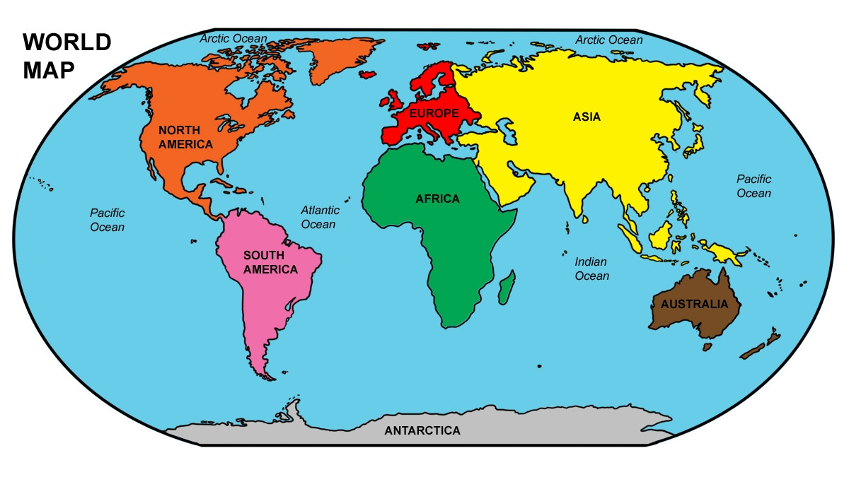

Slide 2
What a continent is? Continents are huge landmasses on Earth, like pieces of a giant puzzle.
1- Asia
2- Africa
3-North America
4-South America
5-Antarctica
6-Europe
7-Austerlia

Slide 3
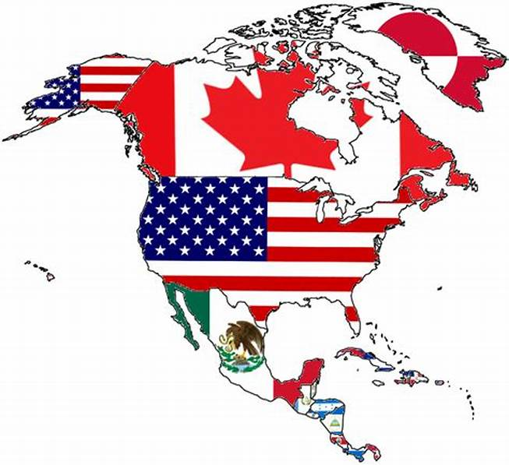
North America: -is the 3rd largest continent.
North America has many countries such as : United States, Canda, and Mexico.

Slide 4
United States:
We can call it United states of America or U.S.A.

Slide 5
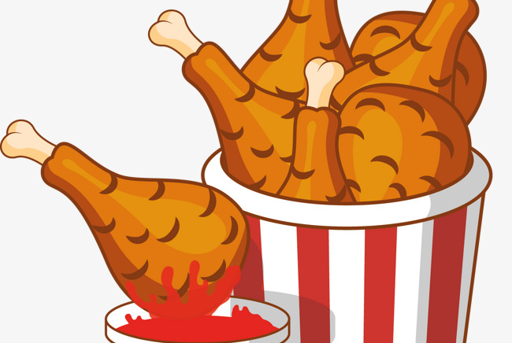
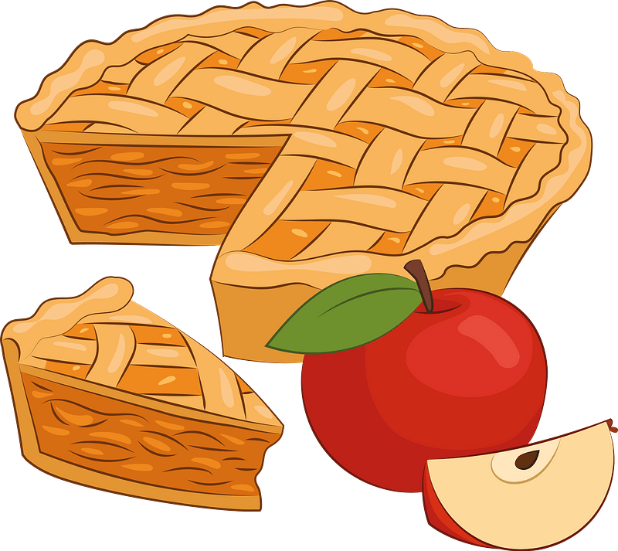
Famous food:

Slide 6
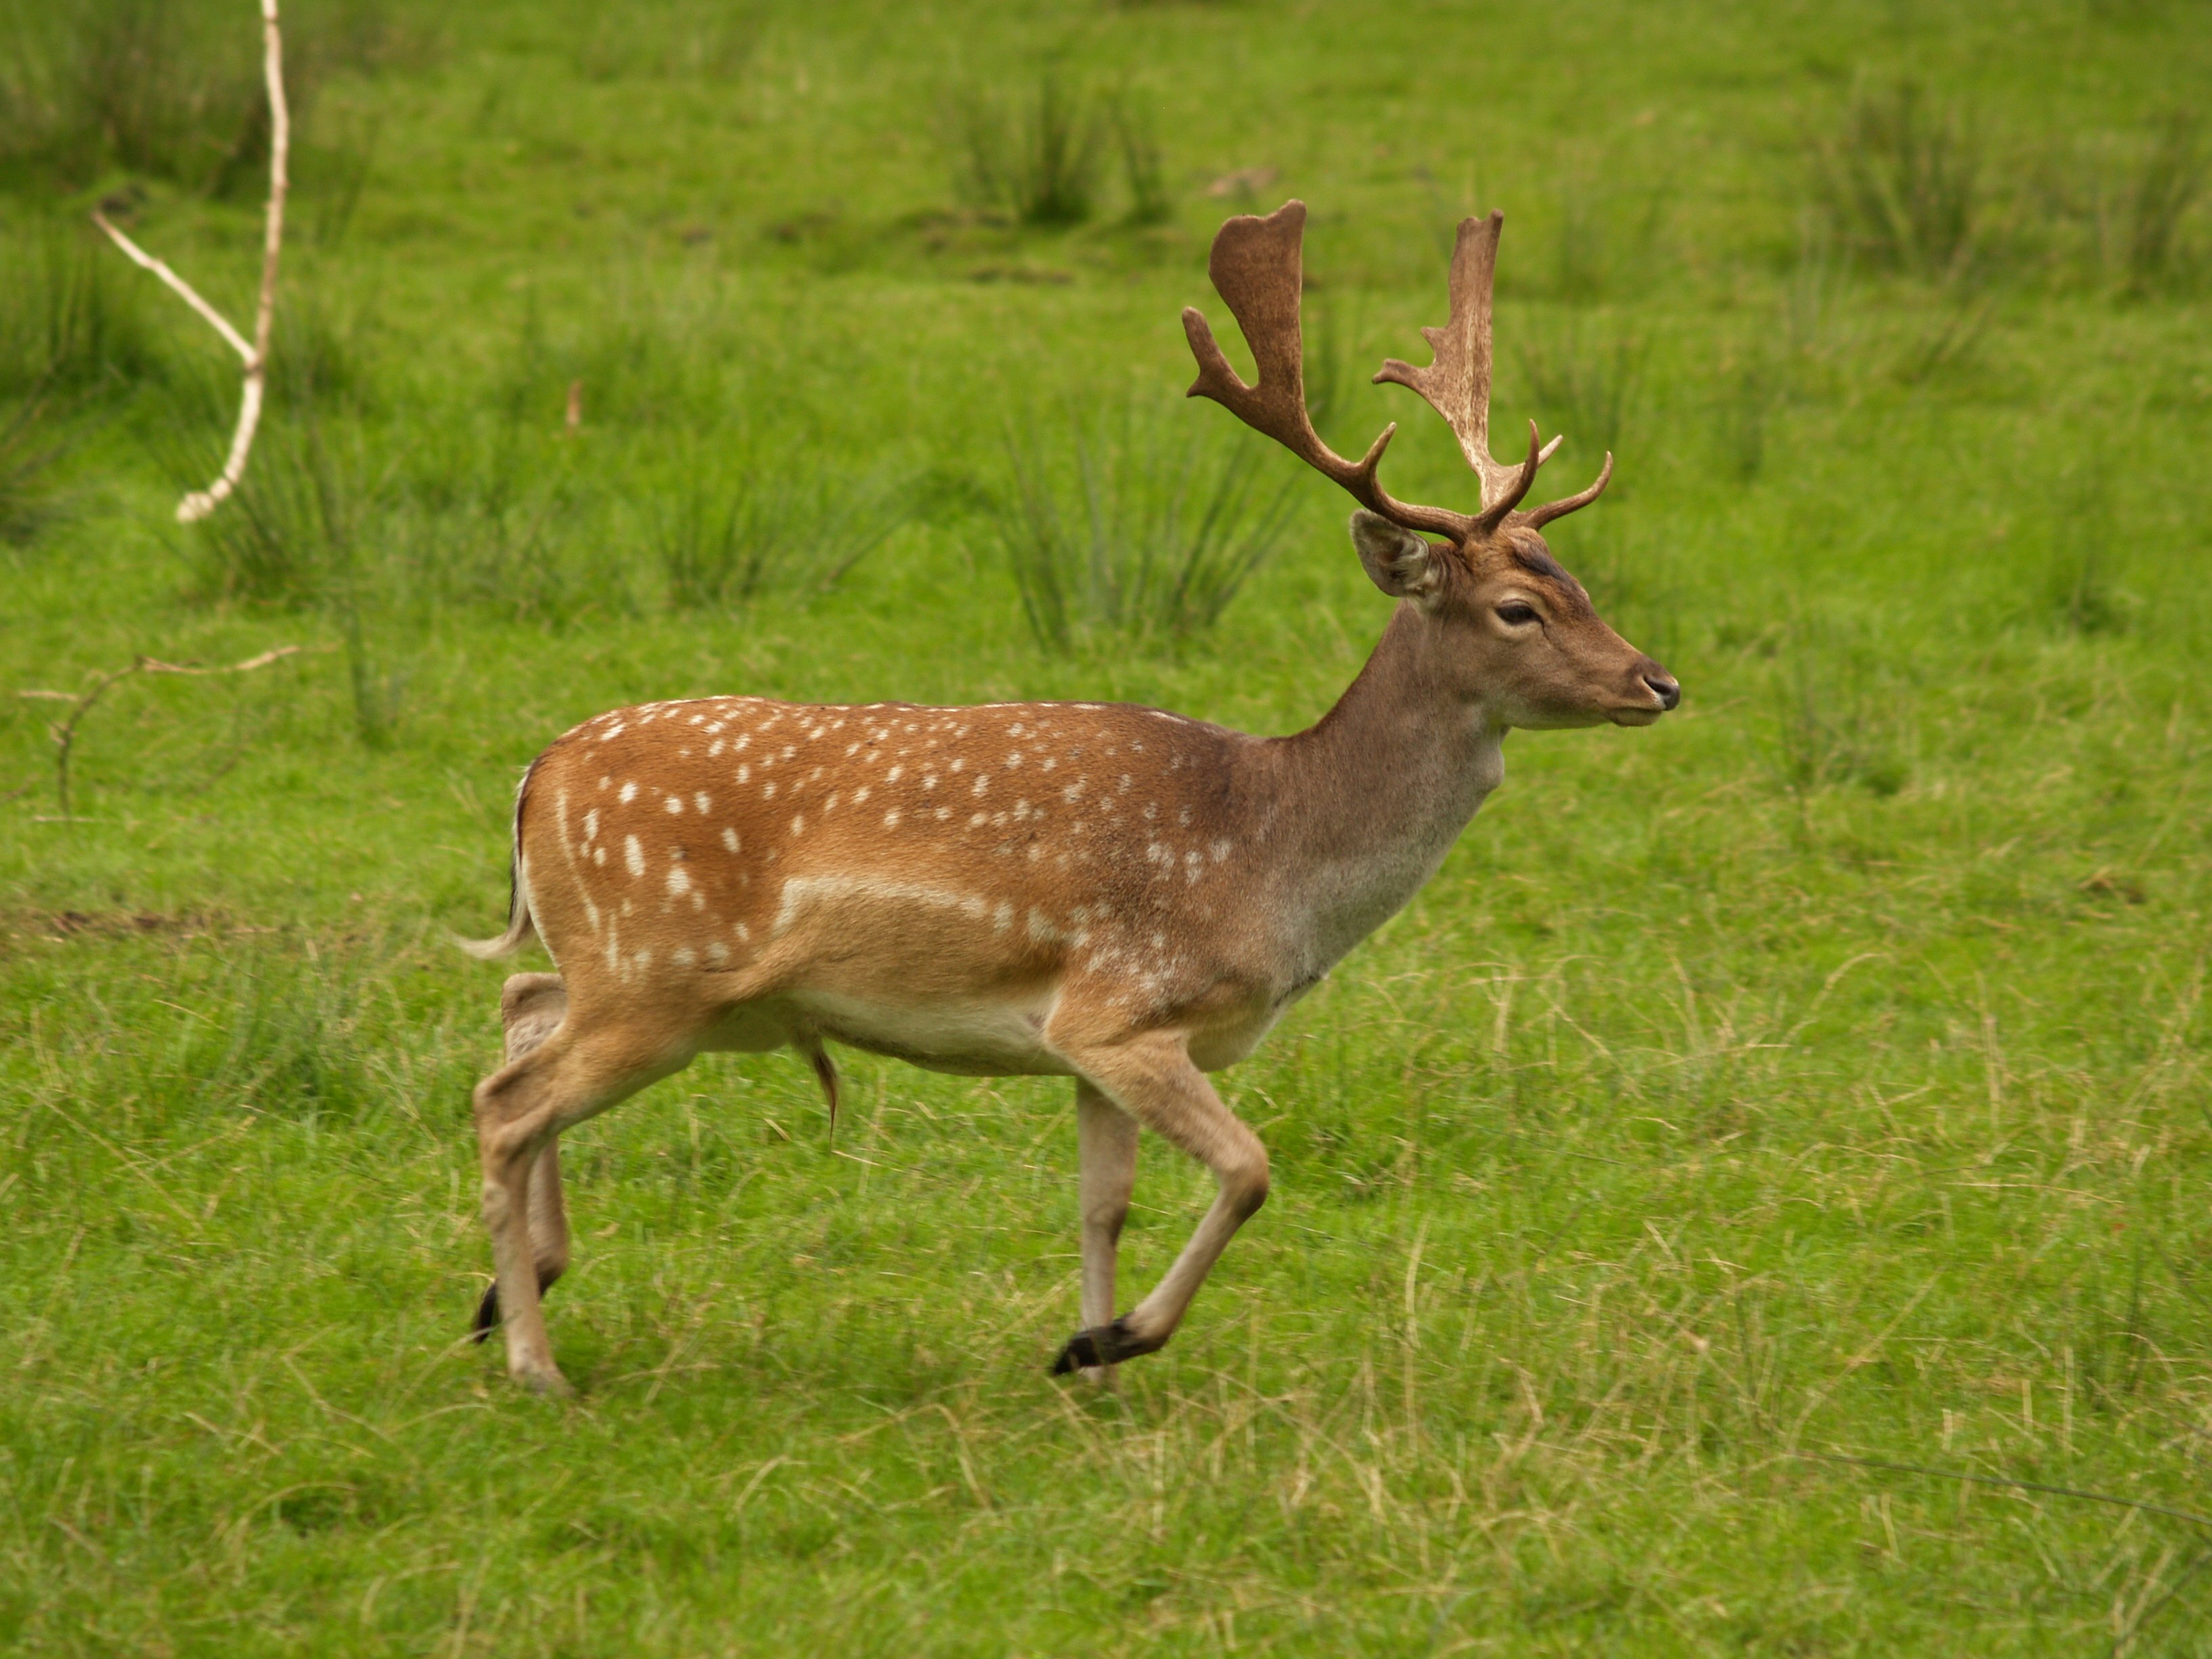
Famous Animals:
Racoon
Deer

Slide 7
Famous landmarks:
The Statue of Liberty
Colorado River

Slide 8
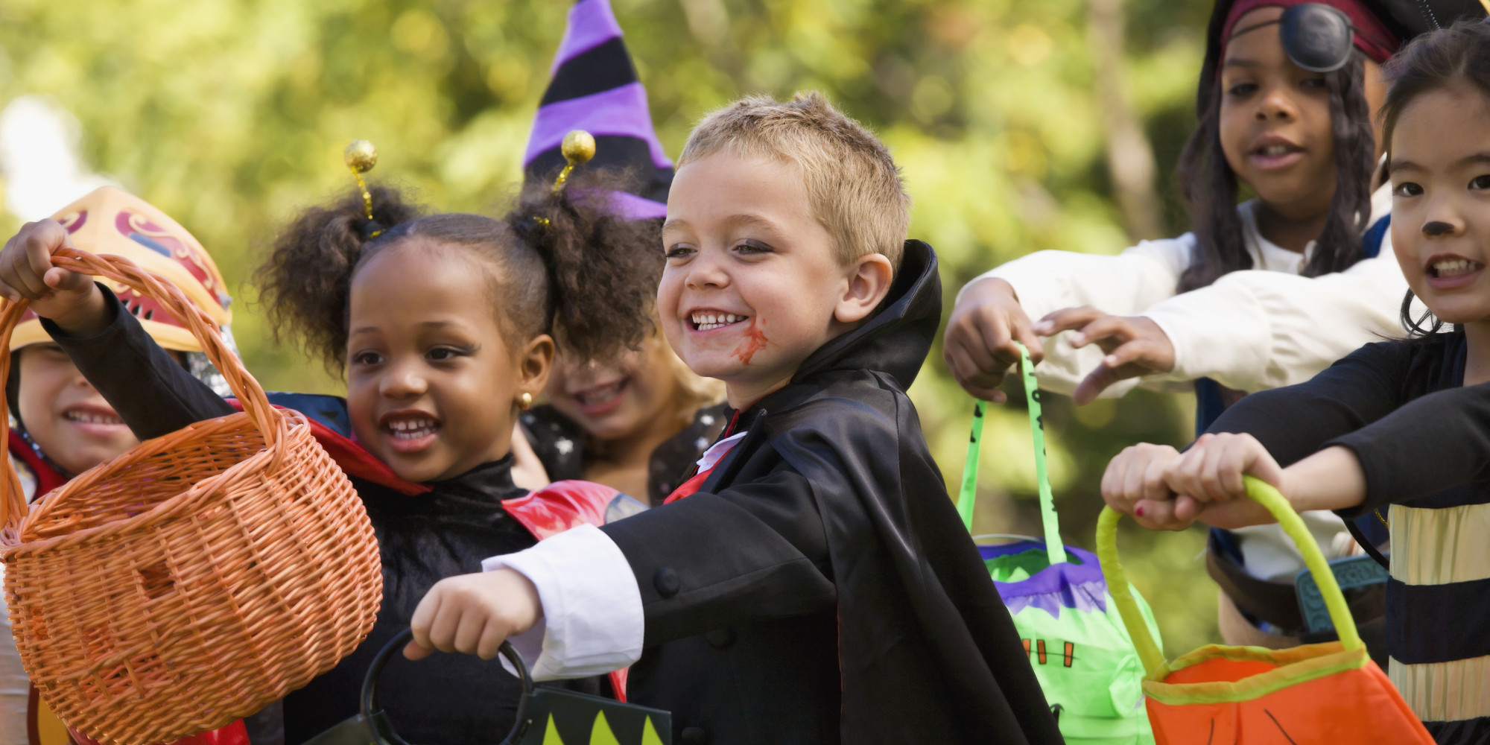
Traditional Celebrations:
Halloween
Halloween takes place on October 31. It is a time when people dress up in costumes, go trick-or-treating, and carve jack-o’-lanterns from hollowed out pumpkins.

Slide 9
South America: Is the 4th largest continent
It has many countries.
Such as : Brazil, Argentina, Colombia.

Slide 10
Brazil:
Brazil is the largest country at South America.

Slide 11
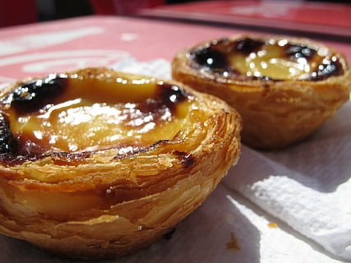
Famous Food
Cheese Bread
Brigadeiro
pastel

Slide 12
Famous Animals :
Toco Toucan
Piranha Fish
Not a nice fish, we need to take care of it.

Slide 13
Famous Landmarks:
Copacabana beach
Amazon Theater

Slide 14
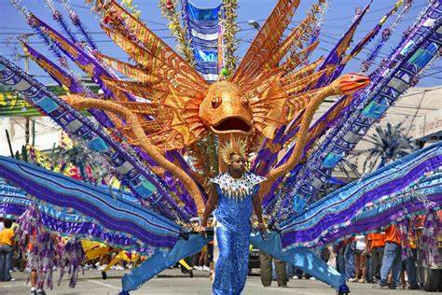
Traditional Celebrations:
it takes place in February or early March.
Its very colorful festival and it goes all over The country.

