Slide 2
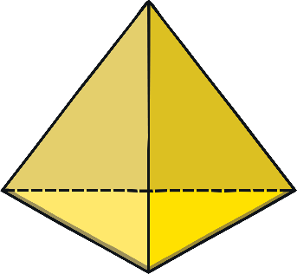
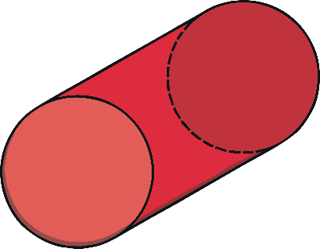
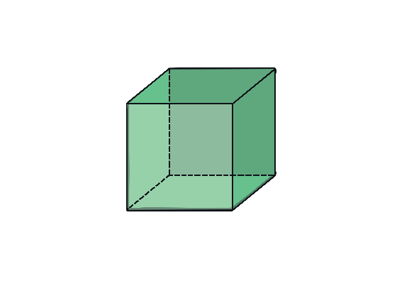
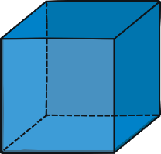
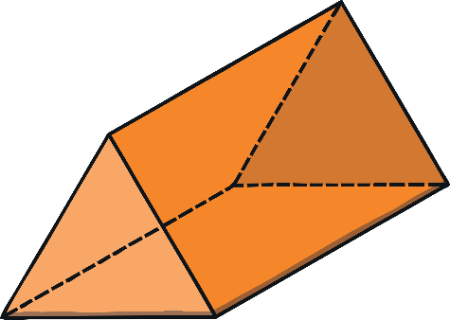
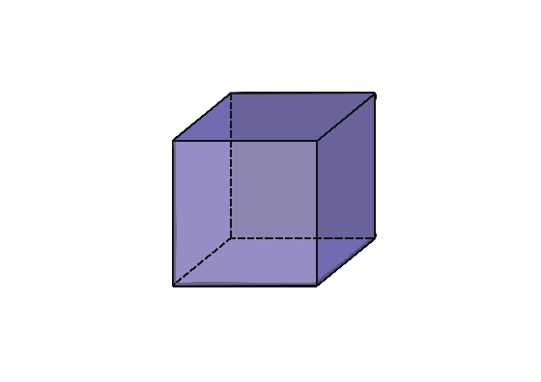
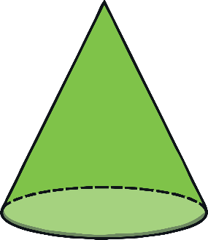
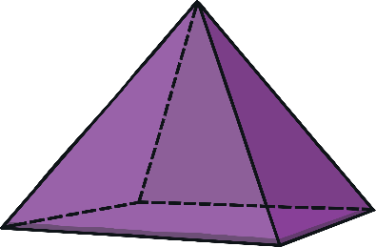
Which 3D Shape Is the Easter Bunny?
Click to reveal the Easter Bunny.
I am a cube Easter Bunny.
Can you help me to find all of the cube shapes?
next

Slide 3
Which 3D Shape Is the Easter Bunny?
Click to reveal the Easter Bunny.
I am a cylinder Easter Bunny.
Can you help me to find all of the cylinder shapes?
back
next

Slide 4
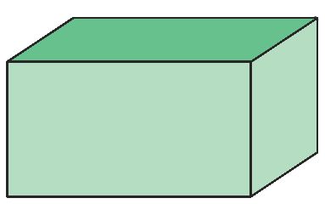
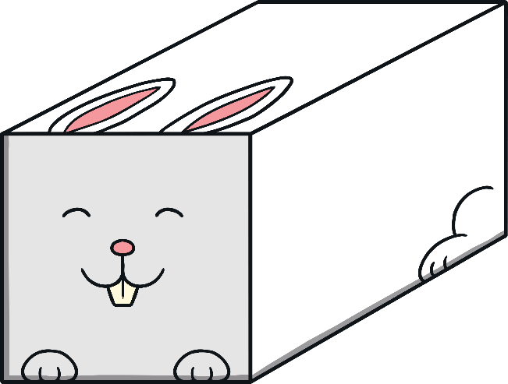
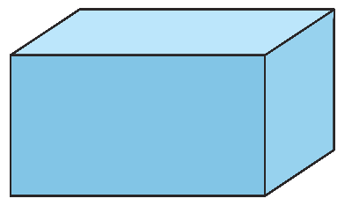
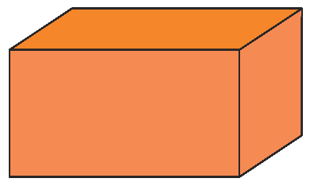
Which 3D Shape Is the Easter Bunny?
Click to reveal the Easter Bunny.
I am a cuboid Easter Bunny.
Can you help me to find all of the cuboid shapes?
back
next

Slide 5
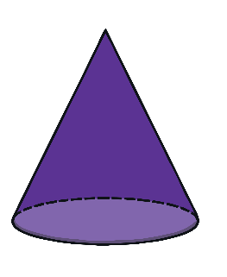
Which 3D Shape Is the Easter Bunny?
Click to reveal the Easter Bunny.
I am a cone Easter Bunny.
Can you help me to find all of the cone shapes?
back
finish

