Slide 1
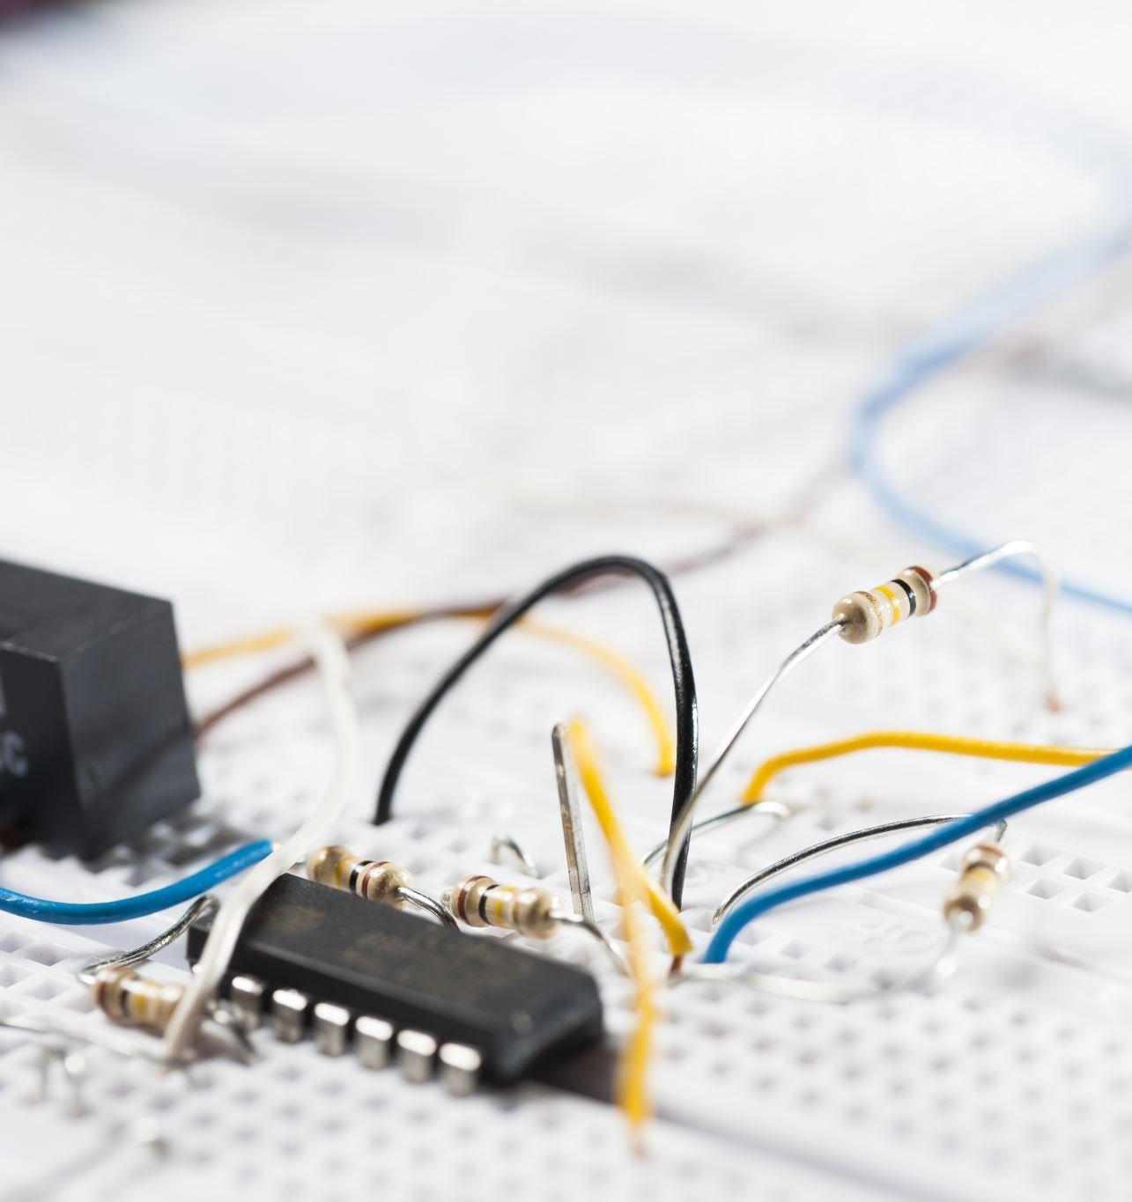
Adding or Removing Components
Lesson 9.5

Slide 2
Objectives
Find out what happens to current when you add more cells in a circuit
Find out what happens to current when you add more lamps in a circuit.

Slide 3
Warming up

Slide 4
Remember
That current is the same all the way around a series circuit.
You can think of the electrons in a series circuit like a train. All parts of the train move at the same speed on the track. The back of the train cannot go faster than the front of the train. As soon as one part of the train moves, all the train will move.

Slide 5
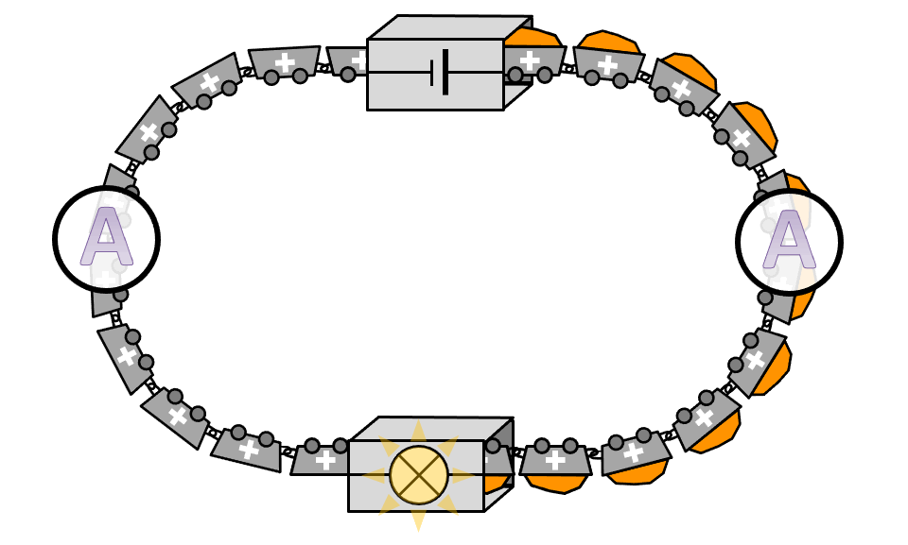
Moreover
Electrons flow at the same speed in the wires of a series circuit. When electrons start to flow in one part of the circuit, they all start to flow.
That means you can put an ammeter at any position in a series circuit and it will give the same result.
It also means that you can put the same components of a series circuit in a different order and the current will be the same.

Slide 6
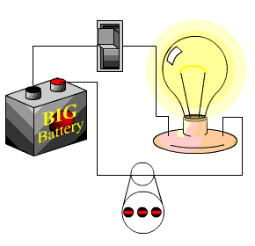
But
Adding components or removing components will affect the current.
The effect depends on what components are changed.

Slide 7
1- Adding or removing cells
Cells and batteries are stores of chemical energy. In a complete circuit, the chemical energy gets changed to electrical energy.
That means if you add more cells to a circuit, you have more chemical energy to change into electrical energy in the circuit.

Slide 8
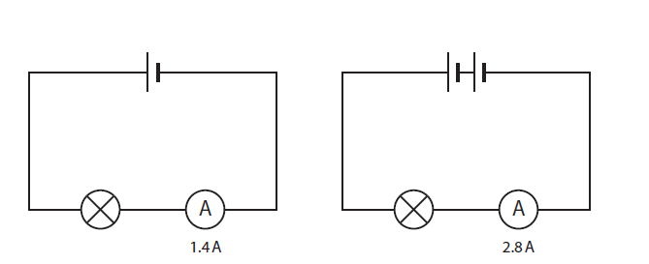
Look at the two circuits.
Each component is identical in both circuits.
The circuit with two cells has double the electrical energy of the circuit with one cell.
The lamp will be brighter.
The ammeter in the circuit with two cells shows that the current is doubled.

Slide 9
Safety tips
You need to be careful adding more cells to a circuit. The lamps can be damaged, and the wires can get hot.
Adding more cells increases the current when the other components are kept the same.
Removing cells decreases the current when the other components are kept the same.

Slide 10
2- Adding or removing lamps
Lamps change electrical energy to light energy and thermal energy.
Electrons carry electrical energy around a circuit.
When the electrons pass through a lamp, the electrons transfer some of their electrical energy to the lamp. The lamp changes the electrical energy into light energy and thermal energy.

Slide 11
Remember that
The current is the same at all positions in a series circuit.
Putting a lamp in a circuit will make the electrons move more slowly, but they move more slowly the whole way around the circuit.
The more the components, the more the resistance and less amps recorded by the Ammeter

Slide 12
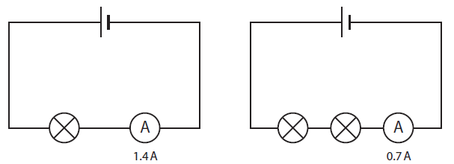
Do you know?
The circuit with two lamps transfers twice as much energy as the circuit with one lamp. The lamps will be dimmer. That means they do not shine as brightly.
This makes the electrons move at half the speed, so the reading on the ammeter is halved.
Adding more lamps decreases the current when the other components are kept the same.
Removing lamps increases the current when the other components are kept the same.

Slide 13
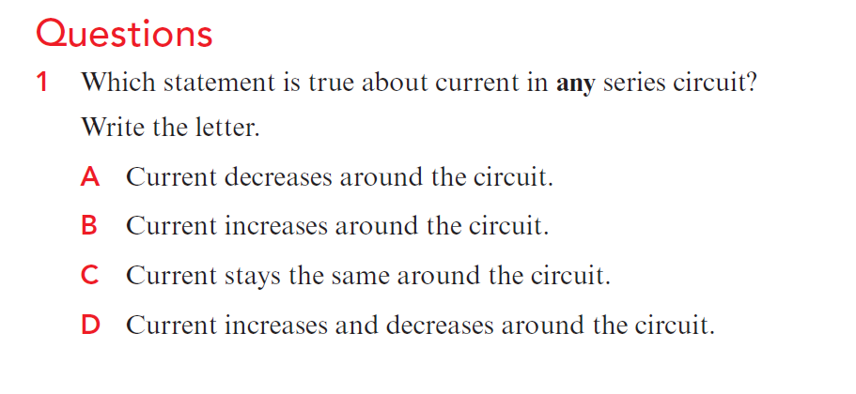
Check your progress
1- C

Slide 14
2 a- B
b Increasing the number of cells in a circuit will increase the current.
3 a- C
b Decreasing the number of lamps in a circuit will increase the current.
4 a- Add another cell; remove one of the lamps. b- Remove one of the cells; add another lamp.

