Slide 2
Subject Pronouns

Slide 3
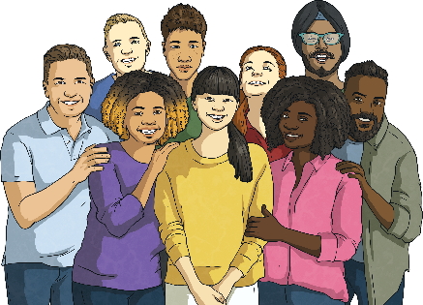
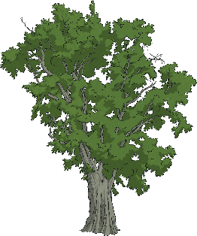
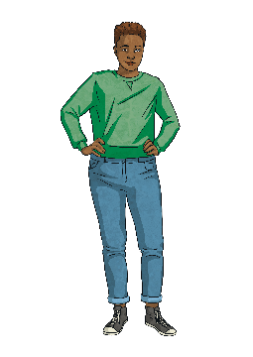
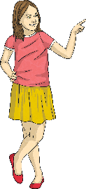
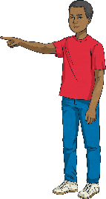
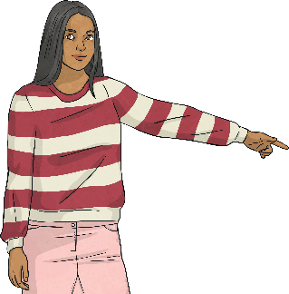
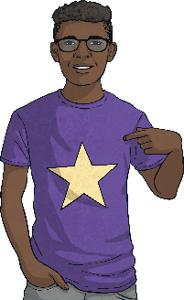
A pronoun goes in the place of a noun.
Match the pictures with the pronouns:
I
You
He
She
It
We
They
A
B
C
D
E
F
G
A
B
C
D
E
F
G
Show Answers
Show Answers

Slide 4
I - You - He - She - It - We - They
We use these pronouns when the noun is the subject of the sentence. That means that the pronoun is the person or thing doing the action.
E.g.
I love cats (I do the action of ‘love’. The cats receive the love.)
We play football. (We do the action of ‘play’. Football is the thing that we play).
They are from France. (We are describing where ‘they’ are from).
Remember: ‘They’ can be for plural people or plural objects or animals.

Slide 5
Complete the sentences with the correct subject pronoun.
1. This is my sister. is a teacher.
2. “I like your phone.” “Thanks! is new.”
3. “How old is your brother?” “ is ten years old.”
4. I live with my family. live in a small house.
5. I love the band BTS. are from South Korea.
6. “Do have a pet? “Yes, I do!”
7. “Do you play tennis?” “No, don’t!”
She
It
He
We
They
you
I
Show Answers
Show Answers

Slide 6
Remember:
We use a noun or a pronoun, we don’t use both!
So:
My sister she is a teacher.
My sister is a teacher.
She is a teacher.

Slide 7
Object Pronouns

Slide 8
We use an object pronoun when the noun isn’t doing the action, it is receiving the action.
e.g.
I love she. I love her.
I love he. I love him.

Slide 9
Match the subject pronoun with the object pronoun.
I
You
He
She
It
We
They
Her
Him
Them
It
You
Us
Me
Show Answers
Show Answers

Slide 10
Complete the sentences with the correct object pronoun.
1. “Do you like my new hat?” “Yes, I love !”
2. “Hi, my name is Tom.” “Nice to meet , Tom!”
3. Can you help , please? I have a problem.
4. Sarah has a problem. Can I go and help ?
5. James has a problem. Can I go and help ?
6. Kelly and I are going to the cinema. Do you want to come with ?
7. “Do you like cats?” “Yes, I love !”
it
you
me
her
him
us
them
Show Answers
Show Answers

