Slide 1
Appositives
p. 69

Slide 2
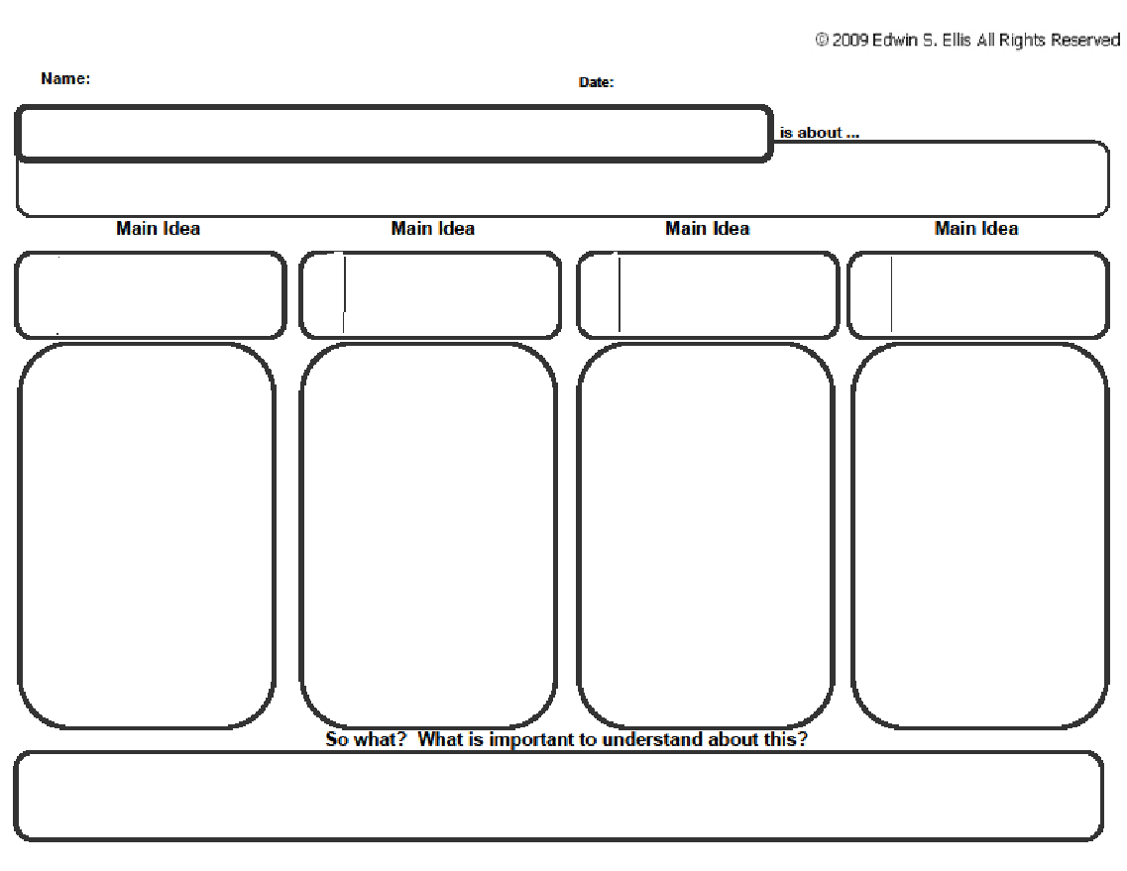
Appositive Phrases
explanatory phrases that follow nouns/pronouns.

Slide 3
Appositives
An appositive is a noun or pronoun that immediately follows another noun or pronoun to identify or explain it.
Example
Our teacher, Mrs. Morrow, is the coolest.

Slide 4
Commas with Appositives
When an appositive is essential to the meaning of the noun to which it belongs, don’t use commas.
When the noun preceding the appositive provides sufficient identification on its own, use commas around the appositive.
Examples
Sarah Morrow, our teacher, was born in Waukegan, IL.
Teacher Sarah Morrow was born in Waukegan, IL.

Slide 5
Appositive Phrases
explanatory phrases that follow nouns/pronouns.
Appositives
Commas
a noun or pronoun that immediately follows another noun or pronoun to identify or explain it.
Appositives are sometimes set off by commas, but not always.

Slide 6
Appositive Phrases
An appositive phrase is made up of the appositive and its modifiers.
TIP: The appositive phrase ends at the next punctuation mark or verb.
Example
My neighbor got her degree in entomology, the scientific study of insects.
Brian, our friend and classmate, is a good student.

Slide 7
Appositive Phrases Cont’d
Occasionally the appositive phrase precedes the noun or pronoun explained.
Creates sentence variety.
Example
An accomplished gardener, Mr. Bostwick could grow vegetables in Antarctica.
The best teacher in the building, Mrs. Morrow could teach a monkey English.

Slide 8
Appositive Phrases
explanatory phrases that follow nouns/pronouns.
Appositives
Commas
Appositive Phrases
Tip
a noun or pronoun that immediately follows another noun or pronoun to identify or explain it.
Appositives are sometimes set off by commas, but not always.
An appositive phrase is made up of the appositive and its modifiers.
The appositive phrase ends at the next punctuation mark or verb.
Occasionally the appositive phrase precedes the noun or pronoun explained.
Appositive phrases…

Slide 9
Sentence Combining
Directions: Combine the following sentences by forming appositives. (Note: Do not use who, which or that to form an appositive)
The car was made in 2009. It is a Toyota. It is red. It belongs to Joe.
The girl is little. She is cute. She is also very smart. Her name is Mary.
Vincent van Gogh was a famous artist. He painted “The Starry Night.” He painted it in 1889.
We watched a movie. The title was “Peter Pan.” It is my favorite movie.
He is my favorite uncle. His name is Bob. He is winning the game.

Slide 10
PRACTICE & APPLY p. 70 #1-5
Directions: Identify the appositive phrase in each sentence. Then, identify the word(s) the phrase identifies.
Wilma Rudolph, another champion sprinter, also overcame a disability.
Rudolph was born with the disease polio.
Her mother, Blanche Rudolph, helped her recover.
Rudolph, a determined child, ignored doctors’ predictions about never being able to walk again.
A basketball star at age 13, she was known for her speed.

