Slide 2
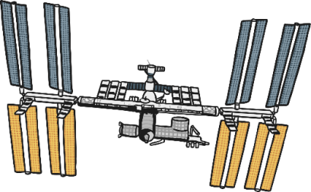
Choose an image

Slide 3
THE SUM WOULD BE WRITTEN LIKE THIS
START
MORE SPACE STATIONS
REVEAL ANSWER
Home

Slide 4
THE SUM WOULD BE WRITTEN LIKE THIS
START
MORE ASTRONAUTS
REVEAL ANSWER
Home

Slide 5
THE SUM WOULD BE WRITTEN LIKE THIS
START
MORE ALIENS
REVEAL ANSWER
Home

Slide 6
THE SUM WOULD BE WRITTEN LIKE THIS
START
MORE ROBOTS
REVEAL ANSWER
Home

Slide 7
THE SUM WOULD BE WRITTEN LIKE THIS
START
MORE ROCKETS
REVEAL ANSWER
Home

Slide 8
THE SUM WOULD BE WRITTEN LIKE THIS
START
MORE SATELLITES
REVEAL ANSWER
Home

Slide 9
THE SUM WOULD BE WRITTEN LIKE THIS
START
MORE ASTRO BIRDIES
REVEAL ANSWER
Home

Slide 10
THE SUM WOULD BE WRITTEN LIKE THIS
START
MORE ALIENS
REVEAL ANSWER
Home

Slide 11
THE SUM WOULD BE WRITTEN LIKE THIS
START
MORE EARTHS
REVEAL ANSWER
Home

