Slide 2
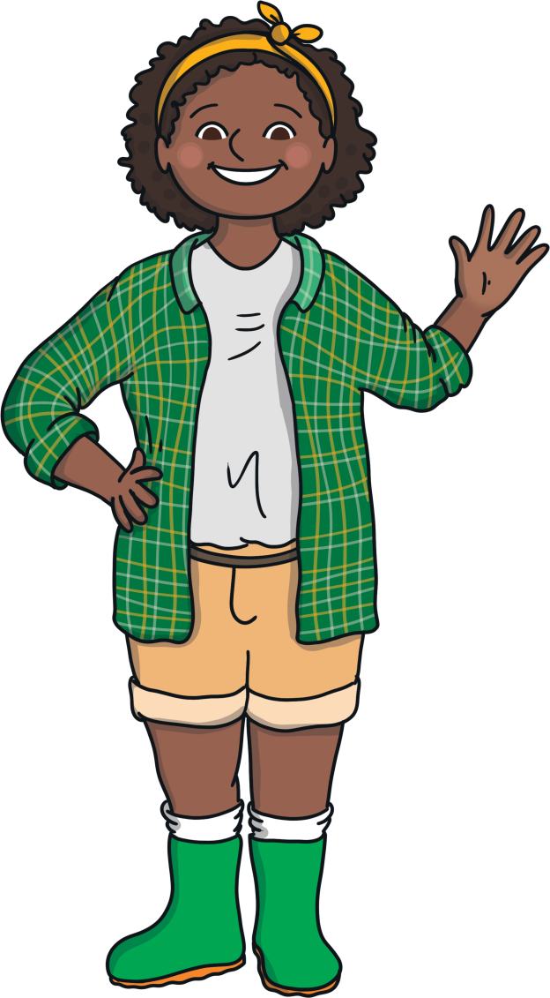
Instructions
There is a hungry rabbit on the farm who keeps digging up all of my number carrots!
Can you help me work out which carrots the rabbit takes?

Slide 3
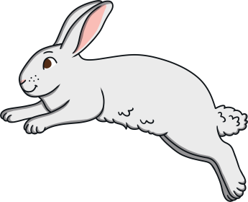
The rabbit took a carrot! What number carrot did the rabbit take? Click the rabbit to take the carrot.
1
2
4
3
6
7
Click on the number the hungry rabbit took.

Slide 4
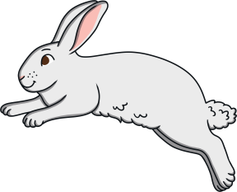
I took the number 3 carrot.
Now I’m going to look for some more number carrots!
1
2
3
4
Next

Slide 5
How can we work out which carrot the hungry rabbit took? Click the rabbit to take the carrot.
5
7
8
3
9
6
Click on the number the hungry rabbit took.

Slide 6
I took the number 6 carrot.
Now I’m going to look for some more number carrots!
5
6
7
8
Next

Slide 7
I think the hungry rabbit took number carrot 5. Am I correct? Why? Why not? Click the rabbit to take the carrot.
6
8
9
2
7
10
Click on the number the hungry rabbit took.

Slide 8
I took the number 7 carrot.
Now I’m going to look for some more number carrots!
6
7
8
9
Next

Slide 9
Can you count up from 7 to find the number carrot that rabbit took? Click the rabbit to take the carrot
7
8
9
6
1
10
Click on the number the hungry rabbit took.

Slide 10
I took the number 10 carrot.
Now I’m going to look for some more number carrots!
7
8
9
10
Next

Slide 11
Thank you for helping me work out which number carrots the rabbit took.
I will harvest these carrots and share them with the hungry rabbit!
Can you say the numbers below to check we have all of the number carrots?
1
2
3
4
5
6
7
8
9
10

