Slide 1
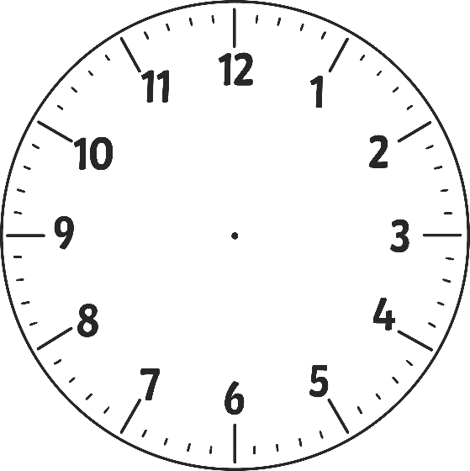
Disclaimer/s
We hope you find the information on our website and resources useful.
Animations
This resource has been designed with animations to make it as fun and engaging as possible. To view the content in the correct formatting, please view the PowerPoint in ‘slide show mode’. This takes you from desktop to presentation mode. If you view the slides out of ‘slide show mode’, you may find that some of the text and images overlap each other and/or are difficult to read.
To enter slide show mode, go to the slide show menu tab and select either from beginning or from current slide.
You may wish to delete this slide before beginning the presentation.

Slide 3
Analogue Clock Face
An analogue clock face is just a different type of number line.
It has the numbers 1 to 12 on its face.

Slide 4
Analogue Clock Face
We can use a number line to help us make a clock face!

Slide 5
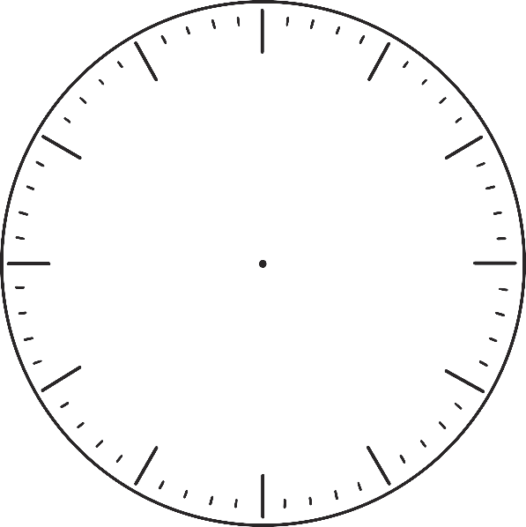
Whole, Halves and Quarters
1 whole
½ or half
¼ or quarter

Slide 6
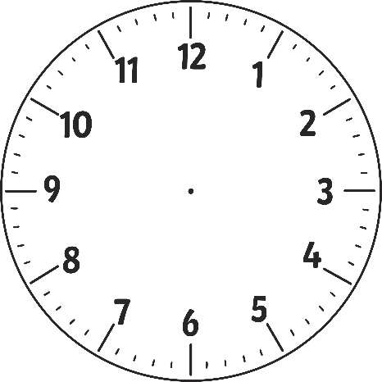
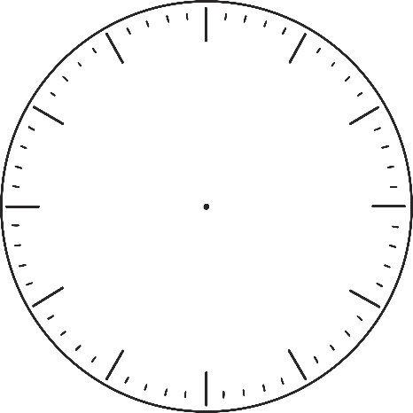
Halves and Half Past
The whole clock is 12. The minute hand points to 12 for o’clock times.
When the minute hand points to the 6, or is halfway around the clock, we say it is half past.

Slide 7
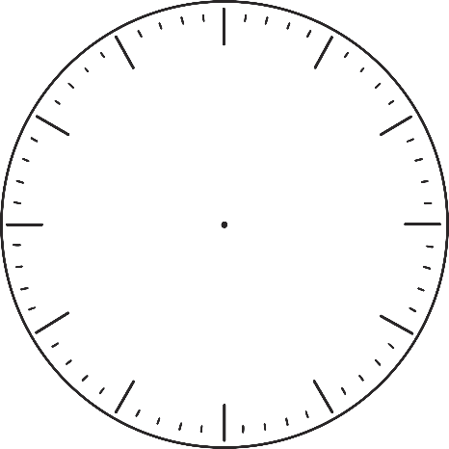
Quarter Past and Quarter To
When the minute hand points to the 3, or is quarter of the way around the clock, we say it is quarter past.
When the minute hand points to the 9, or is three quarters of the way around the clock and only one quarter away from the next hour, we call this quarter to.

Slide 8
Why Is Telling the Time Important?
We need to understand how long something takes in order to plan.
What time does school start?
How long does it take to get there?
What time will you need to leave?
Understanding time can help you get to where you need to be, on time!
An analogue clock face is just a different type of number line. It has 1 to 12 on its face. Thinking about an analogue clock as a number line can help you solve problems about time. Let’s see how that works!

Slide 9
Questions About Time
The movie starts at 7 o’clock. It lasts for 2 hours.
What time does the movie finish?
Reveal Answer

Slide 10
The movie ends at 9 o’clock!

Slide 11
Half Past and Quarter To Number Lines
When we include halves and quarters the number line changes slightly.
Half
One hour is 60 minutes, and half of 60 is 30 minutes. Halfway between each hour we put 30 on the number line.

Slide 12
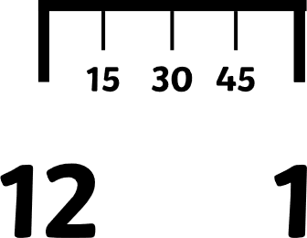
Half Past and Quarter To Number Lines
Quarter
A quarter of an hour is 15 minutes. At quarter past, it is 15 minutes past the hour. Quarter to is 3 quarters past the hour, which is 45 minutes.

Slide 13
Questions About Time
The plane leaves at 4:30 in the afternoon. The flight takes 4 hours.
What time does the flight arrive?
Reveal Answer

Slide 14
The flight arrives at half past 8 or 8.30.

Slide 15
Questions About Time
The train to Glasgow leaves at quarter past 2.
The train journey takes 3 hours.
What time does the train arrive in Glasgow?
Reveal Answer

Slide 16
The train arrives at quarter past 5 or 5.15.

Slide 17
Questions About Time
You arrive at the park at 1 o’clock.
You spend 2 hours and 15 minutes at the park.
What time do you leave the park?
Reveal Answer

Slide 18
You leave the park at quarter past 3 or 3.15.

Slide 19
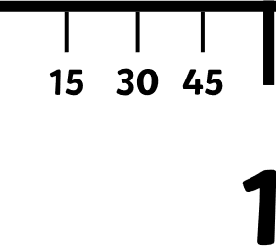
Questions About Time
You are going on a class trip to the aquarium at quarter to 10.
You will be spending 3 hours on the trip.
What time does the trip finish?
Once we pass the midday point and reach 12 o’clock, the number line begins again as each time occurs twice in one day. This is because there are 24 hours in a day (2 x 12 = 24).
Reveal Answer

Slide 20
The trip finishes at quarter to 1 or 12.45.

Slide 21
Questions About Time
The bus arrives at quarter past 7.
It takes 5 and a half hours to reach its destination.
What time does the bus arrive at its destination?
Reveal Answer

Slide 22
The bus arrives at quarter to 1 or 12.45.

Slide 23
Questions About Time
You begin the football match at quarter past 12 and finish 2 hours later. What time does the match finish?
Answer: Quarter past 2 or 2.15.
Reveal Answer
The concert begins at 6 o’clock and lasts for 3 hours and 15 minutes. What time does the concert end?
Answer: Quarter past 9 or 9.15.
Reveal Answer
The train departs at quarter to 3 and the journey is 4 hours long.
What time does the train arrive at its destination?
Answer: Quarter to 7 or 6.45.
Reveal Answer
The runner begins the long distance race at half past 12 and takes 2 hours and 15 minutes to complete it. What time does the runner finish the race?
Answer: Quarter to 3 or 2.45.
Reveal Answer

