Slide 1
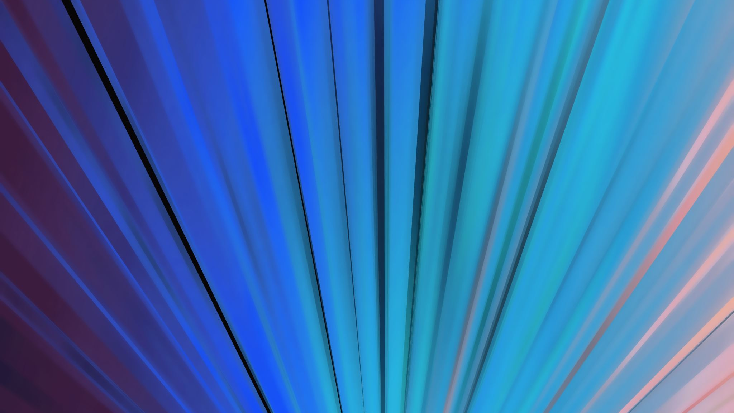
1.2 Animal Cells

Slide 2
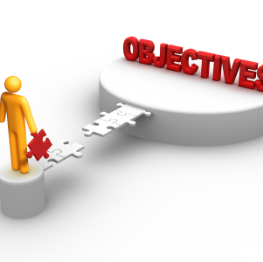
Objectives:
Find out how animal cells differ from plant cells
Use a microscope to look at some animal cells

Slide 3
Key words:
Stain

Slide 4
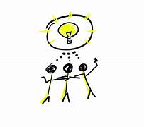
Getting started:
There are five parts of a plant cell with names beginning with the letter C.
Make a list of these five parts. Think about how you can remember what each of the words means.
Be ready to share your ideas.

Slide 5
https://www.sheppardsoftware.com/science/cell/plant/game/

Slide 6
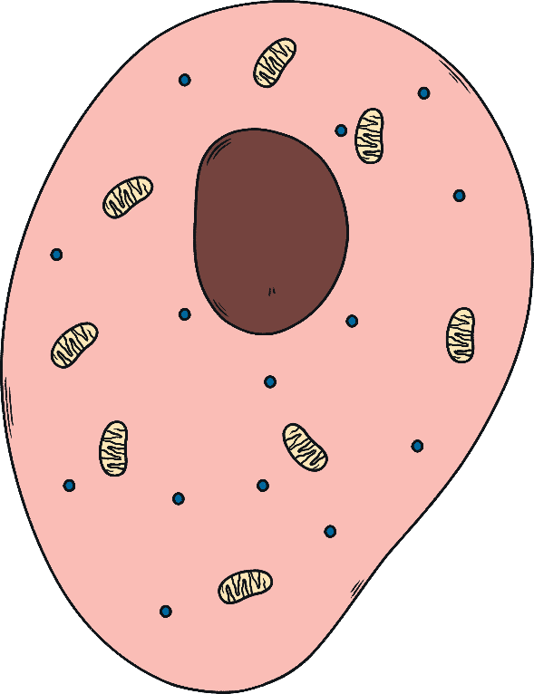
Inside Animal Cells
Look at the image, can you guess in pairs where each of these are?
A place where the cell’s activities are controlled.
A place where chemical reactions happen.
A place where substances can pass in and out of the cell.
A place where energy is released for the cell.

Slide 7
Inside Animal Cells
A
B
Look at the image, can you guess in pairs where each of these are?
A place where the cell’s activities are controlled.
A place where chemical reactions happen.
A place where substances can pass in and out of the cell.
A place where energy is released for the cell.
C
D

Slide 8
Label the following animal cell diagram:
Nucleas
Cell membrane
Vacuole
Cytoplasm
Mitochondria

Slide 9
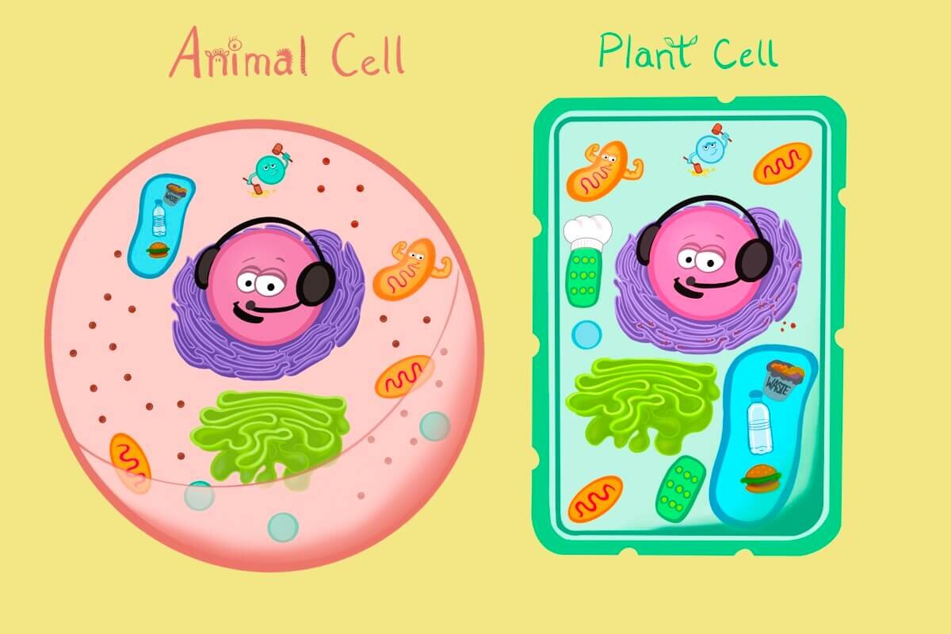
Difference and similarities between animal cells and plant cells

Slide 10
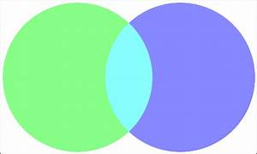
Fixed shape
Cell wall
Sap vacuole
sometimes Chloroplasts
Cytoplasm
Nucleus
mitochondrion
cell membrane
Do not have fixed shape
Do not have cell wall
Smaller vacuole or not at all
Plant cells
Animal cells
Similarities

Slide 11
Animal cells
ORGANELLES
Little organs
Each has its own function
Common to most cells

Slide 12
1. Cell membrane:

Slide 13
2. Nucleas:
Brain of the cell.
Home to cell chromosomes.
Chromosomes are basically the instructional menu on how to make new cells.

Slide 14
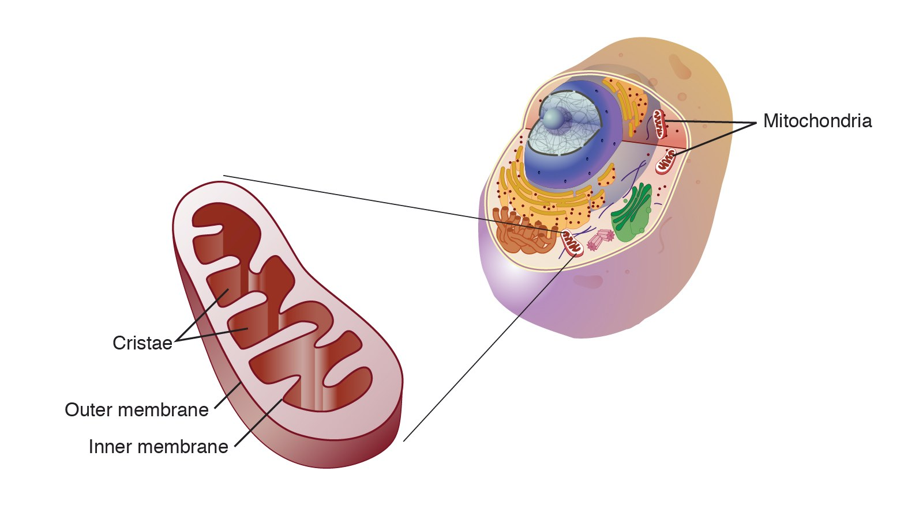
3. Mitochondria:
The energy factory of the cell.
Similar to the power company that gives electricity to the city.
It provides energy needed to power the cell by breaking down food.

Slide 15
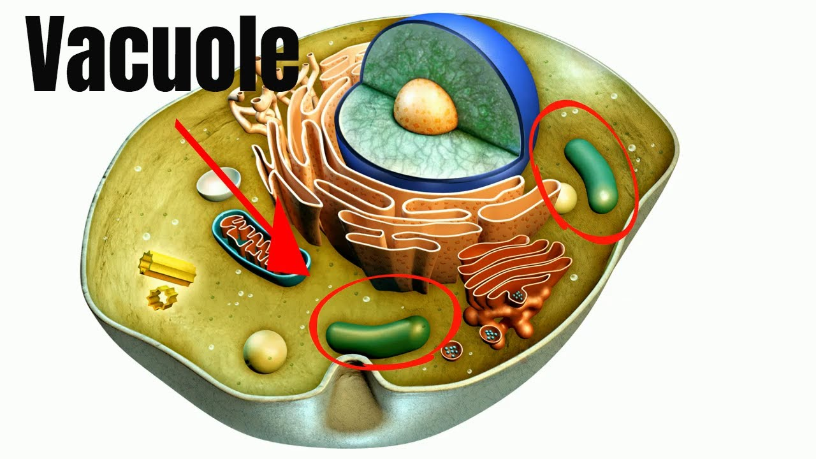
4. Vacuoles
It is the Warehouse of the cell.
Store water, nutrients and cell waste.

Slide 16
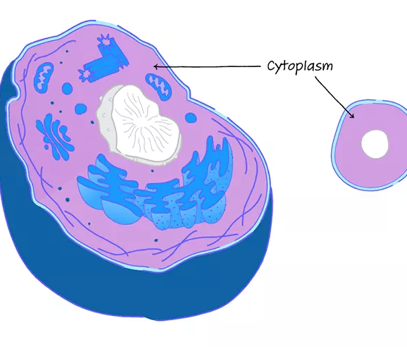
5.cytoplasm
Jelly like substance that fills the cell.
Hold the organelles in place.
Where chemical reactions occur.

Slide 17
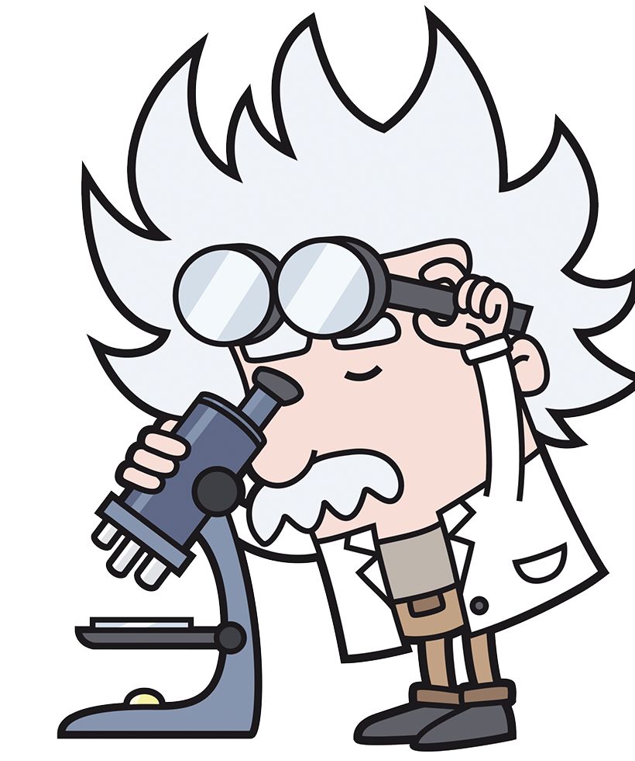
Learner book
Page 14
Looking at animal cells through a microscope
Stain: a coloured substance or dye that is used to colour cells; often, the stain will colour different parts of the cell different colours, making it easier to pick out these parts when viewing the cells through a microscope

Slide 18
Practices

Slide 19
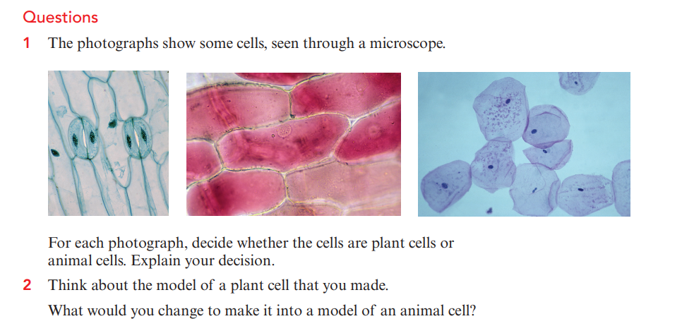
Learner book
Page 15

Slide 20
What have you done that helps you to remember the differences between animal cells and plant cells?
Do you think that you can always decide whether a picture shows an animal cell or a plant cell? What is the most important feature to look for?

