Slide 2
Aim
I can tell you the difference between an autobiography and a biography.
Success Criteria
I can name features of both autobiographies and biographies, saying what is the same or different about the two styles.
I can write in an autobiographical style.

Slide 3
Biographies
A biography gives facts about a person’s life. It is not written by the subject of the book but by an author who has done their research and knows a great deal about that person. Biographies are written in the third person and can be written about someone who is no longer alive.

Slide 4
Other Important Features of a Biography
A biography is a life story written in chronological order.
It can include information about when and where the subject was born, their childhood, important events in their lives including information about what they did or achieved.
If the person is no longer alive, it may include information about when and how they died.
The biography may also include direct quotes from the subject or quotes from others about the subject.

Slide 5
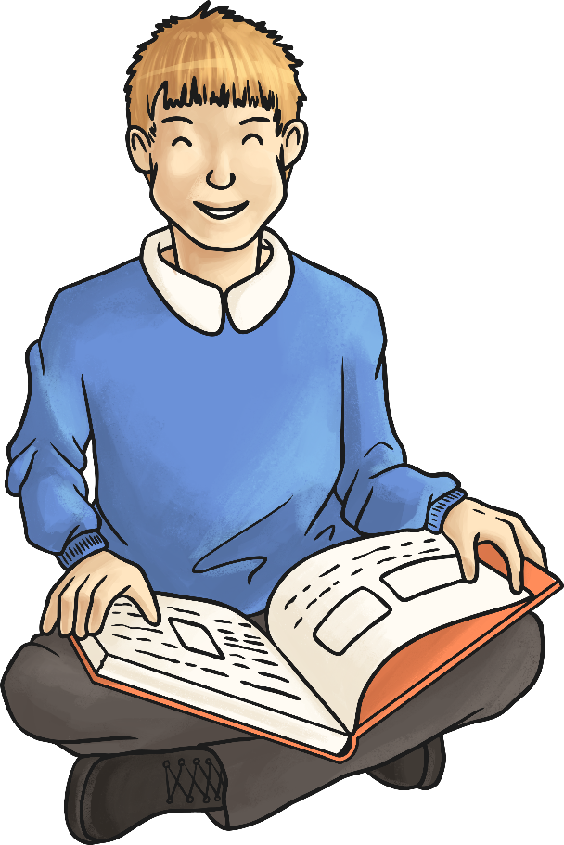
What does the prefix ‘auto’ mean?

Slide 6
Autobiographies
‘Auto’ means ‘self’ therefore an autobiography is self-written. It is an account of someone’s life, written by the person themselves, in chronological order. An autobiography is different to a biography because it is written in the first person, explaining important events in their life. The subject may write about what has influenced them and include details of their feelings during different experiences they have had.
Autobiographies are primary historical sources of information whereas biographies are secondary sources.
To remember the difference … auto = self.

Slide 7
Quick Quiz
Biographical or Autobiographical Writing?
How do you know?
He was born and grew up in London, moving to France at the age of 13.
I never enjoyed writing until I met my idol, Jacqueline Wilson, who ignited my interest.
‘‘She never could sit still at school!’’ was the comment made by Mrs Alice Hall, an old teacher of hers.
He died at the age of 98, with his family at his bedside.
Dancing became my passion. I would dance every day and used to get angry and frustrated when I was told off for practising in the living room. I think my mother was always more concerned about me knocking over her priceless ornaments.

Slide 8
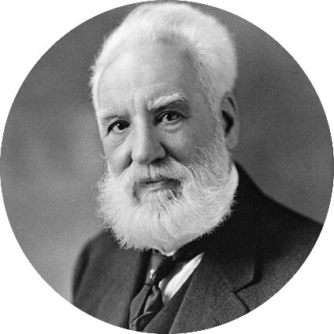
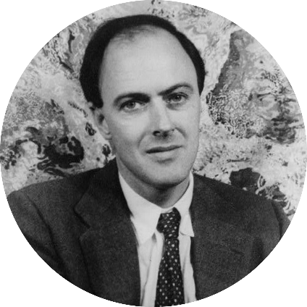
Famous Faces Task
Alexander Graham Bell
Roald Dahl
Is this biographical or autobiographical writing?
Match up the subject to the picture.
He had many inventions, some of these included the metal detector, the audiometer (a device used to detect hearing problems), he invented techniques which helped in teaching speech to the deaf and also made a device to help locate icebergs!
He was born in Wales on 13th September 1916. His father died when he was 3 years old and he was brought up by his mother. He was quite unhappy at boarding school which gave him inspiration for some of his stories.

Slide 9
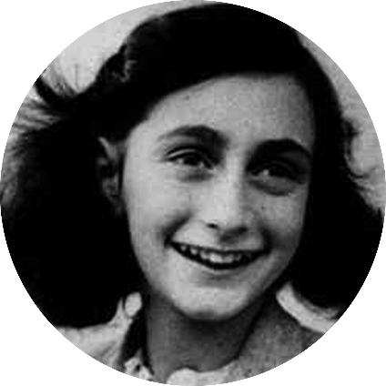
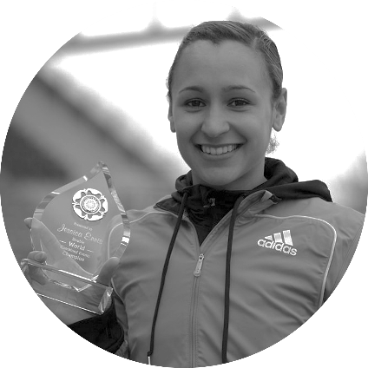
Famous Faces Task
Anne Frank
Jessica Ennis
Is this biographical or autobiographical writing?
Match up the subject to the picture.
I don’t think I shall ever really feel at home in this house, but that does not mean that I loathe it here, it is more like being on vacation in a very peculiar boarding house… The Secret Annexe is an ideal hiding place. Although it leans to one side and is damp, you'd never find such a comfortable hiding place anywhere in Amsterdam, not even in the whole of Holland. Our little room perhaps looked bare at first with nothing on the walls; but thanks to Daddy who had brought my film star collection and postcards beforehand and with aid of paste, pot and brush, I have transformed the walls into one gigantic picture.
I am crying. I am a Sheffield schoolgirl writing in her diary about the bullies awaiting me tomorrow. They stand menacingly by the gates and lurk unseen in my head, mocking my size and status. They make a small girl shrink, and I feel insecure and frightened.
I pour the feelings out into words on the page, as if exposing them in some way will help, but nobody sees my diary. It is kept in my room as a hidden tale of hurt. Fast forward two decades and I am crying again. I am standing in a cavernous arena in London. Suddenly, the pain and suffering and frustration give way to a flood of overwhelming emotion.
Jessica Ennis photo by Adam Kerfoot-Roberts from Halifax, UK - (CC BY-SA 2.0 ) via Wikimedia Commons

Slide 10
Autobiographical Activity
Write about your own life.
Focus on important and interesting events in your life making sure you write in chronological order.
Points to mention:
When and where you were born
Your family
Starting school
Making new friends
New experiences and feelings related to these experiences
People who have influenced you.
Remember: write in chronological order.

