Slide 1
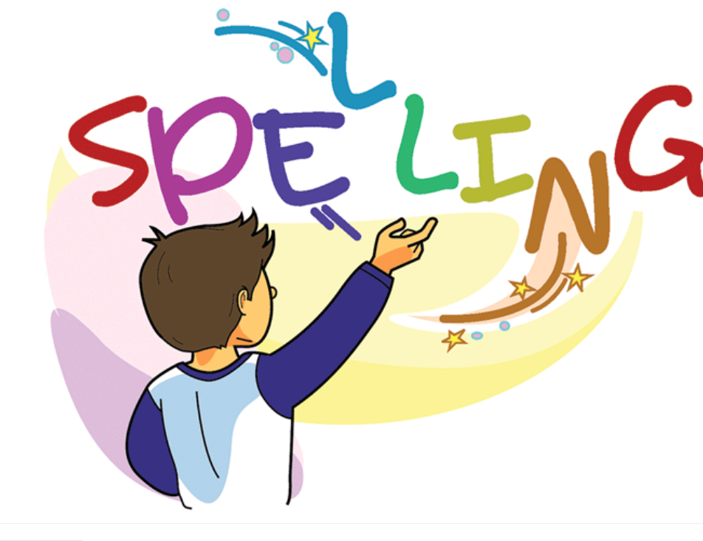

Slide 2
Spelling Test words with /are/ sound. (15 mins)

Slide 3
Words with the /are/ sound
Bingo Game Activity (Group Work)
Explain the Bingo game to students. (5 mins)
1.Teacher will have 10 word mats for the bingo game.
2.Divide your class in a way that each group has 2 mats.
3.Explain to students that picture cards will be distributed on the tables.
4.Explain to students that the teacher will say a word. The aim is put the picture on the correct word.

Slide 4
5.The students who match their pictures first are the winners.
6.Ps. Explain to students that in the bingo game not all pictures match the words.
Some words would be written and without a picture to match it.

Slide 5
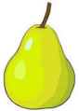
Spelling Words Words with /are/ sound
pear
A pear is a sweet, juicy fruit which is narrow near its stalk, and wider and rounded at the bottom. Pears have white flesh and thin green or yellow skin.
I enjoyed eating a soft juicy pear.

Slide 6
bear
A bear is a large, strong wild animal with thick fur and sharp claws.
Adam saw a white polar bear at the zoo.

Slide 7
tear
If you tear paper, cloth, or another material, or if it tears, you pull it into two pieces or you pull it so that a hole appears in it. [...]
Amy had a tear in her jeans

Slide 8
wear
When you wear something such as clothes, shoes, or jewellery, you have them on your body or on part of your body.
Sara didn’t know what to wear.

Slide 9
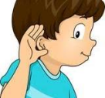
heard
When you hear a sound, you become aware of it through your ears.
The trumpet can be heard all over their house.

Slide 10
scearched
If you search for something or someone, you look carefully for them.
Nancy searched for her spare buttons to use.

Slide 11
earn
If you earn money, you receive money in return for work that you do.
Lina earned 5 dollars, While, Omar earned 8 dollars.

Slide 12
earth
Earth or the Earth is the planet on which we live. People usually say Earth when they are referring to the planet as part of the universe, and the Earth when they are talking about the planet as the place where we live.
Earth looks like a big ball.

Slide 13
Thank You

