Slide 2
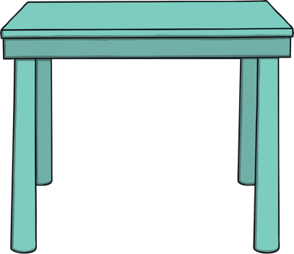
Where is Teddy?

Slide 3
Teddy is on the table.

Slide 4
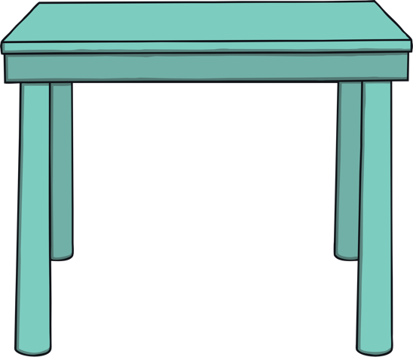
Where is Teddy?

Slide 5
Teddy is under the table.

Slide 6
Where is Teddy?

Slide 7
Teddy is beside the table.

Slide 8
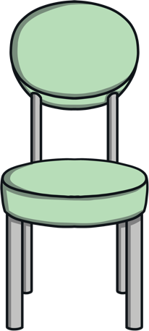
Where is Teddy?

Slide 9
Teddy is behind the table.

Slide 10
Where is Teddy?

Slide 11
Teddy is in the box.

Slide 12
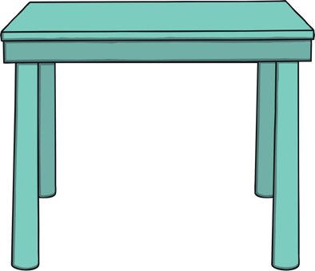
Where is Teddy?

Slide 13
Teddy is between the box and the table.

