Slide 1
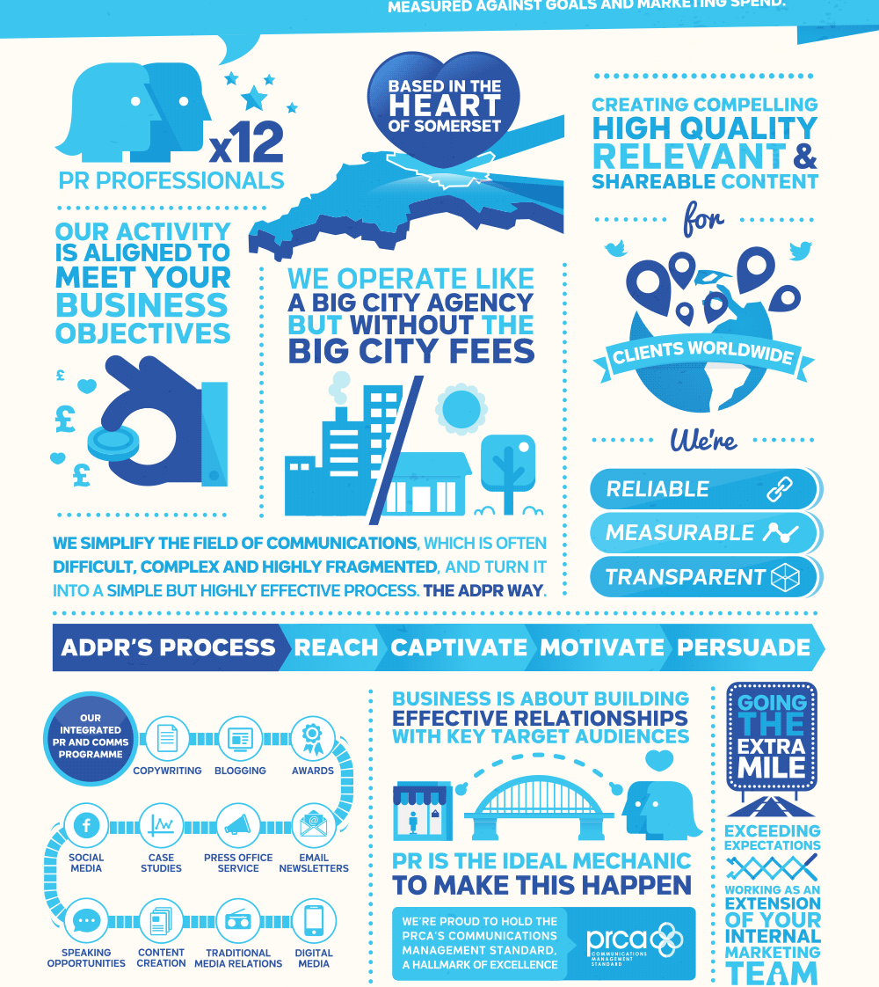
Infographics
This Photo by Unknown author is licensed under CC BY-NC-ND.
This Photo by Unknown author is licensed under CC BY-SA.
This Photo by Unknown author is licensed under CC BY-SA-NC.

Slide 2
It’s a text with pictures ,numbers and symbols to help us understand information about a topic

Slide 3
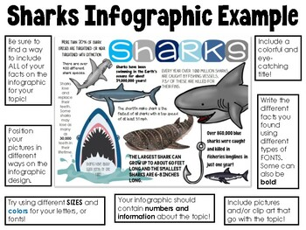
Infographic

Slide 4
How to create a successful infographic?
1-Discruptive title and subheads .
2-Eye -Catching graphics .
3-Bold appropriate color scheme
4-Specially formatted facts.

Slide 5
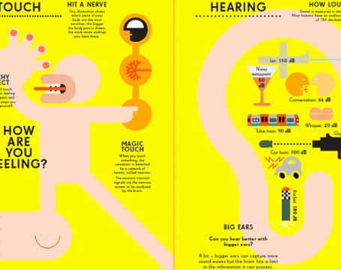
Remember
A good infographic is worth a thousand word

Slide 6
•1-Discruptive title and subheads .
•2-Eye -Catching graphics .
•3-Bold appropriate color scheme
•4-Specially formatted facts.

Slide 7
Top Tips to create an infographic
Use images and words together
Include numbers and fractions
Make your infographic easy to understand and attractive to look at.

Slide 8
What is a survey?
Why do we do it for?

Slide 9
What is a survey?
A way to find out information from a lot of different people by asking them all the same questions.

