Slide 1
Substituting
into
expressions

Slide 2
Day 1
Find the value of each expression when:
a = 4, b = 7 and c = 9
1. 5b + c²
2. ab + 14
3. 3a + a²
4. ab + b + b²
5. 20a - b²
6. c² + b²
7. 10b - a
8. 6c + 4a + c

Slide 3
Day 1
Answers
1. 5b + c² = 116
2. ab + 14 = 42
3. 3a + a² = 28
4. ab + b + b² = 84
5. 20a - b² = 31
6. c² + b² = 130
7. 10b – a = 66
8. 6c + 4a + c = 79

Slide 4
Day 2
Use t = 10 to evaluate the expressions below.
Find which expression has:
the highest value;
the highest value that is an odd number;
a value that is a squared number;
a value that is a multiple of 25;
a value that when doubled, is 90 less than 20t.
1. 5² + t² | 5. t² + 2² + 25
2. 2t | 6. 6² + 3² + t
3. 20t - 119 | 7. 10t + 30
4. 5t + 7t | 8. 20 - t

Slide 5
Day 2
Answers
5² + t² = 125
(a value that is a multiple of 25)
2. 2t = 20
3. 20t – 119 = 81
(a squared number)
4. 5t + 7t = 120
5. t² + 2² + 25 = 129
(highest value that is an odd number)
6² + 3² + t = 55
(when doubled, is 90 less than 20t)
7. 10t + 30 = 130
(the highest value)
8. 20 – t = 10

Slide 6
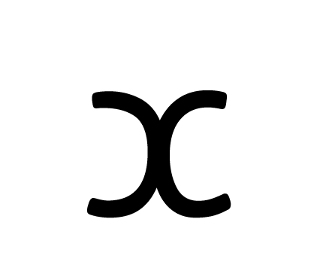
Day 3
Find the value of each expression when:
= -2 and y = 5
1. 2y +
2. + 5y + 10
3. y² +
4. 4y + 2
5. + 2y + 5
6. + 8
7. y + + 12
8. 14 + 3y +

Slide 7
Day 3
Answers
1. 2y +
2. + 5y + 10
3. y² +
4. 4y + 2
5. + 2y + 5
6. + 8
7. y + + 12
8. 14 + 3y +
= 8
= 33
= 23
= 16
= 13
= 6
= 15
= 27

Slide 8
Day 4
Copy both columns of expressions and draw a line to show pairs that have the same value when:
d = 5, f = 9 and h = -3
d² + 7 |  | f² - 2d - 4
10f + h - 20 |  | d² - 1
f + h |  | 4f - 4
5f - 3d |  | f - d + 2
3f + h |  | d² + h + 8

Slide 9
Day 4
Answers
d² + 7 |  | f² - 2d - 4
10f + h - 20 |  | d² - 1
f + h |  | 4f - 4
5f - 3d |  | f - d + 2
3f + h |  | d² + h + 8
= 32
= 67
= 67
= 24
= 6
= 32
= 30
= 6
= 24
= 30

Slide 10
Day 5
Answer the Questions Below:
The formula for the area of a triangle is: ½ (base x height)
We use b and h to represent the base and the height.
Area = ½ (b x h)
Find the area of the triangles with the dimensions below:
1. b = 5cm, h = 17cm
2. b = 10.5m, h = 12m
3. b = 27cm, h = 21cm
height
base

Slide 11
Day 5
Answer the Questions Below:
b = 5cm, h = 17cm A = ½ (b x h) A = ½ (5 x 17) A = ½ x 85 A = 42.5cm²
b = 10.5m, h = 12m A = ½ (b x h) A = ½ (10.5 x 12) A = ½ x 126 A = 63m²
b = 27cm, h = 21cm A = ½ (b x h) A = ½ (27 x 21) A = ½ x 567 A = 283.5cm²

