Slide 1
English

Slide 2
Lessons Objectives
By the end of the lesson, learners will be able to :
read the new words.
read the new words.
read the new words.
understand what conjunctions mean
01
identify the meaning for the new words.
identify the meaning for the new words.
identify the meaning for the new words.
02
use the new vocabulary in their writing.
03
use the new vocabulary in their writing.
04

Slide 3
magnificent
Extremely beautiful
My sister got a magnificent ring yesterday.

Slide 4
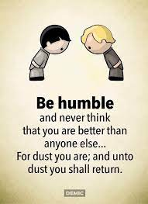
humble

Slide 5
gloomy
Dark or depressing
It’s hard not to feel gloomy when everything around you seems depressing.

Slide 6
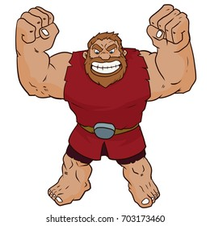
gigantic
Huge or big
It was amazing to see the man surfing on the gigantic waves.

Slide 7
Can you write your own sentences in your copybook?

Slide 8
Lessons Objectives
Objectives check:
read the new words.
.
01
identify the meaning of the new words.
02
03
use the new vocabulary in their writing.
04

