Slide 1
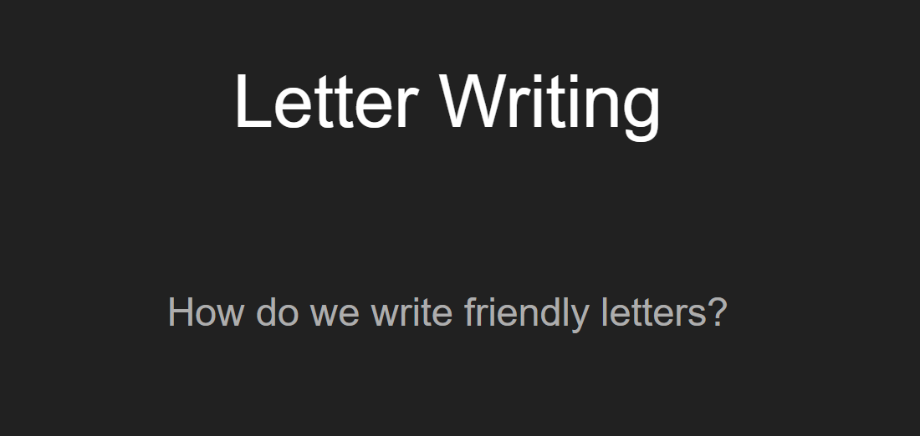
https://docs.google.com/presentation/d/1FucCC3NXp1YMwg5y8OmLEPIF9435dcqOX7PZUr7nZ2M/htmlpresent#!

Slide 6
FRIENDLY LETTER
Dear (Michelle),
It's been a while since we last spoke or saw one another, with all the time that has passed, I think it has been around (6) years now if my memory serves me correctly?
I was going through some old things I had in storage and came across our old school yearbook (or write a similar reason that you thought of this old friend).
I was flipping through the pages when I came across your photo (and a photo of us together). My little trip down memory lane made me wonder what you have been up to all these years, where are you living now and what has life brought to you after all this time? Are you married? Any children?

Slide 7
I am now living in (Paris) with my (husband/boyfriend/wife etc.) (name) and we have been (dating/married) for (2) years now. I met (him/her) in (London) and (he/she) was working in (Paris) at the time. Things went from there and now we are happy, enjoying life and all its wonderful new beginnings together.
On the work front, I am (use this area to talk a little about your current work, what you do etc.). What about you? Tell me a little about what you are doing! I have (enclosed/attached) some current photos of me and (name of partner), if you have any recent photos I would love to see them!
I hope to hear back from you, really looking forward to learning all about what you have been up to and where you have been all this time!
All the best,

