Slide 2
Which skipping rope is long and which is short?
Long
Short
Click here to reveal the answer
Next slide

Slide 3
Which scarf is long and which is short?
Short
Long
Click here to reveal the answer
Next slide

Slide 4
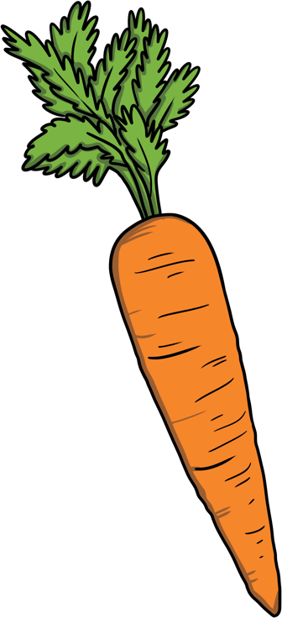
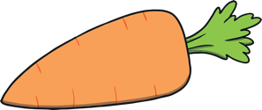
Which carrot is long and which is short?
Long
Short
Click here to reveal the answer
Next slide

Slide 5
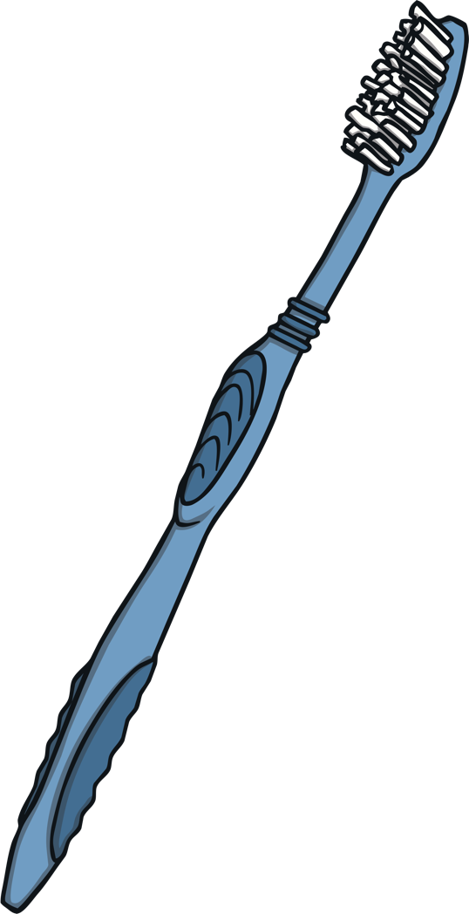
Which toothbrush is long and which is short?
Short
Long
Click here to reveal the answer
Next slide

Slide 6
Which pencil is long and which is short?
Long
Short
Click here to reveal the answer
Next slide

Slide 7
Which twig is long and which is short?
Short
Long
Click here to reveal the answer
Next slide

