Slide 1
English

Slide 2
Lessons Objectives
By the end of the lesson, learners will be able to :
read the new words.
read the new words.
read the new words.
understand what conjunctions mean
01
identify the meaning for the new words.
identify the meaning for the new words.
identify the meaning for the new words.
02
use the new vocabulary in their writing.
03
use the new vocabulary in their writing.
04

Slide 3
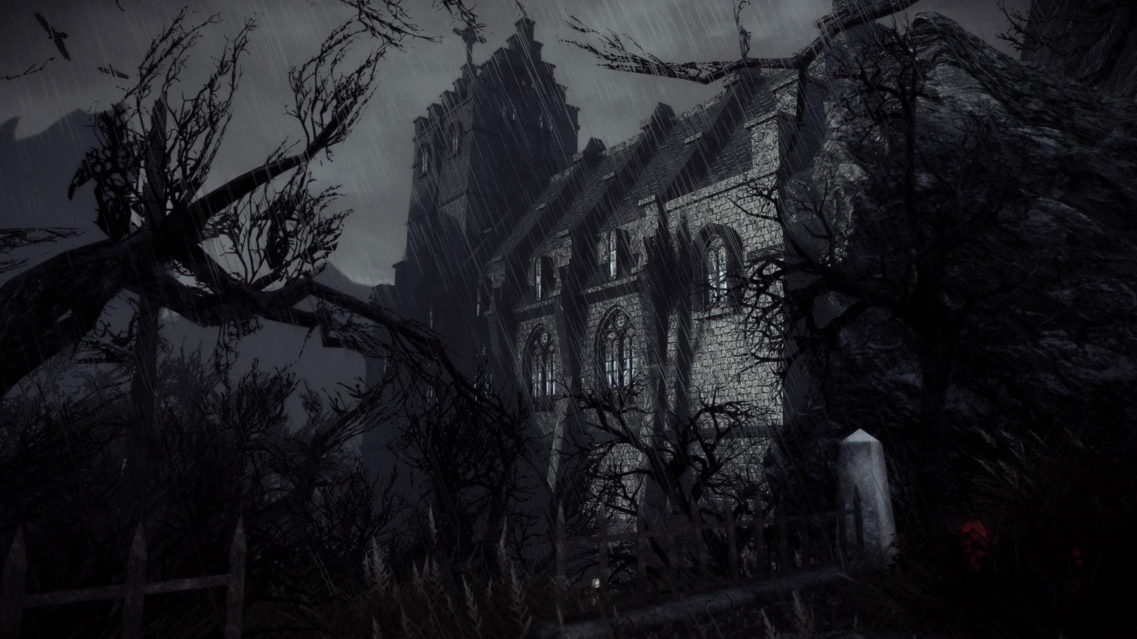
Eerie- spooky- gloomy

Slide 4
Work in your group and write a sentence using these words

Slide 5
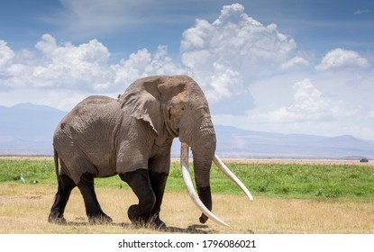
Gigantic- enormous

Slide 6
Work in your group and write a sentence using these words

Slide 7
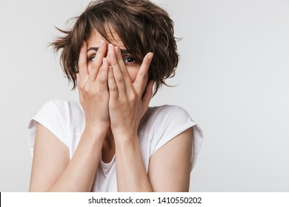
Frightened- terrified

Slide 8
Work in your group and write a sentence using these words

Slide 9
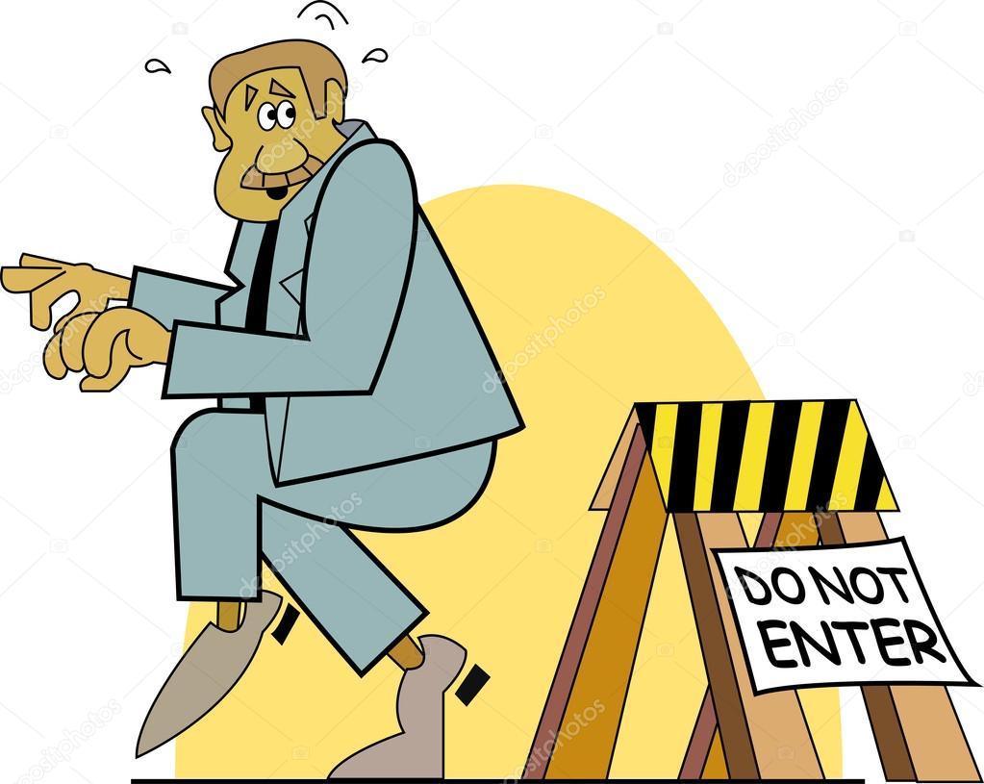
sneaky

Slide 10
Write a sentence with your partner using the word delightful

Slide 11
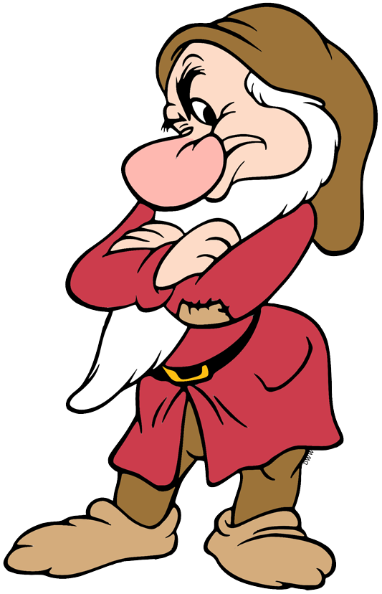
Grumpy=sad

Slide 12
Write a sentence with your partner using the word grumpy

Slide 13
curious

Slide 14
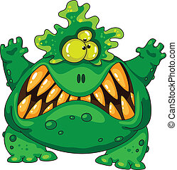
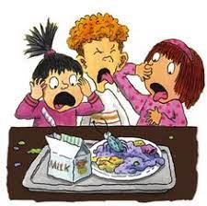
terrible

Slide 15
Choose 5 words from these words and write them in sentences

