Slide 1
Disclaimer/s
We hope you find the information on our website and resources useful.
Animations
This resource has been designed with animations to make it as fun and engaging as possible. To view the content in the correct formatting, please view the PowerPoint in ‘slide show mode’. This takes you from desktop to presentation mode. If you view the slides out of ‘slide show mode’, you may find that some of the text and images overlap each other and/or are difficult to read.
To enter slide show mode, go to the slide show menu tab and select either from beginning or from current slide.
You may wish to delete this slide before beginning the presentation.

Slide 3
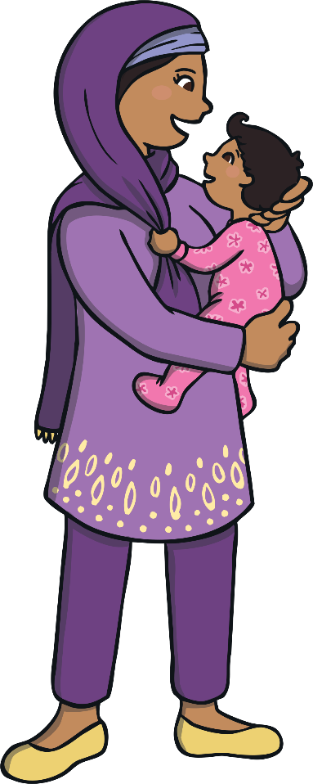
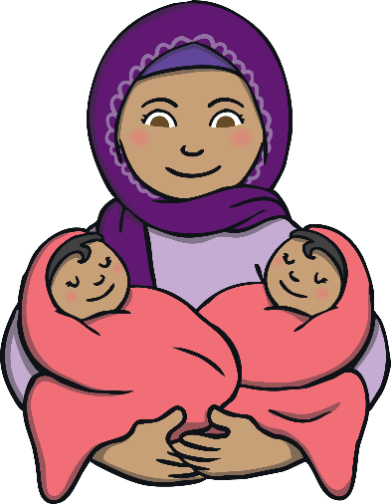
one baby
two babies
baby
babies

Slide 4
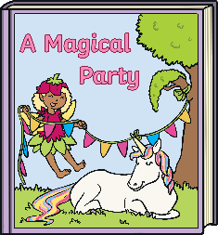
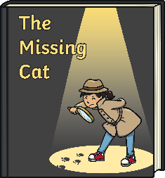
one story
three stories
story
stories

Slide 5
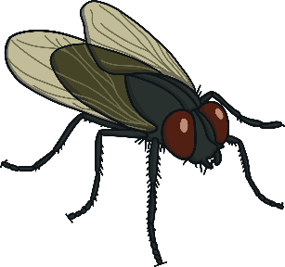
one fly
two flies
fly
flies

Slide 6
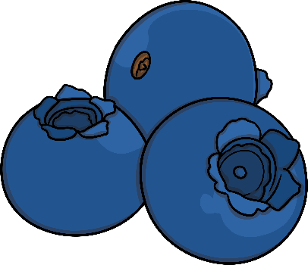
one berry
three berries
berry
berries

Slide 7
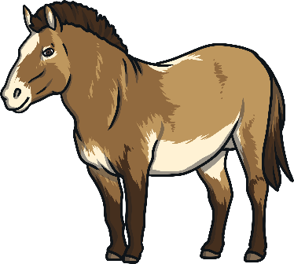
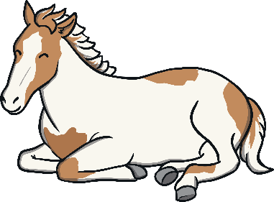
one pony
two ponies
pony
ponies

Slide 8
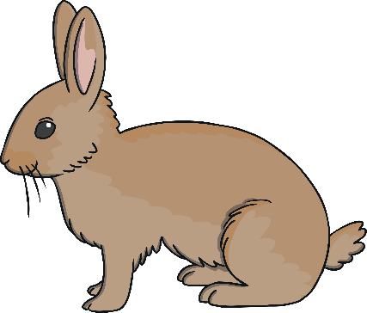
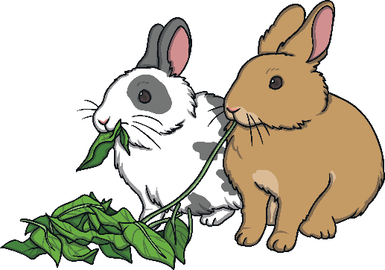
one bunny
two bunnies
bunny
bunnies

Slide 9
one spy
two spies
spy
spies

Slide 10
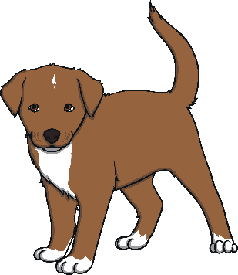
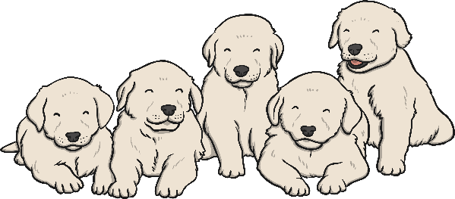
one puppy
five puppies
puppy
puppies

Slide 11
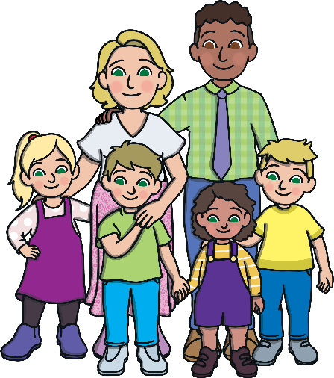
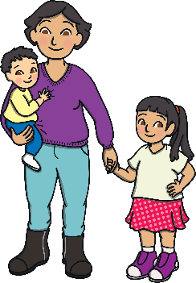
one family
two families
family
families

Slide 12
one city
two cities
city
cities

Slide 13
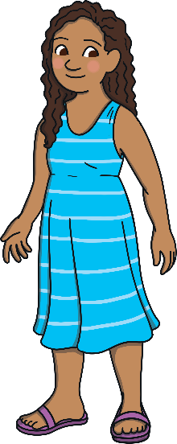
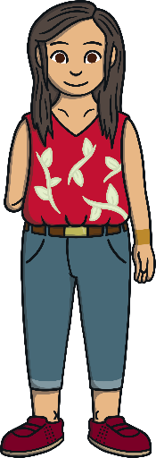
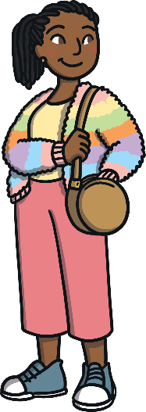
one lady
three ladies
lady
ladies

Slide 14
one lolly
four lollies
lolly
lollies

