Slide 1
5.3 Light reflects off different surfaces

Slide 2
Our Objectives
Determine that light can reflect off surfaces.
Make predictions and see if results support our predictions •
Describe simple patterns in results and make a conclusion.

Slide 3
Our New Vocabulary:
Absorb
image
mirror
reflection
surface

Slide 4
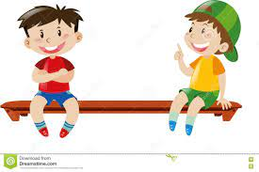
Can you tell me?!
Why can’t we see things in a completely dark room?
There is no light.
Discuss how you can see the person sitting next to you?
Light shines on the person.
Light reflects off the person into my eyes.

Slide 5
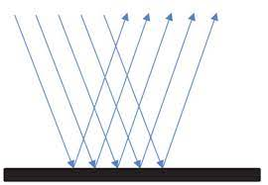
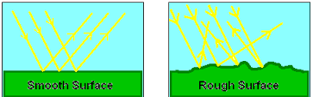
You know that when light reflects off an object into our eyes we see the object.
Some surfaces are much better at reflecting light than other surfaces.

Slide 6
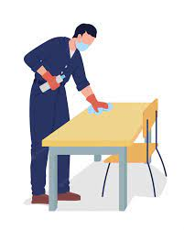
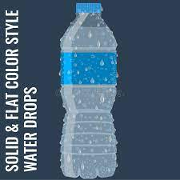
What is a surface?
It is the top layer that is next to the air.

Slide 7
Is mirror a surface ?

Slide 8
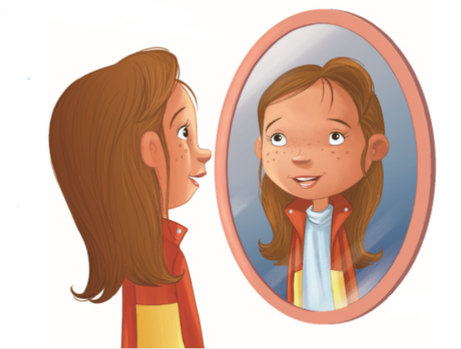
What are mirrors?
A Mirror is a smooth, shiny surface which is very good at reflecting light.

Slide 9
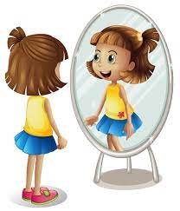
When you see your face in a mirror you are seeing light from your face reflecting off the mirror.
We call the reflection of your face in the mirror your…….
image.

Slide 10
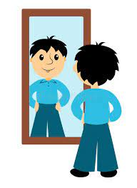
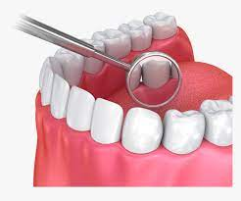
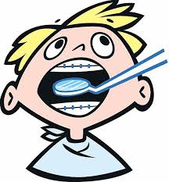
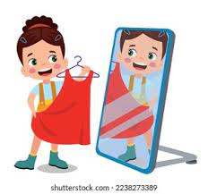
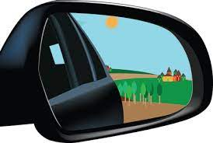
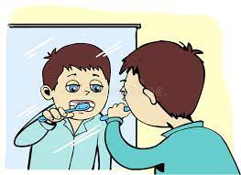
What is the importance of mirrors in our life? Imagine our life without mirrors.

Slide 11
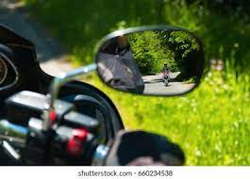
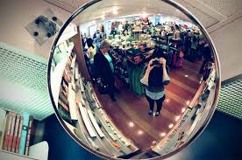
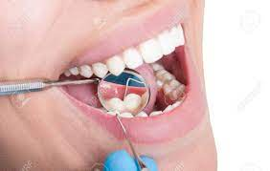
1- Imagine you are riding the bike in the photo. Describe the way the light travels when you see a bike behind you in the rear view mirror.
Light travels from the bike behind me to my rear view mirror. Light reflects off the mirror into my eyes.
2- How does the mirror in the shop help the shop manager?
The shop manager can see what people are doing at the back of the shop. Light travels from the people to the mirror .Light reflects off the mirror into the shop manager’s eye.
3- How does the mirror help the dentist to see the patient’s teeth?
Light from the patient's teeth travels to the mirror ,the light reflects off the mirror into the dentist’s eyes.

Slide 12
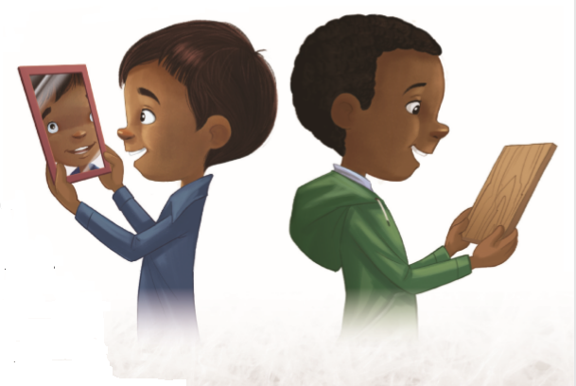
Do some surfaces reflect light better than others?
Arun can see himself in the mirror.
The mirror reflects his image back to him.
Marcus can’t see himself in the wooden chopping board.
The wooden surface absorbs light. It takes the light in and does not reflect it.

Slide 13
Absorb is to take in a substance.

Slide 14
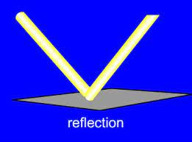
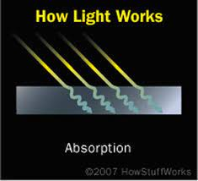
All objects ………….
1- Reflect light
……………. Or…..
2- Absorb light.

Slide 15
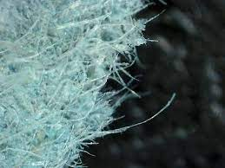
A piece of paper is smooth and flat.
Can you see your picture through it?
But…….why not?!!!
Let’s look at a piece of paper under a microscope…….
The microscope makes everything bigger
The paper contains lots of bumps.
You can see the bumps that you can’t see with your eyes.
Because its surface is not completely smooth, paper absorbs a lot more light than it reflects

Slide 16
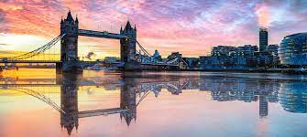
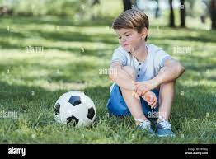
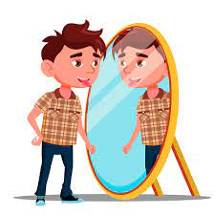
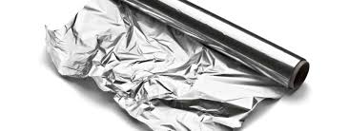
If a surface reflects light very well, you will be able to see your reflection in the surface. If you can’t see your reflection at all in a surface it means the surface absorbs light.
Mention which surface has
Perfect reﬂection ,Fairly good reﬂection Poor reﬂection or No reﬂection ?

Slide 17
Thank you

