Slide 1
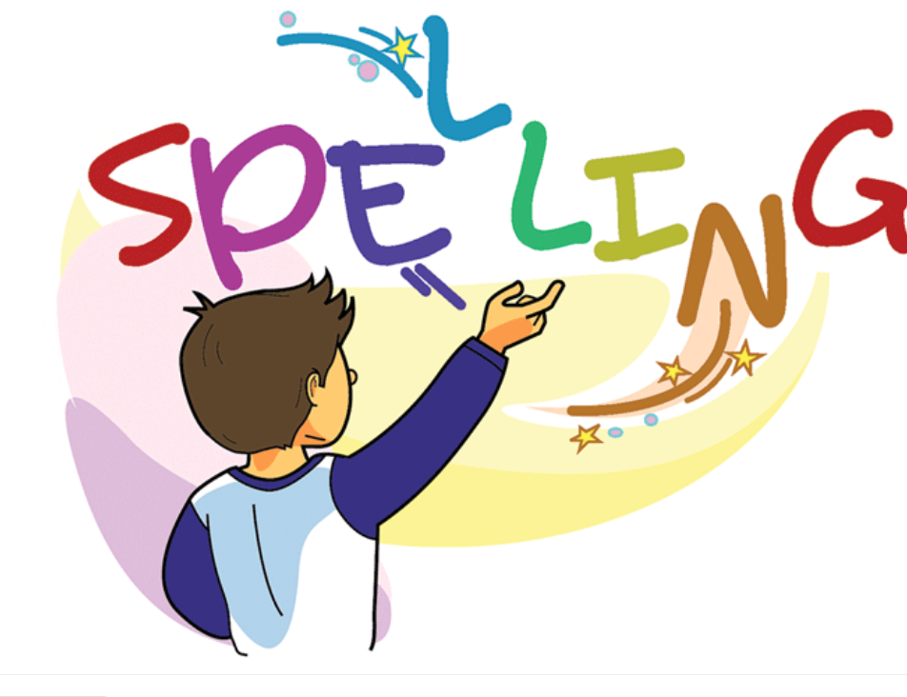

Slide 2
Adding “s” to the verbs
Explain to students the connection between the naming part of the sentence (noun) and the telling part of the sentence (verb)
A singular noun needs to have a verb that ends with “s” or “es”
Ex.
The fox jumps over the fence.
Fox: Noun
Jumps: Verb

Slide 3
Group Work Task: Adding "s" to Verbs
Objective: To practice adding "s" to verbs to show singular present tense.
Group Size: 4 students
Time Frame: Approximately 10 minutes
Task Description:

Slide 4
Group Size: 4 students Time Frame: Approximately 10 minutes Task Description: Formation: Form groups of 4 students with balanced skills. Roles: Assign the following roles to each group member: Leader: Leads the group and ensures everyone participates. Timer: Keeps track of time to stay within the 10-minute limit. Reader: Reads the verbs out loud for the group to practice. Writer: Writes down the verbs with added "s" on a piece of paper.

Slide 5
Instructions:
The Reader will read a list of verbs.
Each student, including the Writer, will add "s" to the verbs to show they are happening now. For example, "jump" becomes "jumps."
The Writer will write down the new verbs with added "s."
Rotate roles after each set of verbs until everyone has had a turn.
Interaction:
Encourage all group members to listen, participate, and help each other if needed.

Slide 6
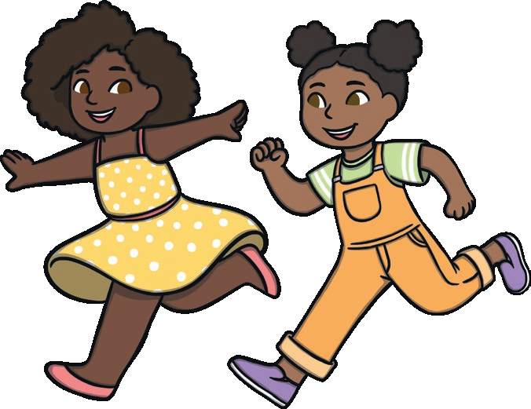
Spelling Words Adding “s” to the verb
Runs
When you run, you move more quickly than when you walk,
for example because you are in a hurry to get somewhere,
or for exercise.
David runs everyday to exercise.

Slide 7
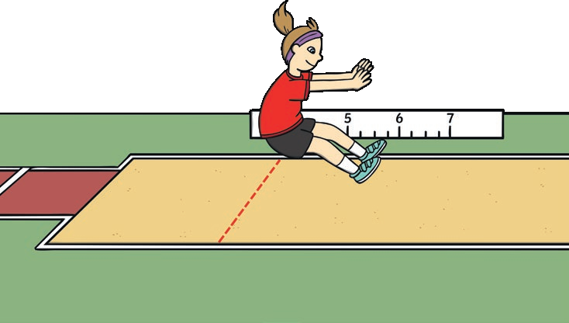
jumps
If you jump, you bend your knees, push against the ground with your feet, and move quickly upwards into the air.
She jumps high in the air

Slide 8
swims
When you swim, you move through water by making movements with your arms and legs.
John swims everday.

Slide 9
talks
When you talk, you use spoken language to express your thoughts, ideas, or feelings.
He talks a lot with his friend on the phone.

Slide 10
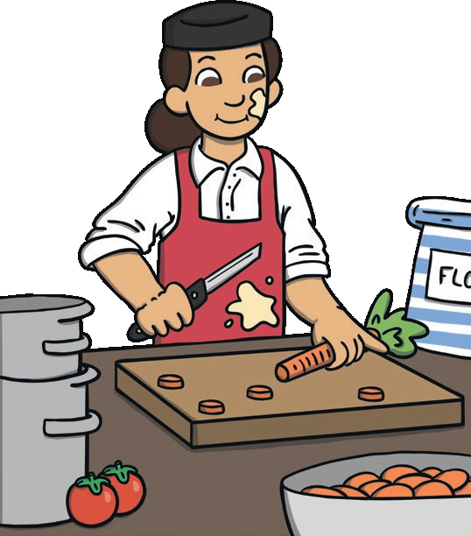
cooks
When you cook a meal, you prepare food for eating by heating it.
Mum cooks dinner for my friends and I.

Slide 11
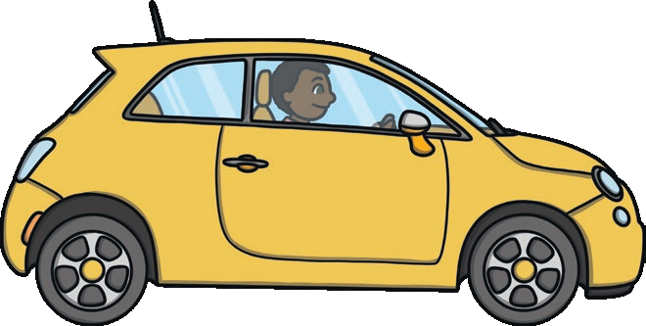
drives
When you drive somewhere, you operate a car or other vehicle and control its movement and direction.
My dad drives us to school everyday.

Slide 12
sings
When you sing, you make musical sounds with your voice, usually producing words that fit a tune.
Lina sings beautifully.

Slide 13
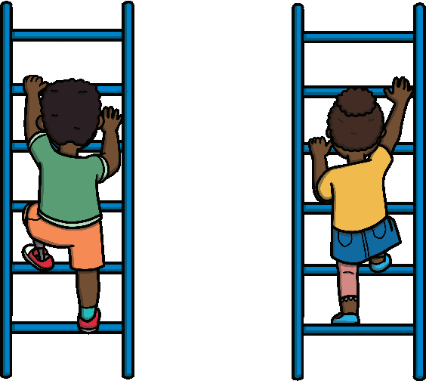
climbs
If you climb something such as a tree, mountain, or ladder, or climb up it, you move towards the top of it. If you climb down it, you move towards the bottom of it.
Ali climbs trees all the time.

Slide 14
reads
When you read something such as a book or article, you look at and understand the words that are written there.
Sam reads spiderman stories to his little brother.

Slide 15
plays
When children, animals, or perhaps adults play, they spend time doing enjoyable things, such as using toys and taking part in games.
Sara plays with her doll in the garden.

Slide 16
Thank You

