Slide 1
VOCABULARY WORDS
Term 3
Week 1

Slide 2
Co-operative
Meaning:
Cooperative:
Synonym: Collaborative, helpful, united
Antonym: Uncooperative, unhelpful.
Meaning: Willing to work together with others towards a common goal or purpose.

Slide 3
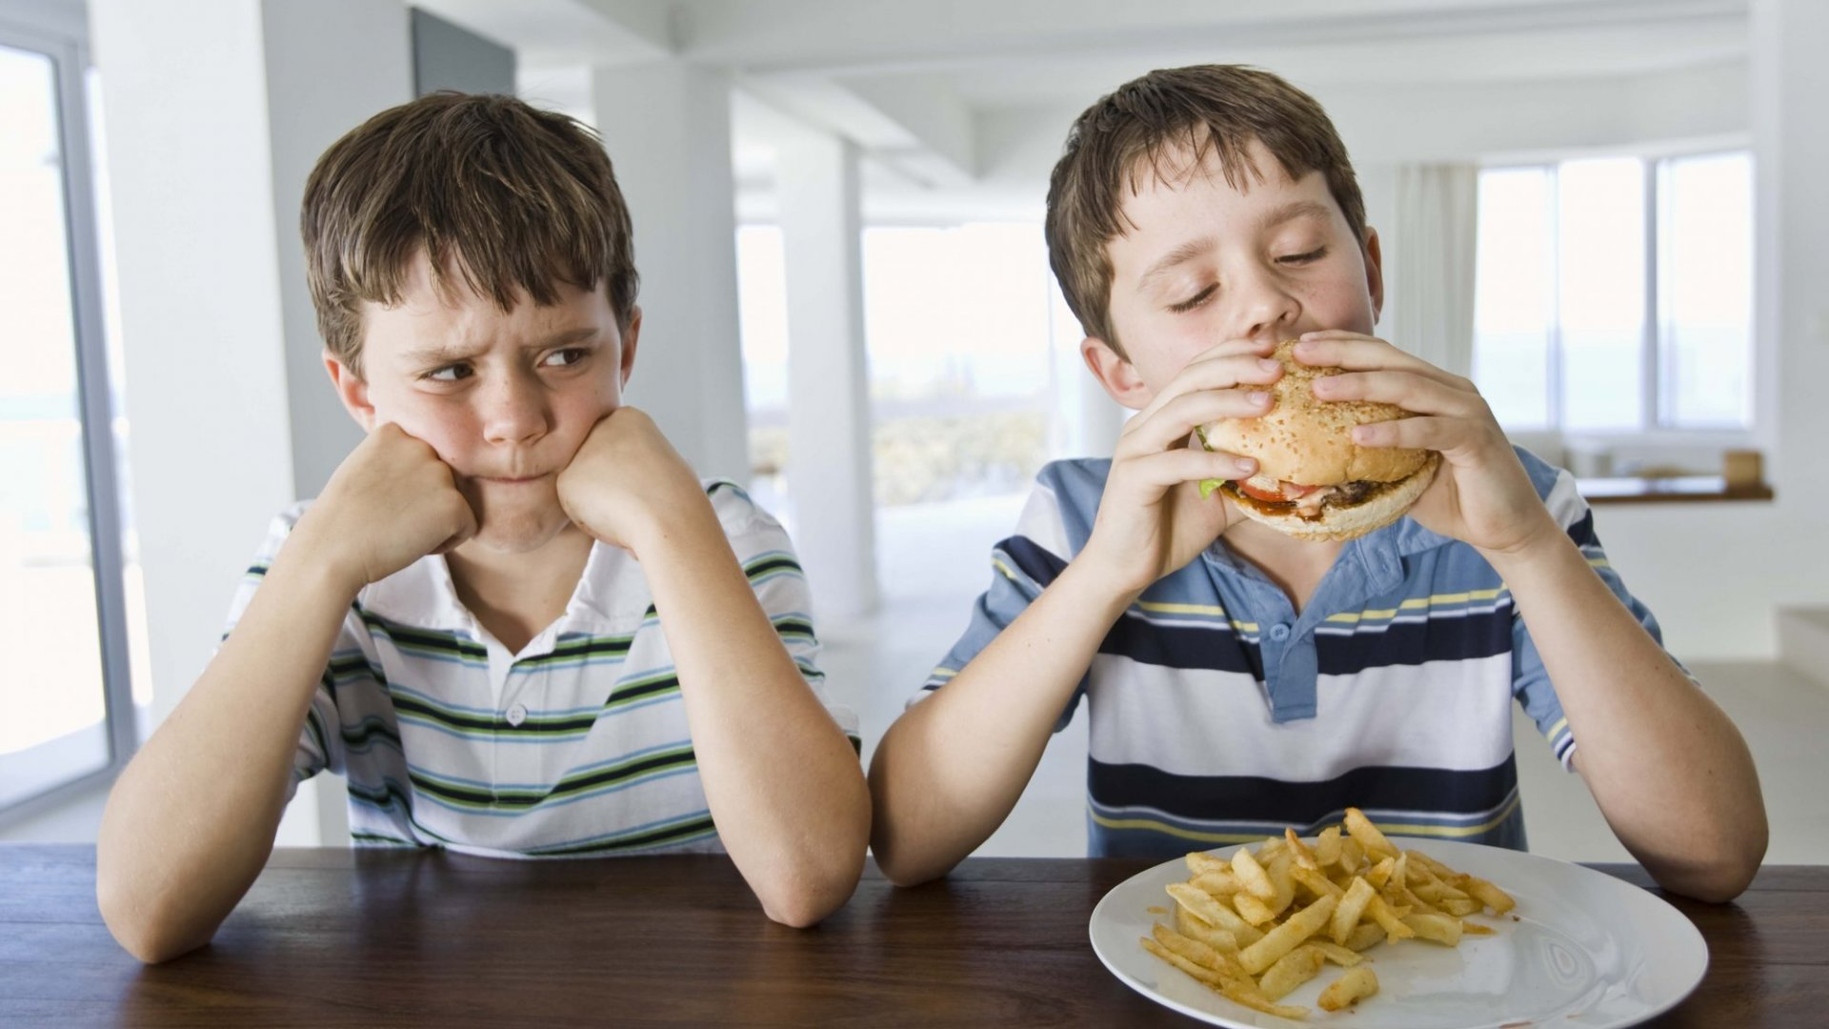
selfish
Meaning:
Synonym: Egocentric, self-centered.
Antonym: Selfless, generous
Meaning: Concerned primarily with one's own interests, benefits, or well-being.

Slide 4
gritty
Meaning:
Synonym: Tough, resilient, determined
Antonym: Soft, delicate.
Meaning: Having courage, resolve, and perseverance, especially in the face of challenges or adversity.

Slide 5
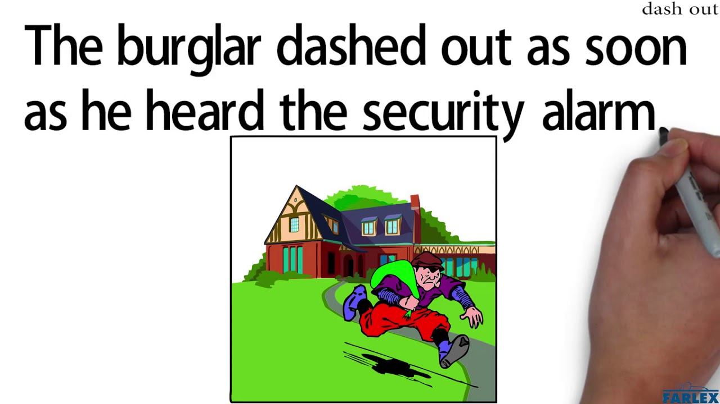
Dashed out
Meaning:
Synonym: Raced out, hurried out.
Antonym: Strolled out.
Meaning: Moved quickly or suddenly out of a place or location

Slide 6
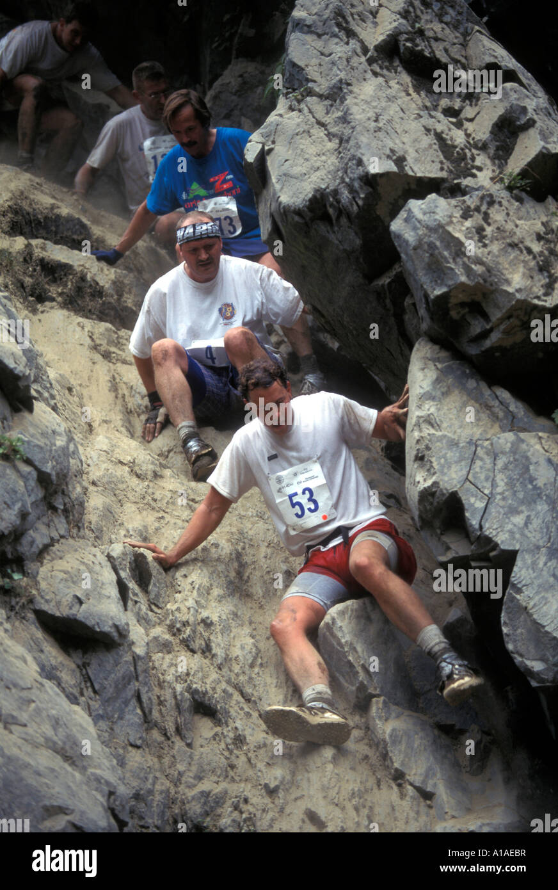
Scrambled down
Meaning:
Synonym: rushed down
Antonym: climbed up slowly, Meaning: Came down quickly and with effort.

Slide 7
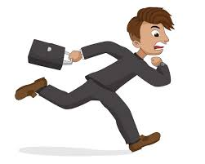
rushed
Meaning:
Synonym: Hurried
Antonym: Relaxed, unhurried
Meaning: Done with great speed or urgency.

