Slide 1
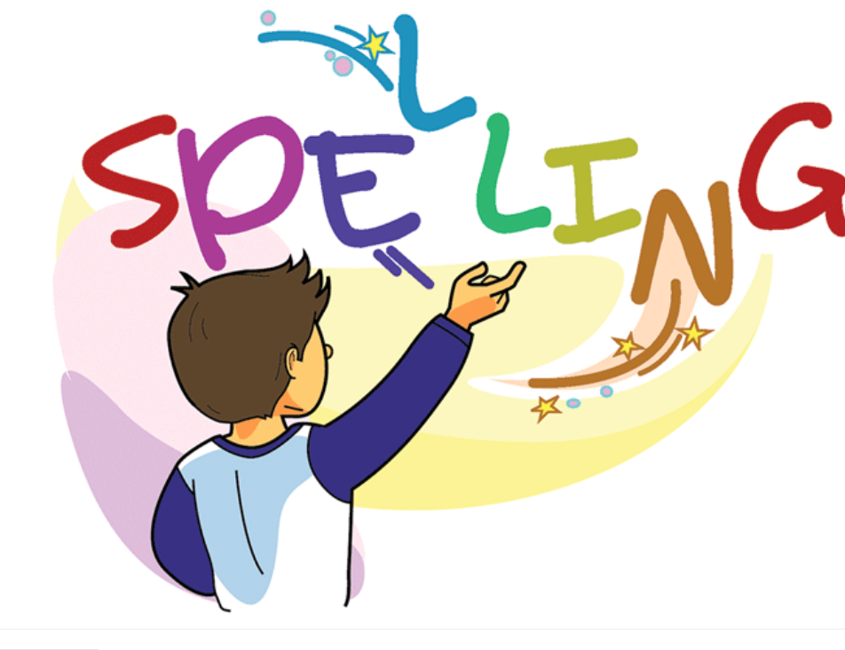

Slide 2
Spelling Test djectives Adjectives “est” 10 minutes
First Session Completed

Slide 3
Adding “un” to Verbs
Explain to students that adding “un” before a verb is called a prefix.
“Un” means not.
When “un” is used with a verb it changes the meaning to the opposite
Ex. tie-------- to tie something
Un tie -------- not to tie
hurt------- to feel pain
Unhurt --------- not feeling pain
The word “the” comes before the adjective.
Ex
Asia is the biggest continent
Superlative Adjective.

Slide 4
Spelling Words Adding “un” to the Verb
unwrap
When you unwrap something, you take off the paper, plastic, or other covering that is around it.
I untied the bow and unwrapped the small box.

Slide 5
unzip
When you unzip something which is fastened by a zip or when it unzips, you open it by pulling open the zip.
James unzipped his bag.

Slide 6
unlucky
If someone is unlucky, they have bad luck.
Owen was unlucky not to score on two occasions.

Slide 7
undo
If you undo something that is closed, tied, or held together, or if you undo the thing holding it, you loosen or remove the thing holding it.
I managed secretly to undo a corner of the parcel.

Slide 8
unsafe
If you are unsafe, you are in danger of being harmed.
In the larger neighbourhood, I felt very unsafe

Slide 9
unplug
If you unplug an electrical device or phone, you pull a wire out of a socket so that it stops working.
I had to unplug the phone.

Slide 10
unlock
If you unlock something such as a door, a room, or a container that has a lock, you open it using a key.
She unlocked the case and carefully lifted out the vase.

Slide 11
unfair
An unfair action is not right or fair.
It is unfair to play 2 against 1

Slide 12
unpack
When you unpack a suitcase, box, or similar container, or you unpack the things inside it, you take the things out of the container.
He unpacked his bag.

Slide 13
unkind
If someone is unkind, they behave in an unpleasant, unfriendly, or slightly cruel way. You can also describe someone's words or actions as unkind.
Hurting animals is an unkind act.

Slide 14
Thank You

