Slide 1
Comparative Adjectives

Slide 2
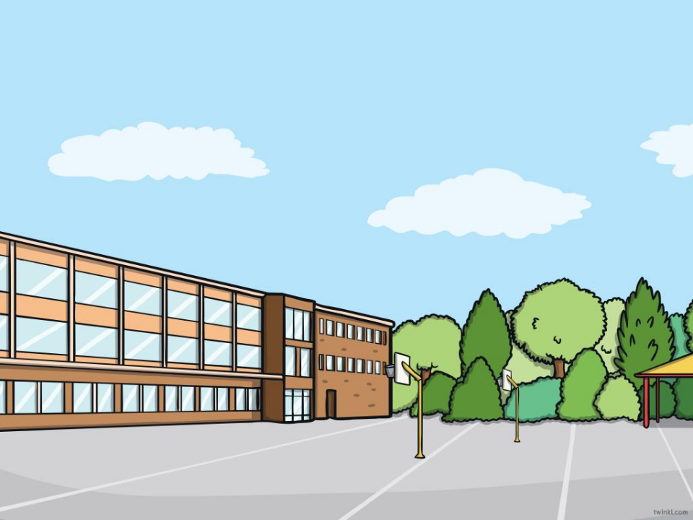
Aim • To understand and use comparative adjectives.

Slide 3
What Is a Comparative Adjective? A comparative adjective is used to compare one person, action, thing or state to another. It adds the suffix -er to the original adjective. e.g. brighter
↓↓↑
‘bright’ is the original adjective. ‘-er’ is the suffix. It is comparing two things only. E.g. Sam’s torch is brighter than John’s torch. The word than always comes after the adjective. As there is a comparision between two items.

Slide 4
What Is a Comparative Adjective? The suffix -er is added to the end of the original adjective to show that it is being compared to one other person, action, thing or state. Sometimes, the root adjective spelling does not change. e.g. warm The weather is warmer today than yesterday. Other times, the root adjective spelling changes, as in these examples:
e.g. happy The boy is happier than the girl.
e.g. big My car is bigger than yours.

Slide 5
What Is a Comparative Adjective? Can you add the suffix ‘-er’ to these adjectives, to turn them into comparative adjectives and then put them in a sentence? Can you write your sentences down? Take care with your spellings. e.g. small The mouse was smaller than the elephant. (Click to reveal the answer.)
hot | long | wet
shiny | light | bright

