Slide 1
Using the properties of materials to separate mixtures
Lesson 5.4

Slide 2
Objectives:
Learning objectives:
Use what you know about mixtures to separate them.
Choose apparatus to carry out a practical task.
Carry out practical work in a safe way

Slide 3
Pre-Assessment

Slide 5
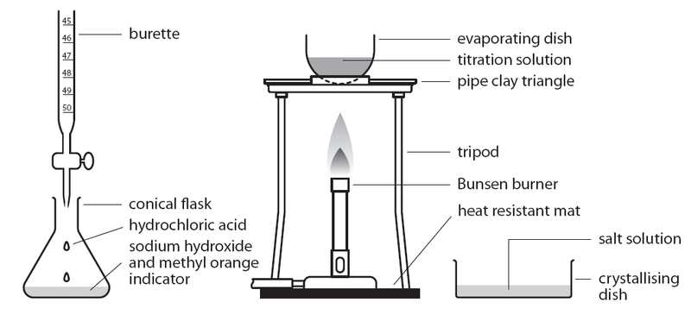
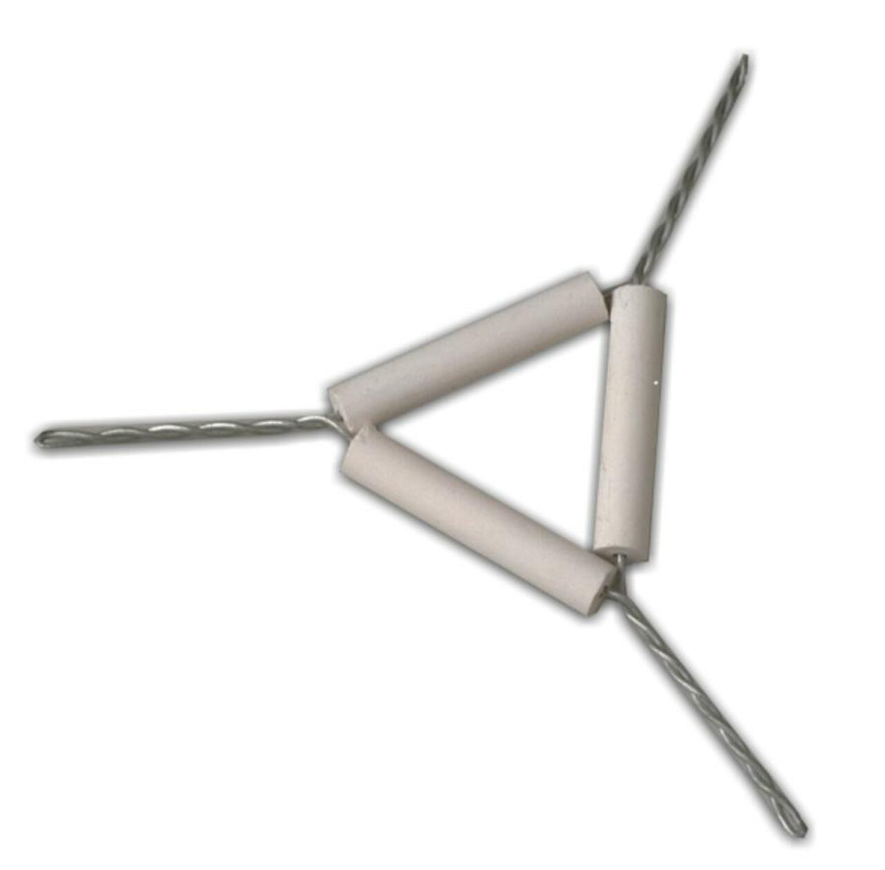
Tools and Equipment you have to know

Slide 6
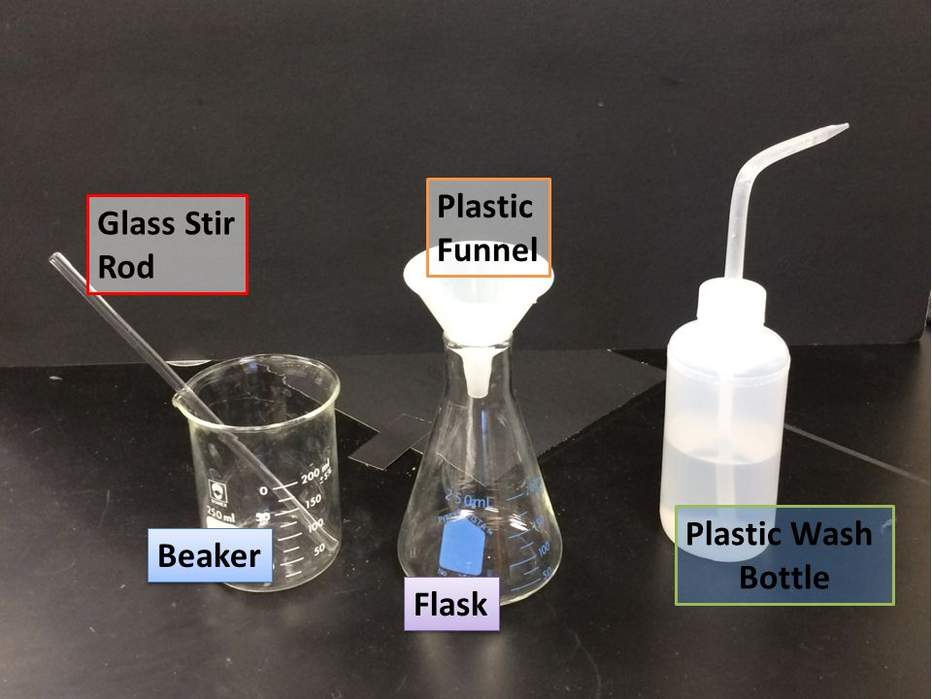
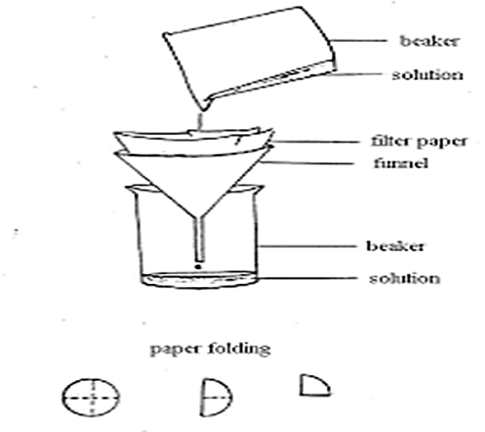
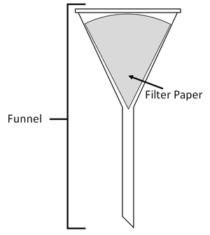
Tools and Equipment you have to know

Slide 7
Test yourself!

Slide 8
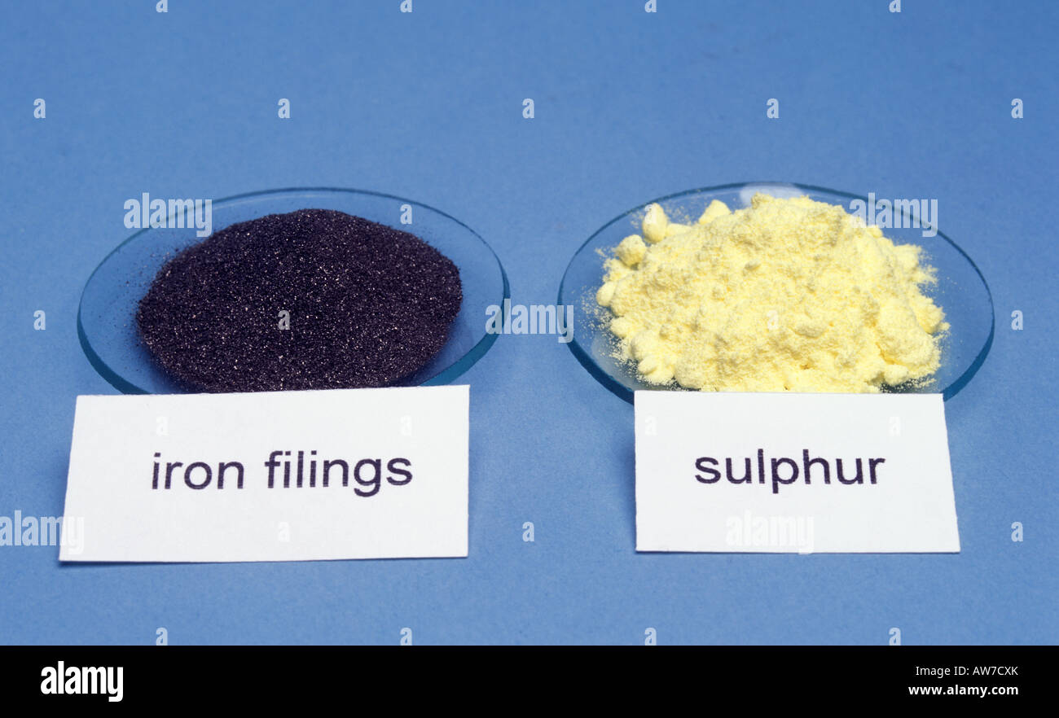
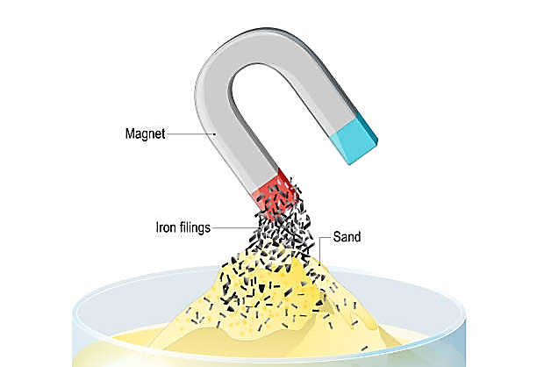
Separating mixtures
If you have a mixture of iron filings and sulfur, how you can separate them from each other?
You can separate the iron and sulfur in your mixture by using a magnet, as iron is magnetic while sulfur is not magnetic.

Slide 9
How to separate Copper sulfate from water
The evaporating dish contains a mixture of water and copper sulfate.
By heating, water will be evaporated and leaves the copper sulfate in the evaporating dish

Slide 10
How to separate food dye and water?

Slide 11
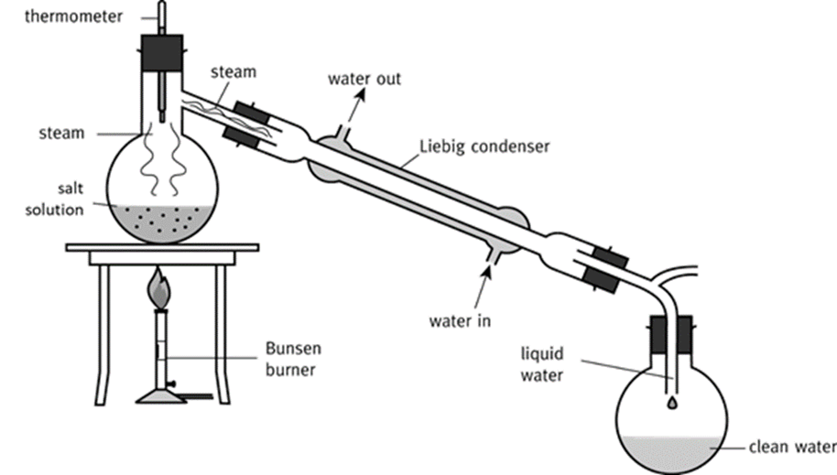
A condenser is used to separate mixtures of two liquids.

Slide 12
Separating food dye and water
The water and food dye mixture is heated and boils, the liquid water reaches the temperature where it changes state and becomes a gas (100 C boiling point), water changes to steam, the gas travels along the tube into the condenser, the cold water that surrounds the outside of the condenser cools the gas down and converts it to be liquid again.
The liquid water collects in the beaker while the food dye remains in the heated container.
The food dye and water have different boiling points.
The boiling point of food dye is a little bit higher than water.

Slide 13
Condenser Technique

Slide 14
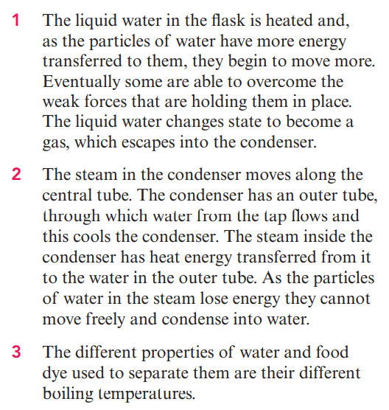
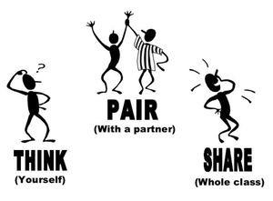

Slide 16
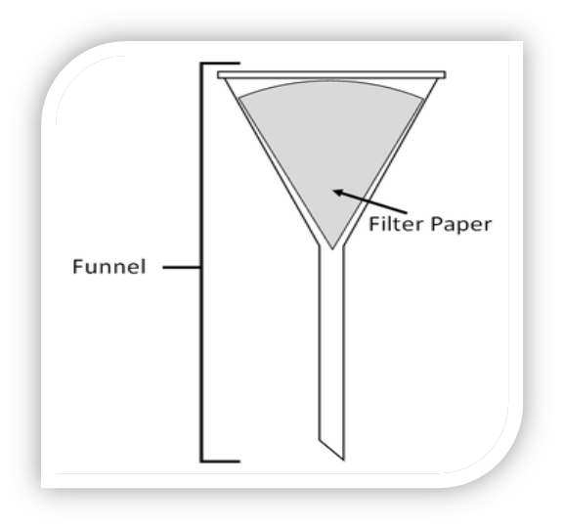
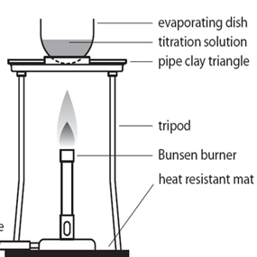
How to separate sandy, and salty water?
Filter paper will filter the salty water from the sand, so the filter paper will allow the salty water to pass into the conical flask , while the sand no.
Then by heating the water, the water will be evaporated leaving the salt in the evaporating dish

Slide 17
Example 2: Mixture of water, sand and iron filling.

Slide 18
Let's play

Slide 19
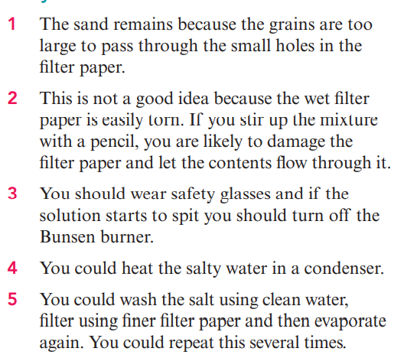

Slide 21
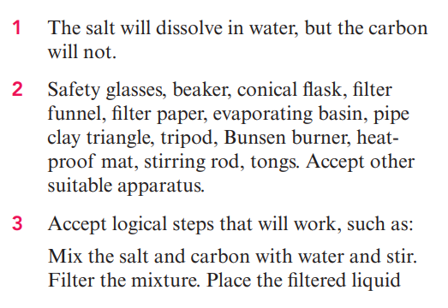
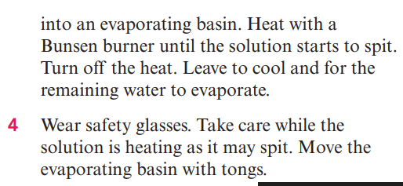

Slide 22
Let's have fun!

